Slide 1
Housing and Homeless Coalition: State of Homelessness 2015
December 16, 2015

Slide 2
2015 Accomplishments

Slide 3
Ending Veteran Homelessness/ Declaring Functional Zero
1st population goal of United States Interagency Council on Homelessness Opening Doors Strategic Plan
Veterans Workgroup
One of the first in the country to end Veteran homelessness

Slide 4
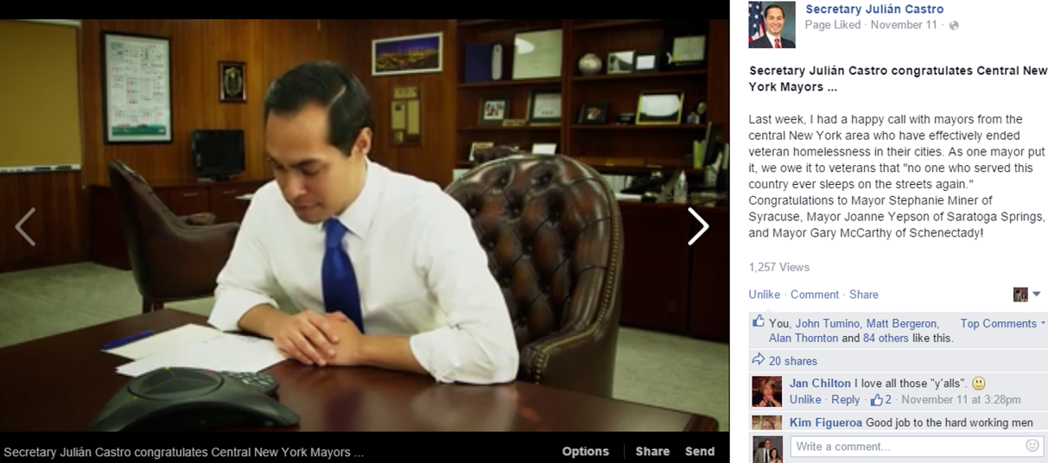
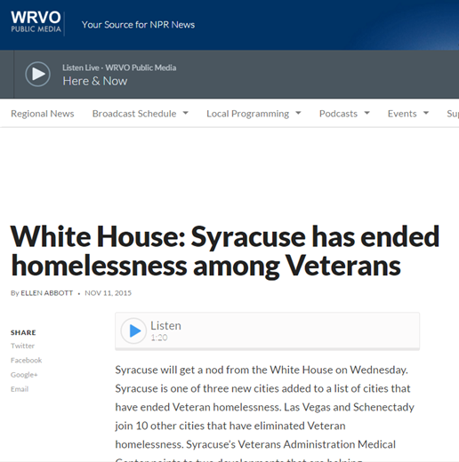
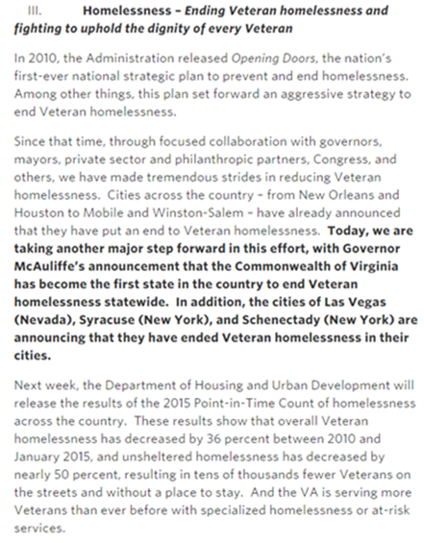

Slide 5
Coordinated Entry
Developed to prioritize the most vulnerable individuals experiencing homelessness for housing
Over 30 individuals have been housed through this process
Developed Policy and Procedures Manual
Workgroup meeting twice a month to review list of most vulnerable and hard to serve individuals with longest length of stays in shelter
In accordance with HUD’s standards

Slide 7
Enhanced Outreach Workgroup & Services
Outreach Workgroup/Downtown Project meets monthly to review list of individuals who are street homeless as well as panhandling
Chaired by Onondaga County Department of Adult and Long-Term Care and Rescue Mission
Comprised of shelter, outreach, mental health, substance abuse providers as well as SPD, Downtown Committee, Volunteer Lawyers Project and others
Rescue Mission retooling their HIS Team
Trios Model: Hutchings Psych Center, SBH, CHANCE Team, Outreach
27 individuals have been brought indoors between IMFK & RM

Slide 8
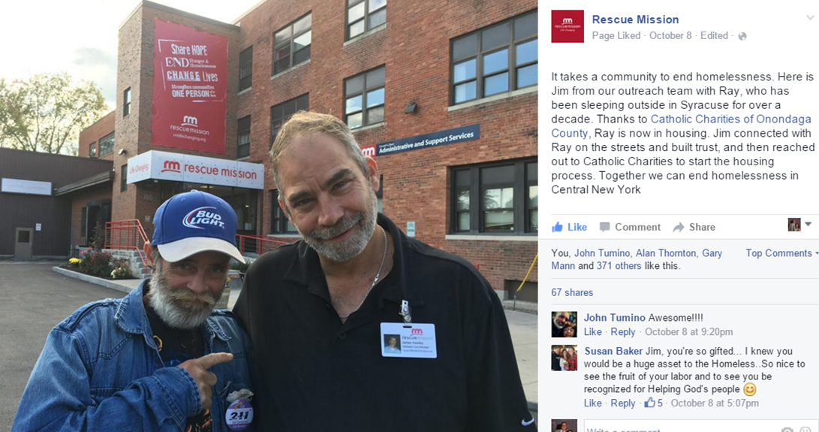
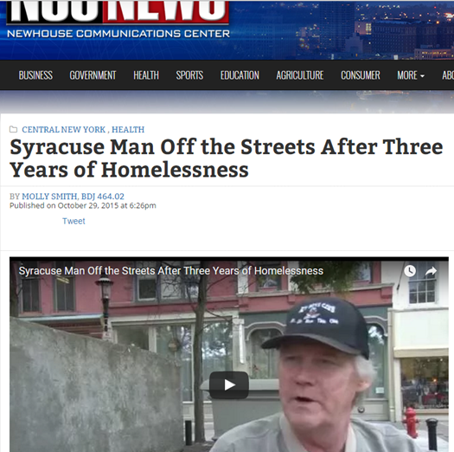

Slide 9
Continuum of Care Merger with Oswego County
Oswego applied for $360,000 in PSH and RRH funding in CoC FY2015 NOFA Competition
Coordination of services
Technical assistance

Slide 10
Housing
FY2015 NOFA Competition
FY2014 NOFA – RRH and PSH beds
HHAP/Federal Home Loan Bank of NY Grant Funding for Rescue Mission
Affordable Housing Development Committee
CSH Needs Analysis

Slide 13
Gaps and Needs Survey
Conducted focus groups for shelter residents on services to prevent homelessness and services needed to become housed
Operations Committee members (PSH/TH/Shelter Providers) interviewed residents at different agencies other than their own
Consistent themes: Transportation, lack of safe, quality and affordable housing options, employment, criminal history barriers, discrimination for a variety of reasons, lack of knowledge regarding resources, computer and financial literacy, desire for a higher level of case management and assistance, strong need for more Section 8

Slide 14
Homeless Management Information System (HMIS)
Welcome Sarah Schutt!
HMIS moving to the HHC
Bringing more users onto HMIS
All accomplishments have a lot to do with HMIS and the data’s ability to focus and drive our efforts

Slide 15
Building more partnerships
CNYCF
HSLC
United Way
Gifford Foundation
Syracuse Community Health Center
Elected Officials from all levels of government

Slide 17
Community Progress
Onondaga County DSS: Homeless Housing Unit, Kiosks on 2nd Floor, continued efforts and partnerships
211CNY
Rescue Mission new shelter and day center, sheltering women
CNY Fair Housing Analysis of Impediments to Fair Housing

Slide 18
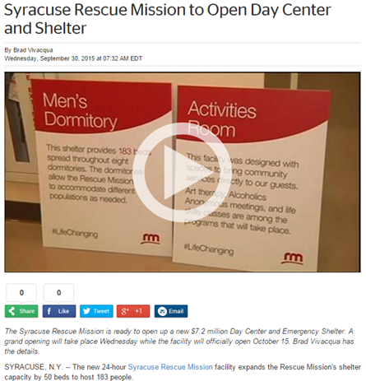
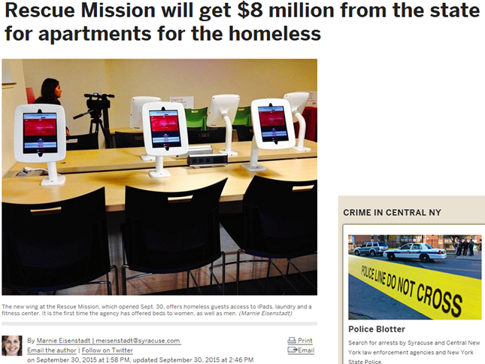
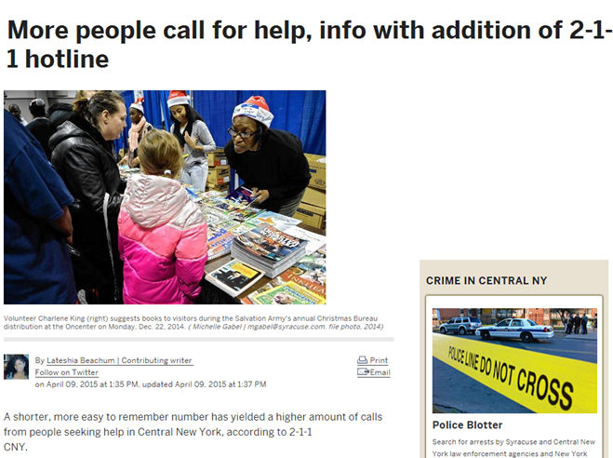

Slide 19
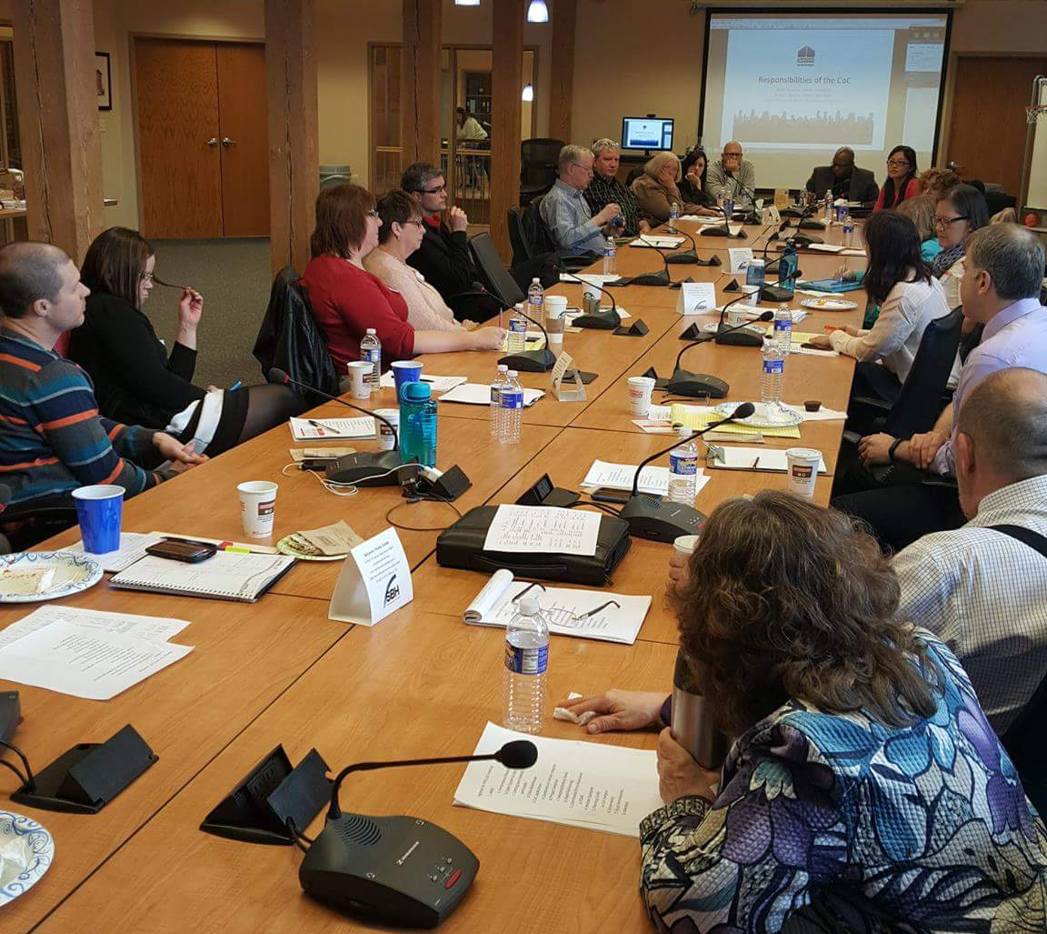
Continuum of Care Statewide Meeting
Syracuse hosted the first NYS CoC Lead Meeting

Slide 20
2016 Community Priorities

Slide 21
Poverty/Segregation in Syracuse
80/20 split for all new CoC-funded projects

Slide 22
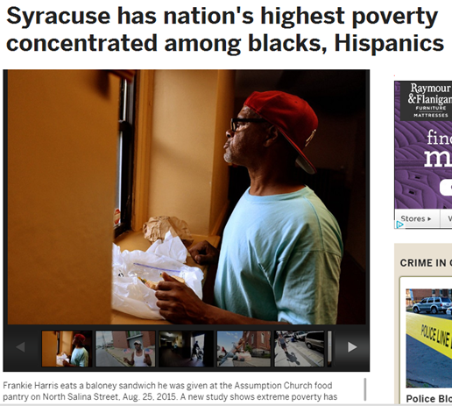
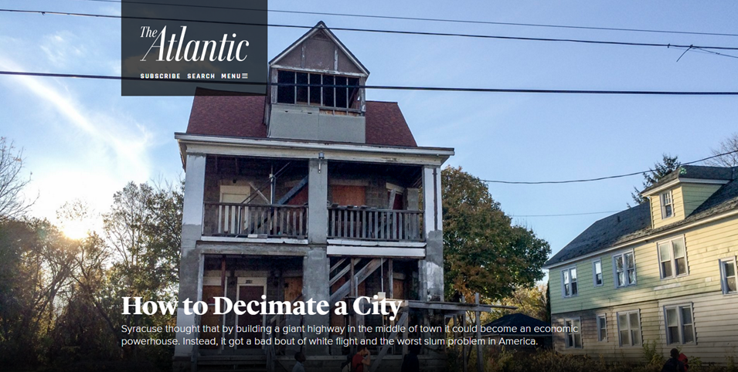
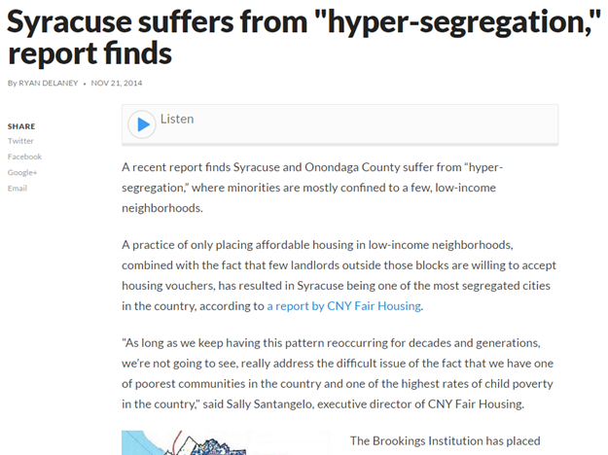

Slide 23
Establishing a Code Blue Policy
Would like this to be completed by our january meeting
Bringing all stakeholders to the table
Onondaga county policy

Slide 24
Continuum of Care Mergers
Oswego County CoC
HMIS
Coordination
Technical Assistance
Cayuga County CoC
Technical Assistance

Slide 25
Building Partnerships
Healthcare
H2 Collaborative rescheduled to April
Employment
Youth
RHY Committee gearing up to end youth homelessness

Slide 26
Data!

Slide 27
Annual Homeless Assessment Report (ahar) data
Emergency Family Shelters:
2014: 1,885 (1,187 children)
2015: 1,699 (1,107 children)
Emergency Shelters for Individuals:
2014: 3,197
2015: 3,058
Unaccompanied Youth (under the age of 18) in Shelters:
2014: 187
2015: 176

Slide 28
Point in Time (PIT) count Data
Emergency Shelters:
2014: 92 (60 children)
2015: 182 (112 children)
Unaccompanied Youth in Shelters:
2014: 31
2015: 60
Chronically Homeless
2014: 74
2015: 71

Slide 29
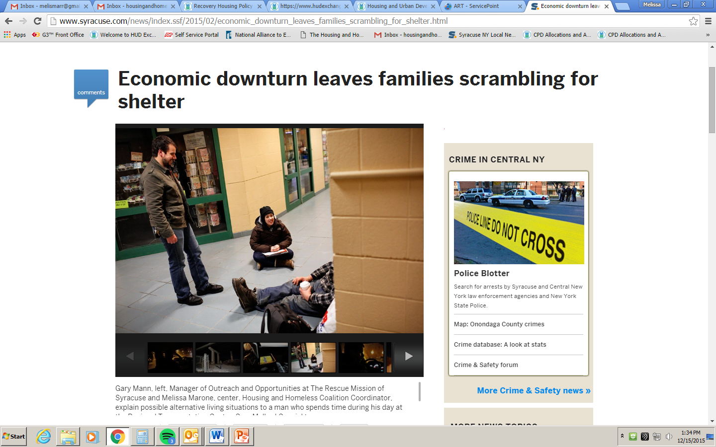
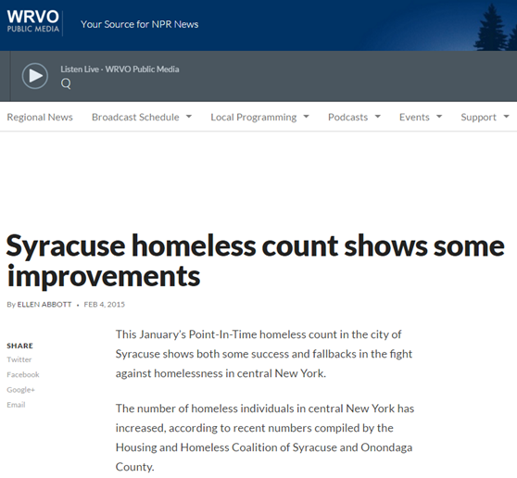
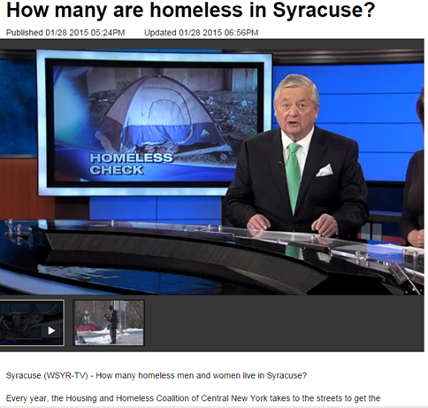

Slide 30
Thank you!

