Slide 1
Coordinated Entry Training
Housing and Homeless Coalition of Central New York

Slide 2
Agenda
Definitions and concepts (30-45 mins)
Overview of coordinated entry system and prioritization (15-30 mins)
Break
Making referrals (60 minutes)
Accepting referrals (30 minutes)

Slide 3
Literally Homeless
Individual or family who lacks a fixed, regular, and adequate nighttime residence
Source:
https://www.hudexchange.info/resources/documents/HomelessDefinition_RecordkeepingRequirementsandCriteria.pdf

Slide 4
Types of literal homelessness
Has a primary nighttime residence that is a public or private place not meant for human habitation;
Is living in a publicly or privately operated shelter designated to provide temporary living arrangements (including congregate shelters, transitional housing, and hotels and motels paid for by charitable organizations or by federal, state and local government programs); or
Is exiting an institution where (s)he has resided for 90 days or less and who resided in an emergency shelter or place not meant for human habitation immediately before entering that institution
Is fleeing or attempting to flee domestic violence, has no other residence, and lacks the resources to obtain other permanent housing

Slide 5
Chronic Homelessness
Individual who has a disabling condition
AND
Has been continuously homeless for a year or more
OR
Has had 4 or more episodes of homelessness in the last 3 years, adding up to 12 months.
Source:https://www.hudexchange.info/resources/documents/DefiningChronicHomeless.pdf

Slide 6
Episodes of homelessness must be separated by 7 days or more in a “non-homeless” housing situation (transitional housing, RRH, PSH, or living/ staying with friends or family).
DOCUMENTATION OF DISABILITY AND TIME HOMELESS IS REQUIRED TO BE ELIGIBLE FOR CHRONIC DEDICATED PROGRAMS
A small percentage of time can be self-reported.

Slide 7
VI-SPDAT (Vulnerability Index – Service Prioritization Decision Assistance Tool)
Standardized Interview
Provides numerical assessment of client risk factors
Based on client self-report
Takes into account history of homelessness, financial issues, medical issues, mental health
Final score gives recommendation for No housing intervention, Rapid Re-housing, or Permanent Supportive Housing
Score is out of 17 for individuals.

Slide 8
VI-SPDATS for special populations
TAY-VI-SPDAT : Transition Age Youth VI-SPDAT
Additional questions about youth-specific issues
Recommendations are not for specific types of CoC programs, just longer or shorter interventions
VI-FSPDAT: Family VI-SPDAT
Changes wording from individual to family
Adds an additional “family unit” risk category.
Score is out of 22 rather than 17

Slide 9
Limitations of the VI-SPDATs
Clients may not understand wording/ timeframe of questions
Language barriers
Client’s ability to recall history
Client’s sensitivity to questions asked
Intentional answering to get higher score
Workers administering the tool may not understand questions, may not read tool as written
Relative weighting of risk factors may not be the same as community values

Slide 10
Types of Projects
ESG supplemental/ESG RRH
Limited time program (ending in April 2019)
Very temporary rental assistance
Minimal Case Management; 6 months maximum
Targeted to clients that need the least amount of assistance to be independent

Slide 11
Types of Projects
HOPWA – Housing opportunities for persons with AIDS.
Rental Assistance programs
Community Residences
HIV Positive individuals qualify

Slide 12
Types of Projects
Rapid Rehousing
6-24 months in duration
Rental assistance
Case management to stabilize client and increase income
Client starts in project in shelter, then moves to own apartment
Lease is in client’s name

Slide 13
Types of Projects
Permanent Supportive Housing
Indefinite duration
Rental Assistance
Case management to stabilize client and increase income.
Most intensive intervention
Provider holds lease, acts as intermediary with landlord

Slide 14
Types of Projects
Rental Assistance Program (HUD-RAP)
Tenant holds lease, finds housing unit
Rental assistance – 30% of income
Some case management

Slide 16
Coordinated Entry System for CoC housing programs
Shelters
Accept in order of priority and need
Housing
Rapid Re-housing
Referrals
Street Outreach
Coordinated Entry List
Supportive Housing
HUD RAP
ESG Supplemental
Housing and Homeless Coalition
HOPWA

Slide 17
Example of one possible path through coordinated entry
John comes to the shelter.
Disabled
Chronic
Shelter worker
does a VI-SPDAT assessment
makes a referral in ServicePoint.
A supportive housing provider has an opening
Sees that John’s priority is highest on the list,
Calls the caseworker at the shelter to let them know that there is an opening if John wants it.
John agrees to move in and the staff at the shelter and the housing program start coordinating his move out of shelter.

Slide 18
Roles of each part of the system
Shelter and Street outreach
Assess clients
Refer to coordinated entry
Explain different program types to clients
Refer to programs that are appropriate and that the client is interested in.
Manage referrals
Update information as it changes
Remove clients who have self-resolved or otherwise are no longer interested in services

Slide 19
Roles of each part of the system
Housing and Homeless Coalition Staff
Organize referrals in order of priority and distribute list to coordinated entry group
Check quality of referrals
Check that all entries to CoC-funded housing providers are coming from coordinated entry
Organize Coordinated Entry Workgroup

Slide 20
Roles of each part of the system
Housing Service Providers
Identify clients in order of priority
Accept most vulnerable clients first
Contact the Emergency Shelter or Street Outreach Staff
Don’t keep a separate waiting list
Adhere to Housing First practices
Discharge clients only to positive housing destinations or transfer to other housing providers

Slide 21
PSH Prioritization
Chronically homeless with VISPDAT >8
All other chronically homeless individuals and families with a SPDAT score of 8 or below.
Homeless individuals and families with a disability with the most severe service needs, evidenced by their assessment score on their respective SPDAT
Homeless individuals and families with the longest periods of continuous or episodic homelessness
Homeless individuals and families coming from places not meant for human habitation

Slide 22
Tie breakers
Longest history of homelessness in past 3 years
In an unsheltered location during Code Blue
VISPDAT Score
Veteran Status

Slide 23
Examples
Family with 12 months of homelessness with a VISPDAT score of 14
VS
Individual with 20 months of homelessness and VISPDAT score of 10

Slide 24
RRH Prioritization
Individuals and Families with VI-SPDAT scores of 10 and below
Tie Breakers -Longest length of current episode of homelessness
-An individual or family who is living in an unsheltered location during Code Blue

Slide 25
HUD RAP Prioritization
Homeless individuals and families with a VI-SPDAT between 8 to 10
Tie-Breakers
-Longest history of homelessness in the past 3 years.
-Families
-Individuals in unsheltered locations during code blue

Slide 26
ESG Prioritization
Literally homeless individuals and families with VISPDAT of 7 or less, ordered by length of stay in shelter
Families
Individuals

Slide 27
ESG Tie breakers
Unsheltered location during Code blue
Veteran Status
Households with a housing option identified
Fleeing domestic violence

Slide 28
Examples
Family with a VISPDAT of 3 with 2 months homeless
VS
Individual with a VISPDAT of 6 with 1 month homeless

Slide 29
Eligibility for certain projects
Some projects target specific populations (youth, veterans, women, etc.)
These projects are required to follow prioritization among those eligible for their projects

Slide 30
Acceptance/Rejection policies
If a referral matches eligibility requirements, housing providers can only reject it if:
The client is a danger to themselves or others
The client has previously been unsuccessful in the agency’s housing project

Slide 31
If a client refuses entry into a project
Other projects offer similar services as openings become available
Case Conferencing at coordinated entry workgroup
Bi-weekly engagement from shelter workers, documented in HMIS

Slide 32
Special note about DV clients
Privacy concerns
Still have full access to Coordinated Entry System
Their referrals DO NOT GO THROUGH HMIS

Slide 33
De-Identified Referral
With minimal Info
DV Shelters
Coordinated Entry List
Communication based on DV Shelter’s ID number
Housing Service Providers

Slide 34
DV Clients
Once clients of VSPs are entered in CoC-funded projects, they must be entered into HMIS
Clients still have the choice not to release their information to other HMIS providers.

Slide 35
Cross-County Referrals
According to HUD, services provided through coordinated entry are available to clients in all geographic areas of the CoC.
Client choice is most important when considering this option. Data has shown that cross county movement is very low in our homeless population.
In Cayuga and Oswego counties, shelter and street outreach should refer to the Coordinated entry provider for that county.

Slide 36
When to make a referral (Shelters and Street Outreach)
If this is the person’s first time being homeless and they have not been able to find housing within the first 2-4 weeks.
If they are chronically homeless.
If they have a disability that is limiting them in obtaining or maintaining housing (many times homeless).

Slide 37
When to enter a new VISPDAT
Only enter a new VI-SPDAT if significant changes have occurred that would affect the client’s vulnerability.
Examples: substantially increased history of homelessness, new medical issues, loss of income, etc.
—If it appears that the client did not fully disclose all of the accurate information on the original survey.

Slide 38
Reminder on VISPDAT Types
VI-SPDAT – is a referral for single adults 25 years of age or older.
TAY-VI-SPDAT is for single youth ages 18 to 24 years of age.
VI-FSPDAT is for Families, even families where the Head of Household is 24 or under.

Slide 39
COMPUTER TIME
Add a new client to the training site using a fake name, D.O.B., and SSN
Additional program info is not necessary

Slide 40
H3lpMeLearn!

Slide 41
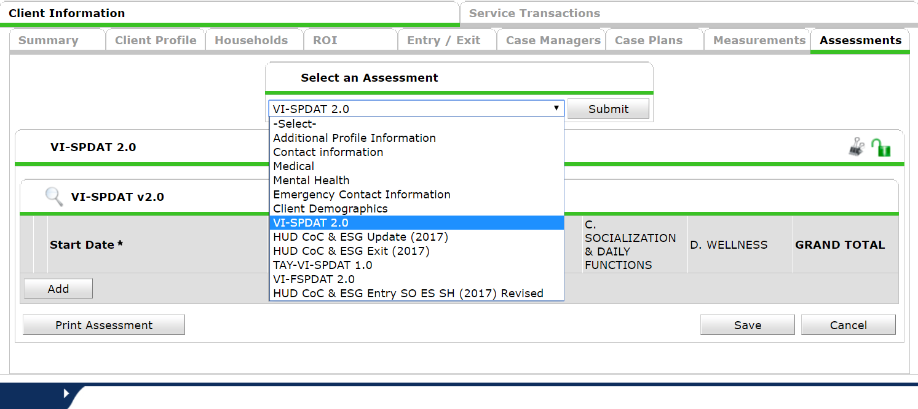
Entering VISPDATs into HMIS
In clientpoint, select the assesments tab
In Clientpoint, select the Assessments tab
Select the VI-SPDAT 2.0,
TAY-VI-SPDAT 1.0,
or VI-FSPDAT 2.0 Assessment from the list
Click add if there isn’t already an appropriate VI-SPDAT

Slide 42
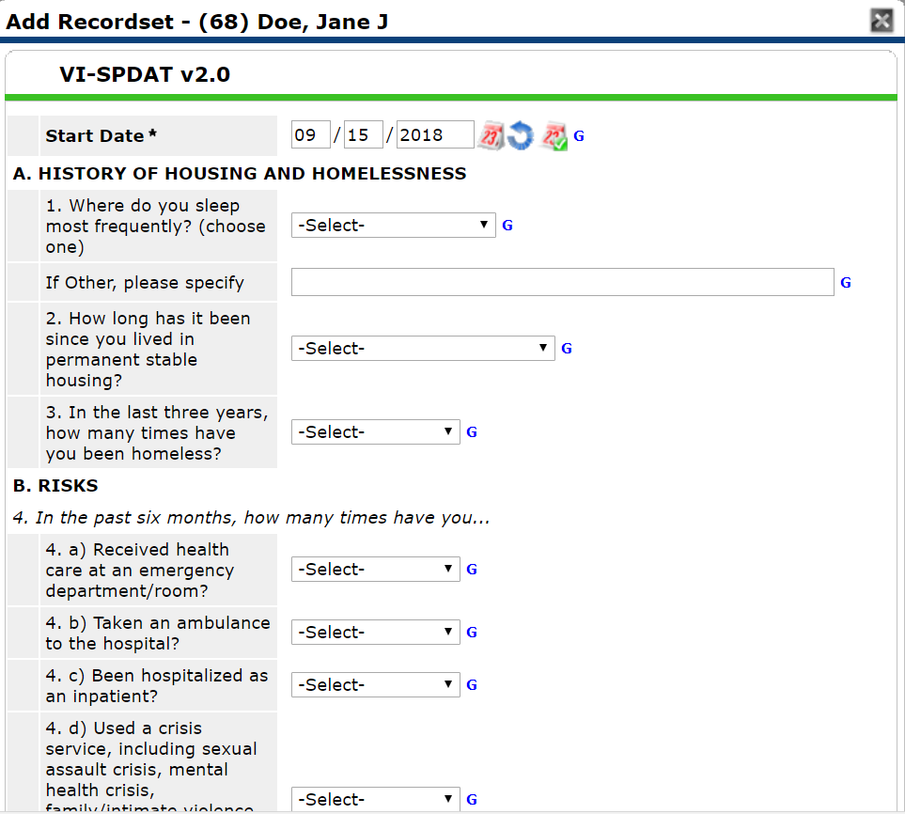
Entering VI-SPDATs into HMIS
Questions are same as on the VI-SPDAT assessments

Slide 43
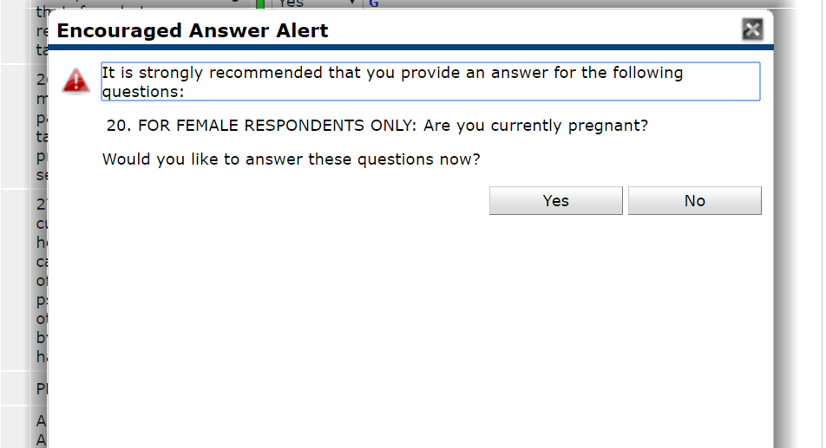
Warnings
FOR FEMALE RESPONDENTS ONLY: Are you currently pregnant?
This question does not need to be answered for male respondents, even though the following warning will be displayed

Slide 44
View VI-SPDATs
You can see completed VI-SPDATs in the assessments tab.

Slide 45
Creating a Referral
Using Client Point you first need to go into the Client’s file:

Slide 46
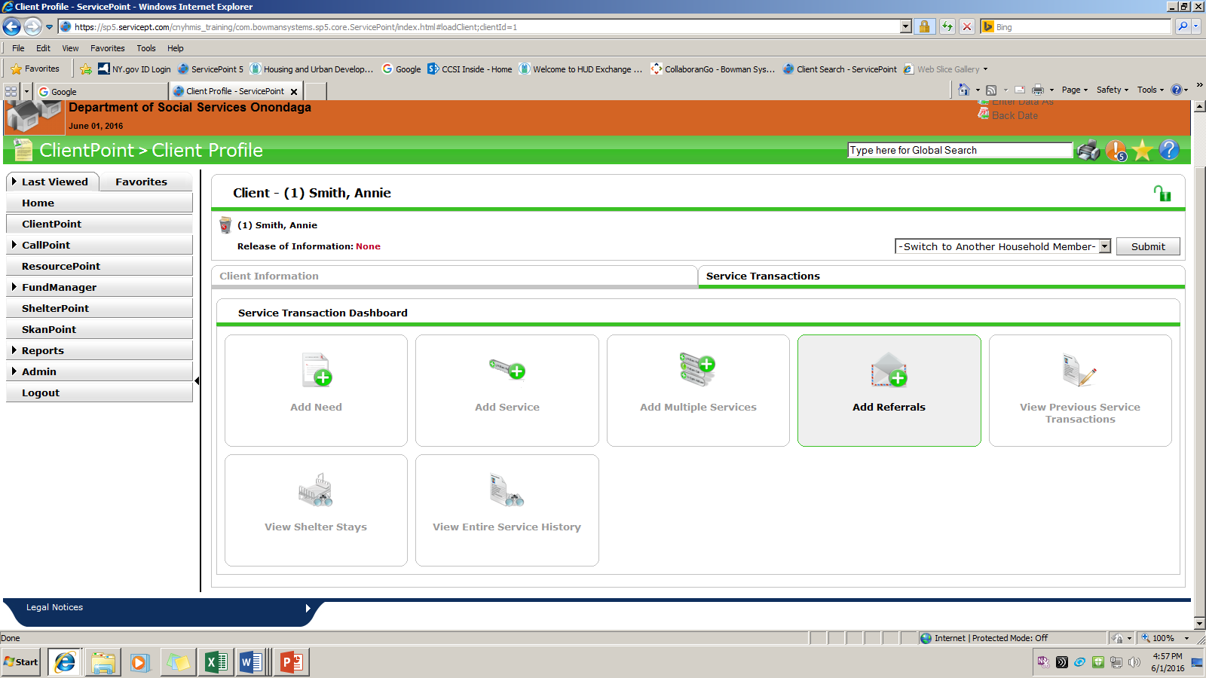
When you enter the client file you need to first go to the “Service Transactions” tab.
Click on the “Add Referrals” box.
Check in the entire family or just the individual.

Slide 47
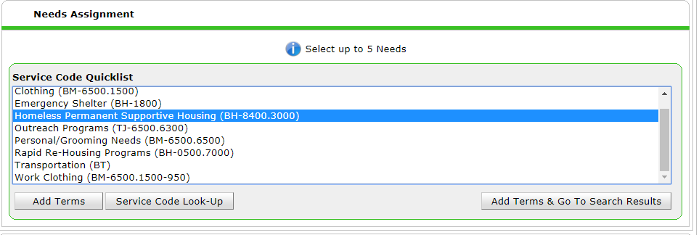
In the Service Quicklist, select either
“Homeless Permanent Supportive Housing” or
“Rapid Re-housing Programs” or “AIDS/HIV Control” for HOPWA
If your agency admin has not set up the service code quicklist, ask them to do it or consult with HMIS staff

Slide 48
If your Agency Admin has created the “Referral Provider Quicklist” then you can select the “Coordinated Entry NY-505” provider.

Slide 49
This is where you add the appropriate VI-SPDAT to the referral.
ALL Coordinated Entry referrals must have a VI-SPDAT attached to them.

Slide 50
Make sure that the check box is filled in for the Referrals portion of the transaction.
Check to make sure the correct need is in the “Selected Needs” box
To complete the referral you need to click the “Save All” button and the referral will be sent!!

Slide 51
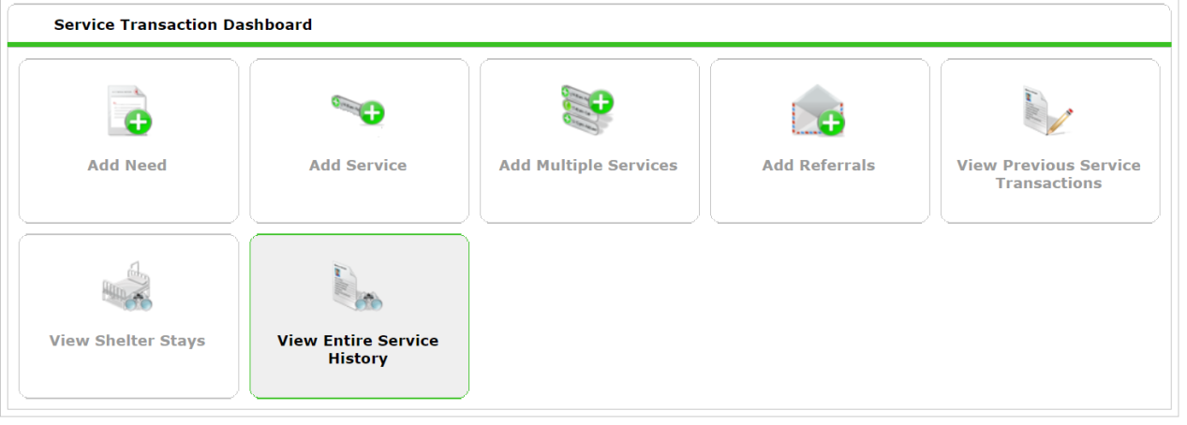
You can always check on the Status of your referrals by going into HMIS Service Transactions and pressing “View Entire Service History”
Please note the “Need Status” and “Outcome” columns.

Slide 52
Need Notes
Currently, we enter additional information about referrals using the need notes field
Some client information is needed for prioritization and appropriate referrals
This information should be entered and checked for accuracy when the referral is entered and EVERY CONSECUTIVE MONTH the referral is open.

Slide 53
Need Notes
Navigate to
Service Transactions -> View Entire Service History
Click the pencil next to “Need”

Slide 54
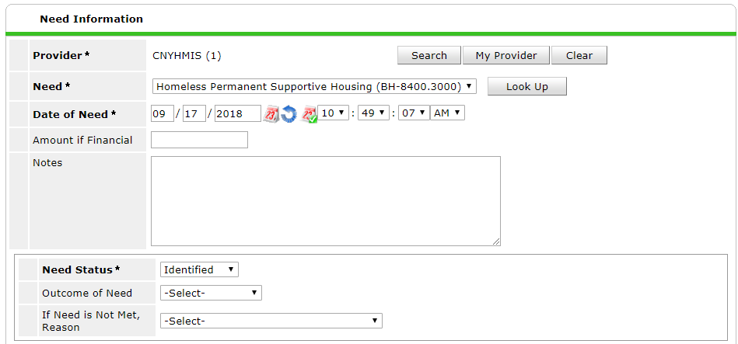
Need Notes
Enter Note in this field

Slide 55
Note Templates
Individuals:
Age of HoH:
Veteran Status:
Chronic Homeless Status:
Cumulative Months Homeless:
Disabilities*:
Counties Preferred:
ESG Supplemental**:
* DO NOT write client’s actual diagnosis!!!!
** Please note if client would like to be considered for ESG Supplemental

Slide 56
Note Templates
Families:
Age of HoH:
Veteran Status:
Chronic Homeless Status:
Cumulative Months Homeless:
Family Composition:
Disabilities*:
Medical:
Income:
Counties Preferred:

Slide 57
Coordinated Entry Information Assessment-
Beginning January 1st 2018
Need notes will now be an assessment in SP

Slide 58
Coordinated Entry Information Assessment
After entering the referral, go to the Assessments tab for your client (Under Client Information).
1
2

Slide 59
Coordinated Entry Information
Select the Coordinated Entry Information Assessment

Slide 60
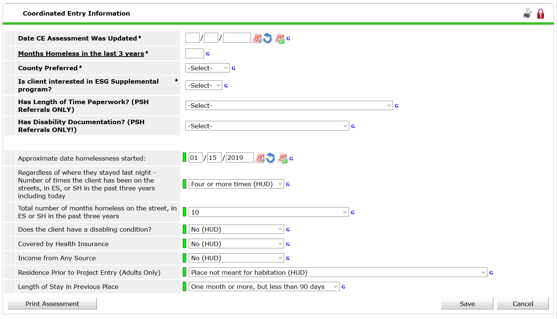

Slide 61
Coordinated Entry Information
Some information will populate from the intake.
Fields in bold need to be entered/changed
Fields not in bold should not be changed here
Change those fields from the most recent program entry or create an interim review

Slide 62
Coordinated Entry Information Assessment
Fields not on intake assessment:
Date CE Assessment was updated
Lifetime Cumulative Months Homeless
County Preferred
Is client interested in ESG program

Slide 63
Common Problems with CE Referrals
Providers add services before referrals are accepted
Shelters/Street Outreach do not include all information in referral notes
Referrals are not cancelled in a timely manner

Slide 64
Taking Coordinated Entry
Referrals Off the List
Go to the Client File through Client Point
Go to the “Service Transaction” tab
Click on the box marked “View Entire Service history
Then Click on the “Referrals” tab and look for the referral for “Coordinated Entry NY 505”
Click on the pencil to edit the referral

Slide 65
When you open the referral you scroll down to the Referral Data portion of the referral. The process for closing is as follows:
Choose the “Referral Outcome”
Accepted, or Cancelled
If the choice is Cancelled you need to choose a reason.
Then you change the “Need Status” to “Closed”
The “Outcome of Need” answer is either Fully Met or Not Met, and if it’s Not Met you need to choose a reason.
The final step is to “Provide a Service”
Once you choose that it will take you to another page to assign a service to your Provider.

Slide 66
Providing a Service to the Coordinated Entry Referral
When providing a service remember that you are going to be leaving it open and do not add an end date.
First, you select Service Provider (Program) that the client was accepted to.
Second you need to click on the blue font that states “Make Service same as Need” which will add in the service for which the referral was made. If you service is different then you will have to do the “Look Up”
Then you push “Save & Continue”

Slide 67
Finishing up the Process…
Finally you will scroll down and complete the Service Transaction for the referral and click “Save & Exit.”
The process will then be complete and we will be able to accurately assess through the system that a Shelter or Street Outreach Provider completed the referral on “X” date, the referral was on the list for “X” amount of time, and then “X” Provider accepted them off of the list.
Please remember to use the proper Prioritization Process during the process.

Slide 68
How we pull referrals for the weekly list?
Referrals will continue to stay on the list unless all of the following are completed:
Referral outcome is “Accepted” or “Cancelled”
Need outcome is closed
If accepted, service has been provided.

Slide 69
Thanks!
Please give us your feedback:
surveymonkey.com/r/HHCCNY_CE_Training
Or link on the HHC website’s Coordinated Entry page

