Slide 1
Coordinated Entry Training
Housing and Homeless Coalition of Central New York

Slide 2
Agenda
Introductions
Key Terms
Progressive Engagement and Housing First
Assessment:
VI-SPDAT
Client Preference
Assessing Chronic Homelessness
Project Types (breakout activity)
Overview of Coordinated Entry System, roles and responsibilities
Prioritization
The List
Break
Entering Assessments in HMIS
Recording Contacts in HMIS

Slide 3
What is Coordinated Entry?
Coordinated Entry describes how our community
Assesses
Prioritizes
Refers
People experiencing homelessness to
Housing assistance resources.

Slide 4
Literally Homeless
Individual or family who lacks a fixed, regular, and adequate nighttime residence
CoC and ESG PSH and RRH programs are for these people
Notes:
Source:
https://www.hudexchange.info/resources/documents/HomelessDefinition_RecordkeepingRequirementsandCriteria.pdf

Slide 5
Types of literal homelessness
Has a primary nighttime residence that is a public or private place not meant for human habitation;
Is living in a publicly or privately operated shelter designated to provide temporary living arrangements (including congregate shelters, transitional housing, and hotels and motels paid for by charitable organizations or by federal, state and local government programs); or
Is exiting an institution where (s)he has resided for 90 days or less and who resided in an emergency shelter or place not meant for human habitation immediately before entering that institution
Is fleeing or attempting to flee domestic violence, has no other residence, and lacks the resources to obtain other permanent housing

Slide 6
Philosophies of Coordinated Entry
Progressive Engagement
-Provide only as much assistance as necessary to re-house a person
- Provide more services as are necessary to keep them housed

Slide 7
Progressive Engagement and the Black hole of homelessness
People with less time homeless may need less assistance to become stably housed

Slide 8
Black hole of homelessness
People remain homeless longer -> lose social ties/connections
Lost social ties -> more difficult to get out of homelessness
Assistance can
“catapult” people
out of homelessness

Slide 9
Housing First
The solution to homelessness is safe and affordable permanent housing for everyone
5 Principles:
No Preconditions For Housing Readiness
Consumer Choice and Self-Determination
Not protecting clients from negative consequences
Recovery Orientation
Individualized and Person-Driven Supports
Social and Community Integration
https://www.youtube.com/watch?v=pwdq2VWavtc&t=37s

Slide 10
Why Housing First?
Evidence shows that there are no reliable predictors of success in Housing First programs.
Housing First respects client choices and autonomy.

Slide 11
What is the purpose of CE assessment?
Triage vs. Comprehensive Case Planning
Target clients to achieve community goals (e.g. ending youth, family, and chronic homelessness)
Aid in prioritizing program referral

Slide 12
Prioritization
Old Way : First Come First Served
Solely based on relationship with case manager and program
Not designed to serve most in need
Referral/Acceptance based on unclear, inconsistent rules
New Way: Evidence Based Assessment and Prioritization
Referrals based on consistent assessment, comparable across providers
Most in need get served first
All eligible clients are referred, most vulnerable are prioritized

Slide 13
What the vulnerability index doesn’t do:
The tool DOESN’T Make decisions
It DOESN’T provide a diagnosis
It DOESN’T take the place of professional clinical assessment

Slide 14
Not a prediction of Success
“Everyone’s very focused on - ‘let’s predict who can’t make it’, but in fact we can’t predict who can make it. We really don’t know. So we have to give every single person a chance to demonstrate what they can do in that new environment.”
-Dr. Sam Tsemberis, creator of the first Housing First program in the US

Slide 15
2 components of assessment
The VI-SPDAT
Client Preferences
Verifying History of Homelessness

Slide 16
VI-SPDAT (Vulnerability Index – Service Prioritization Decision Assistance Tool)
Standardized Interview
Numerical rating of vulnerability
Based on client self-report
Different domains of vulnerability
Recommends an intervention
Score out of 17
Use TAY-VI-SPDAT for Youth
Use VI-F-SPDAT for Families

Slide 17
VI-SPDAT Musts
Conduct the interview in a private room or confidential setting
Store data securely – Paper copies should be locked in a cabinet. Files should only be saved in password-protected accounts or folders.
Information about VI-SPDAT scores or that was learned through the course of the interview should only be shared if the sharing takes place in the course of coordinating or providing services to the client.

Slide 18
Rules of thumb for administering the VI-SPDAT
Allow clients to stop or not answer when they choose
Do not promise clients housing services based on their VISPDAT results.
Do not tell clients that they cannot access a certain service based on their VISPDAT results.
Be attentive to power dynamics – Workers who administer beds, food, etc. should not also conduct the VI-SPDAT if possible.

Slide 19
If a client’s safety is in danger, talk to them about how they would like to proceed, what supports they would need in order to feel safer, and what strategies they could use to keep themselves safe. Attempt to do a “warm handoff” to services like DV shelter, EMS, or other services.

Slide 20
What DOES the tool do:
Helps prioritize who gets served in housing services next
Prompt conversations around barriers to housing

Slide 21
The tool is not perfect
There are instances when the tool will recommend an outcome/score that isn’t appropriate
Reasons:
Misunderstanding questions
Language barriers
Recalling history
Sensitive questions
Other vulnerabilities not assessed

Slide 22
When to enter a new VISPDAT
Enter a new VI-SPDAT if significant changes have occurred that would affect the client’s vulnerability.
Examples: substantially increased history of homelessness, new medical issues, loss of income, etc.
—If it appears that the client did not fully disclose all of the accurate information on the original survey.

Slide 23
Chronic Homelessness
Individual who has a disabling condition
AND
Has been continuously homeless for a year or more
OR
Has had 4 or more episodes of homelessness in the last 3 years, adding up to 12 months.
Source: https://www.hudexchange.info/resources/documents/DefiningChronicHomeless.pdf

Slide 24
Episodes of homelessness must be separated by 7 days or more in a “non-homeless” housing situation (transitional housing, RRH, PSH, or living/ staying with friends or family).
Documentation required for Chronic-dedicated Permanent Supportive Housing projects
A small percentage of time can be self-reported.

Slide 25
Assessing Chronic Homelessness
Step 1: Do your homework.
Find all of the client’s shelter stays and count up the number of months and episodes of homelessness in the last three years before meeting with the client, if possible.
Step 2: Meet with your client and ask where they were during their gaps in shelter stays.
Step 3: Document this information using the standardized PSH packet forms.
Step 4: Collect disability documentation, self-certification, and third-party verification forms if necessary.

Slide 26
PSH Assessment Packet
Disability Documentation
HHC Disability Verification form
SSA Award Letter
Other documentation signed by a health professional qualified to diagnose that disability in NYS
Length of Time Documentation
HMIS Entry/Exit Page
Third-Party Verification
Self-Certification

Slide 27
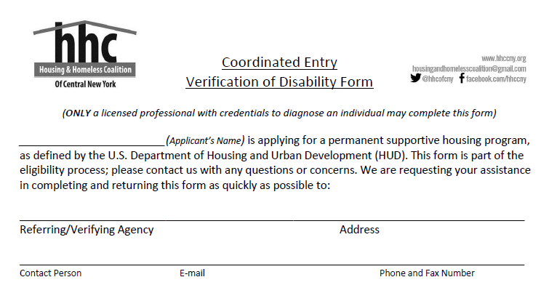
Your information goes here

Slide 28
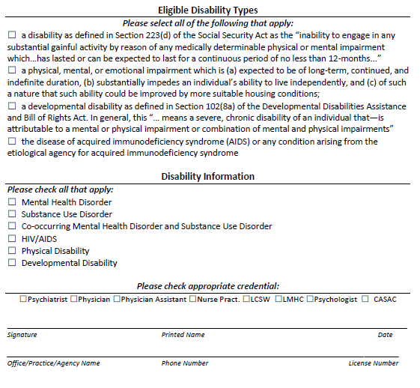
Ensure at least one is checked
Ensure at least one is checked
Health Care Provider Information Here

Slide 29
Third-Party Verification Of Homelessness
“Third party” means not the client or the PSH project.
Should be able to describe instances where the person was seen in a literally homeless situation at least once in each month verified.
Acceptable: “The Helpers Outreach team visited Bill’s encampment next to the railroad crossing at West Genesee St and Erie Boulevard West on the following dates: 1/9/2020, 4/7/2020, 7/1/2020”
Unacceptable: “I, Fred Hintz, attendant at West Genesee Byrne Dairy, have known Bill to be continuously homeless in the west side of Syracuse for the last 5 years from 2016 to the present.”
Why? No specific location, No specific dates (gas station attendants or other community members are OK, if they saw the client’s nighttime sleeping location).

Slide 30
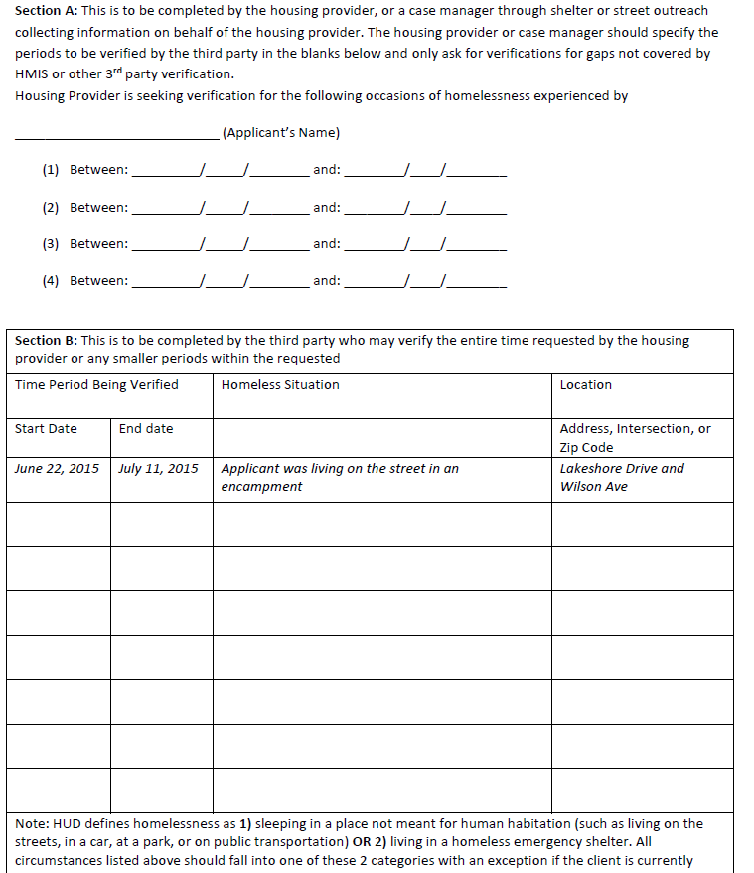
Time Periods Requested by case manager
Living situations verified by Third Party

Slide 31
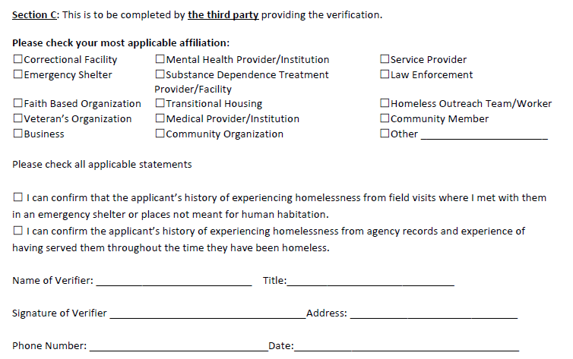
Should be filled out completely

Slide 32
Self-Certification / Breaks
Self-certification: When no third party can be reached to verify the client’s living situation, the client can self-certify up to 3 months of their 12 months of homelessness.
Breaks in homelessness: If a person is chronically homeless because they experienced homelessness 4+ times in the last three years, they must attest that they were housed at least 3 times in the last three years.

Slide 33
Self-statement certification

Slide 34
Breaks in homelessness certification

Slide 35
Client Preferences
Project Type (Question in HMIS)
Which project type is the client interested in?
ESG RRH, CoC RRH, or Permanent Supportive Housing
Primary way clients are sorted into referral lists.
Clients can choose multiple project types.

Slide 36
Which housing assistance programs accept referrals through coordinated entry?
Rapid Re-Housing
ESG/STEHP
CoC
Transitional Housing
Permanent Supportive Housing

Slide 37
Project Types: Breakout activity
In a small group, describe each of the types of housing available through coordinated entry
Write out the following for your assigned project type:
Who is eligible for this project?
What kind of assistance is available?
How long can someone receive this assistance?
Where can you live if you sign up for this program?
(For PSH) How is PSH different from HUD RAP?
Other questions clients have asked you about this project type

Slide 38
Types of Projects
ESG/STEHP Rapid Re-Housing
CoC Rapid Re-Housing
Transitional Housing
Permanent Supportive Housing

Slide 39
“Set up for failure”
What percentage of people who enroll in Rapid Rehousing exit to permanent housing destinations in our CoC?
88%
What percentage return to homelessness within 6 months after a successful exit?
17% in 6 months
28% in 2 years
Notes:
FY2020 system performance measures

Slide 40
Quiz

Slide 41
Q1
Samantha became homeless in February 2020. She has not had any housing situation since February 2020 for more than 7 days. She was homeless for 13 months from April 2013 to May 2014. She has a severe mental health disorder.
Is she chronically homeless as of December 11, 2020?

Slide 42
Q2 : Bill’s Shelter History:
Provider | Entry Date | Exit Date
CC Men’s Shelter | 10/1/2017 | 2/1/2018
RM Emergency Shelter | 8/1/2018 | 11/15/2018
RM Emergency Shelter | 3/1/2020 | 6/15/2020
CC Men’s Shelter | 8/2/2020

Slide 43
Q3
What are some challenges that have come up for you during the assessment process?
How have you dealt with them?

Slide 44
Coordinated Entry System for CoC housing programs
Shelters
Order for priority and need based on CE plan
Housing referrals
Rapid Re-housing
Assessments
Street Outreach
Coordinated Entry List
Supportive Housing
HUD RAP
ESG Supplemental
Housing and Homeless Coalition

Slide 45
Roles of each part of the system
Shelter and Street outreach
Assess clients
Refer to coordinated entry
Explain different program types to clients
Refer to programs that are appropriate and that the client is interested in.
Manage referrals
Update information as it changes
Remove clients who have self-resolved or otherwise are no longer interested in services

Slide 46
When to make a referral (Shelters and Street Outreach)
If this is the person’s first time being homeless and they have not been able to find housing within the first 2-4 weeks.
If they are chronically homeless.
If they have a disability that is limiting them in obtaining or maintaining housing (many times homeless).

Slide 47
Roles of each part of the system
Housing and Homeless Coalition Staff
Organize referrals in order of priority and distribute list to coordinated entry group
Match clients to housing provider openings
Check quality of referrals
Check that all entries to CoC-funded housing providers are coming from coordinated entry
Organize Coordinated Entry Workgroup

Slide 48
Roles of each part of the system
Housing Service Providers
Communicate openings to CE in a timely manner
Contact clients that have been matched to the program in order of priority
Give clients 2 weeks to attempt to make contact
Record contact attempts in HMIS
Close out CE program entries when clients have moved into housing units

Slide 49
How matching works
Step 1: Housing providers contact CE staff when they have program openings via E-mail

Slide 50
How matching works
Step 2: HHC Staff match the next person on the appropriate list that
Is not already matched to a different program
Has had recent contact with emergency shelter or street outreach staff
Has not previously been housed or contacted by that program
Fits the program’s targeting criteria

Slide 51
How matching works
Step 3: Matches are communicated through the weekly CE email list.
“Matched housing provider” column on lists
“RRH Matches” or “PSH Matches” tab on list
Matches may not always appear in order

Slide 52
How matching works
Step 4: Providers contact clients directly or shelter case managers to set up appointments
Matches are taken off the list when clients are opened in an RRH or PSH program

Slide 53
How matching works
Step 5: Matches are removed when:
Providers no longer have openings
Clients have been intaked
Clients have been contacted and choose not to participate in services
Providers deny clients

Slide 54
Issues/Grievances/Inappropriate Matches
Contact CE staff
Cassandra Montressor, Sherrain Clark, or Fred Hintz
Document reasons match is inappropriate

Slide 55
COVID-19 Changes to Prioritization
In April 2020, the CE committee decided to prioritize:
Adults over the age of 65
People with conditions the CDC declared were at high risk for COVID-19
These conditions are:
Chronic Kidney Disease
COPD
Immunocompromised
Obesity
Serious Heart Conditions
Sickle Cell Disease
Type 2 Diabetes
People who had housing identified for RRH

Slide 56
Prioritization
Priority groups vs Tie breakers
Priority Groups – people in higher priority groups must be served before people in lower priority groups
Tie Breakers: determines who gets served first within each priority group.

Slide 57
PSH Prioritization
Chronically homeless with VISPDAT >8
All other chronically homeless individuals and families with a VISPDAT score of 8 or below.
Non-chronic Homeless individuals and families with a disability with a VISPDAT of 8 or above
All other non-chronic homeless individuals and families with a disability

Slide 58
Tie breakers
Older than 65
Susceptible to COVID-19
Longest history of homelessness in past 3 years
In an unsheltered location during Code Blue
VISPDAT Score
Veteran Status

Slide 59
PSH Example
Who would be first on the list?
Sandra
Chronic individual
20 months homeless
VISPDAT of 9
Not susceptible to COVID-19
Younger than 65
Janet
Chronic Individual
16 months homeless
VISPDAT of 15
Not susceptible to COVID-19
Younger than 65

Slide 60
RRH Prioritization
Individuals and Families with VI-SPDAT scores of 10 and below
Tie Breakers
Older than 65
Susceptible to COVID-19
People who have identified housing
Longest length of current episode of homelessness
An individual or family who is living in an unsheltered location during Code Blue

Slide 61
RRH Example
Who would be first on the list?
Kenneth
Individual
Homeless for 4 weeks
VISPDAT of 9
Not vulnerable to COVID-19
Younger than 65
Julio
Individual
Homeless for 8 weeks
VISPDAT of 5
Not vulnerable to COVID-19
Younger than 65

Slide 62
HUD-RAP Prioritization
Homeless individuals and families with a VI-SPDAT between 8 to 10
Tie-Breakers
Over age 65
Susceptible to COVID-19
Longest history of homelessness in the past 3 years.
Families
Individuals in unsheltered locations during code blue

Slide 63
HUD-RAP Example
Who would be first on the list?
Billy
Individual
Homeless for 12 months
VISPDAT of 9
Not vulnerable to COVID-19
Younger than 65
Julia
Individual
Homeless for 20 months
VISPDAT of 12
Not vulnerable to COVID-19
Younger than 65

Slide 64
ESG/Transitional Prioritization
Literally homeless individuals and families with VISPDAT of 7 or less
All Individuals

Slide 65
ESG/Transitional Tie breakers
Older than 65
Susceptible to COVID-19
Housing Identified
Length of stay in shelter
Unsheltered location during Code blue
Veteran Status
Fleeing domestic violence

Slide 66
ESG/Transitional Example
Who would be higher on the list?
Gary
Individual
8 weeks homeless
VISPDAT of 9
Not vulnerable to COVID-19
Younger than 65
Paola
Individual
4 weeks homeless
VISPDAT of 6
Not vulnerable to COVID-19
Younger than 65

Slide 67
Eligibility for certain projects
Some projects target specific populations (youth, veterans, women, etc.)
Matches are made with consideration of project’s targeted groups.

Slide 68
Acceptance/Rejection policies
If a referral matches eligibility requirements, housing providers can only reject it if:
The client is a danger to themselves or others
The client has previously been unsuccessful in the agency’s housing project

Slide 69
If a client refuses entry into a project
Other projects offer similar services as openings become available
Case Conferencing as needed or at Chronic Task Force
Bi-weekly engagement from shelter workers, documented in HMIS

Slide 70
Special note about DV clients
Privacy concerns
Still have full access to Coordinated Entry System
Their referrals do not go through HMIS

Slide 71
De-Identified Referral
With minimum necessary Info
DV Shelters
Coordinated Entry List
Communication based on DV Shelter’s ID number
Housing Service Providers

Slide 72
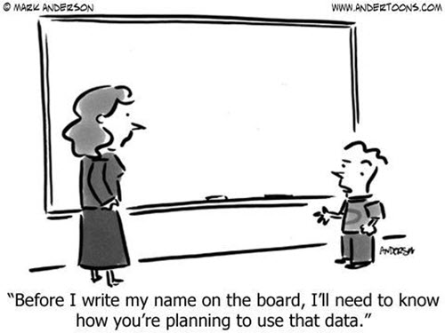
DV Clients
Once clients of VSPs are entered in CoC-funded projects, they must be entered into HMIS
Clients still have the choice not to release their information to other HMIS providers.

Slide 73
Cross-County Referrals
Clients are allowed to move across geographic areas
Providers are only required to accept clients outside of geographic area if there are no eligible assessed clients in their area.
May create significant logistical difficulties
Mark this on their assessment form

Slide 74
The List
14 tabs:
PSH: Chronic, Individuals, Families, and HUD RAP
RRH: Combined, Individuals, and Families
ESG: Individuals and Families
SSVF and VASH
All open PSH Matches, All open RRH Matches

Slide 75
The list – Continued
Lists for each program type are made according to prioritization criteria from most recent information in HMIS
Includes information from assessments, most recent shelter/street outreach record, most recent case manager

Slide 76
Error Lists
Clients with assessments/records that probably should be fixed
Missing CE Information
Duplicate Entries
Clients open in PSH
Inactive Clients
Clients who have not been in shelter for 90 days

Slide 77
Error lists (cont.)
Clients with “Approximate Date homelessness Started” > 100 days
Inconsistent Months
Clients matched but now inactive

Slide 78
Provider Matches / Provider Openings

Slide 79
Final thoughts about CE
Will Coordinated Entry solve homelessness?
NO
It helps us do the coordination and communication we were already doing in a more intentional and formalized way.

Slide 80
Quiz

Slide 81
What is not a role of shelter and street outreach staff in the CE system?
Assess clients
Explaining program types to clients
Matching clients to program openings
Exiting clients who have self-resolved from the program

Slide 82
What is not a role of HHC staff in the CE system?
Generating the weekly list
Contacting case managers individually about housing provider matches
Matching clients to program openings
Organize CE Workgroup

Slide 83
What is not a role of Housing Provider staff in the CE System?
Updating information about client assessments
Communicating openings to CE in a timely manner
Recording Contact attempts in HMIS
Closing CE program entries

Slide 84
Who would get prioritized between the two clients for chronic PSH?
Chronic Individual with a disability, 20 lifetime months homeless and a VISPDAT score of 10 or
Chronic Individual with a disability, 13 lifetime months homeless and a VISPDAT score of 17

Slide 85
Practice in Servicepoint
Add a new client to the training site using a fake name, D.O.B., and SSN
Additional program info is not necessary

Slide 86
Servicepoint Training Site
Hhccny.org -> Hmis -> Direct link to hmis training site
Sp5.servicept.com/cnyhmis_training

Slide 87
Entering clients into CE
Providers in Oswego or Cayuga county should use their county-specific provider. I will refer to all 3 providers as “Coordinated Entry NY-505”.
Shelter and street outreach workers are required to:
Create new “Coordinated Entry” Entry/Exit records for clients who are assessed and being considered for housing services.
Update information once a month for clients who are continuously engaged with seeking services.
Close old “Coordinated Entry” Entry/Exit records for clients who have not been engaged with services for over 90 days.

Slide 88
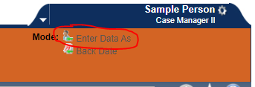
Switch Enter Data As to “Coordinated Entry NY-505”

Slide 89
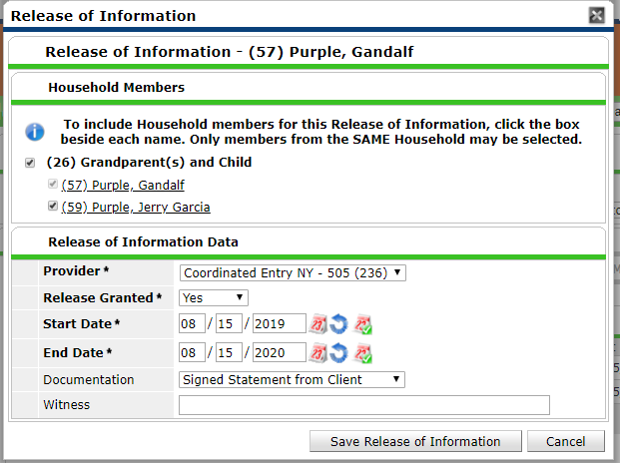
Entering clients into CE
Navigate to client’s profile in Clientpoint
Add a release of Information for the “Coordinated Entry NY-505” Provider

Slide 90
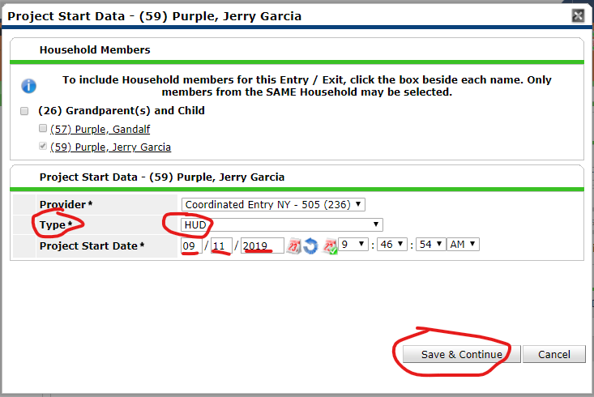
Entering clients into CE
Navigate to the Entry/Exit Tab, and add a new entry/exit for the “Coordinated Entry NY-505” provider on the date the client was assessed. Select “HUD” as the Entry Type. Remember to add the entry for all household members if a household is being assessed.

Slide 91
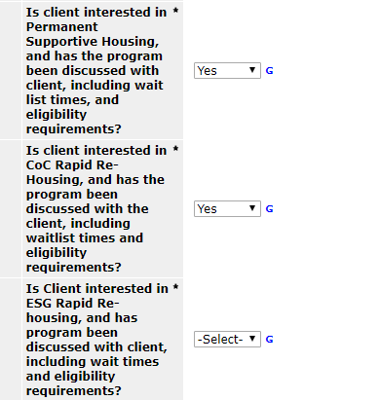
CE Assessment
Complete the Coordinated Entry Information Assessment
Complete the questions referring to clients interest in PSH, CoC RRH, and ESG RRH after discussing the program types with the client and cooperatively determining which would best suit the client’s needs.

Slide 92
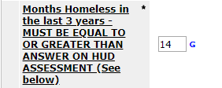
CE Assessment
Complete the “Months homeless in the last 3 years” question.
combination of HMIS information along with a conversation with the client about their housing history in the last three years.
This field is the primary prioritization metric for permanent supportive housing, but is not used in rapid re-housing prioritization.
The value of this field should be greater than or equal to the answer on the most recent entry/exit assessment, which is shown at the bottom of this assessment. Assessments with inconsistent months homeless information will be placed on the errors list until they are corrected.

Slide 93
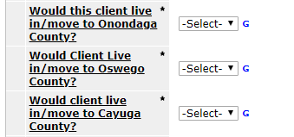
Complete the county preference questions. Only select a different county than their current location if you have discussed the implications of moving with the client

Slide 94
Complete the Paperwork Readiness question for PSH referrals

Slide 95
Complete the Family composition question.
Enter the number of bedrooms needed in the unit, or the age and gender of each member of the household
e.g., 33 F, 2 M, 0 F

Slide 96
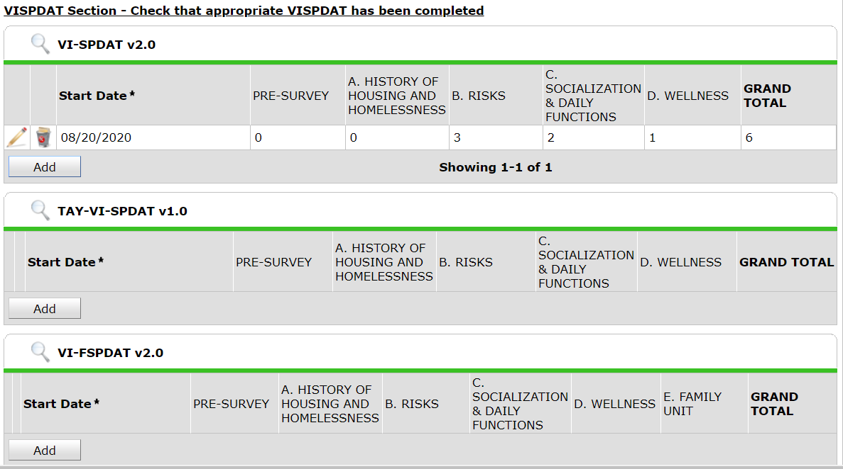
Check that the client has the appropriate VI-SPDAT completed and that the score is up to date.

Slide 97
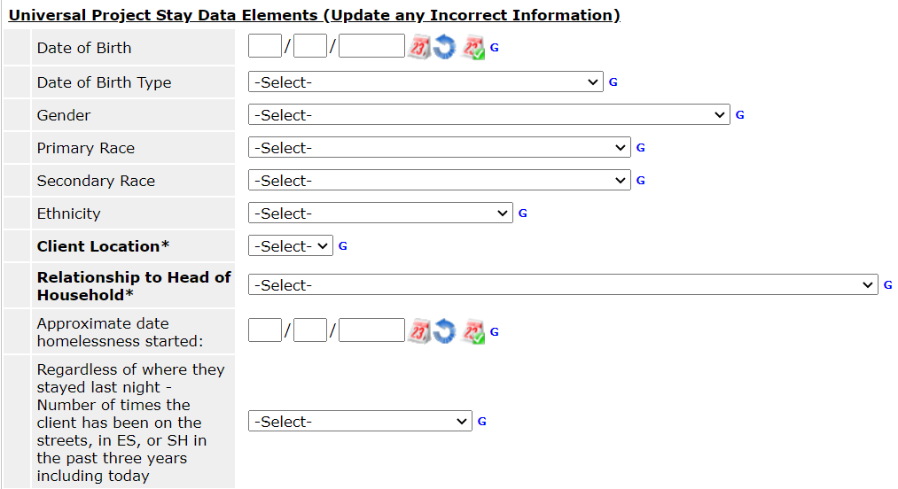
Confirm that the information being pulled from the most recent intake assessments is as accurate as possible.
If information is not accurate, change it on the CE Entry.

Slide 98
Updating CE Assessments
Add an interim assessment whenever client information needs to be updated

Slide 99
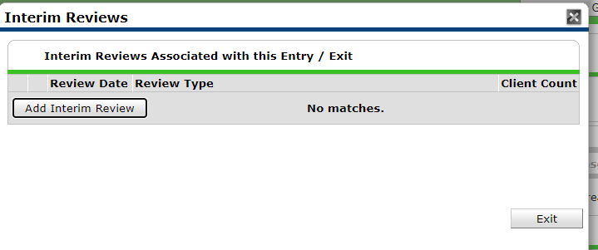

Slide 100
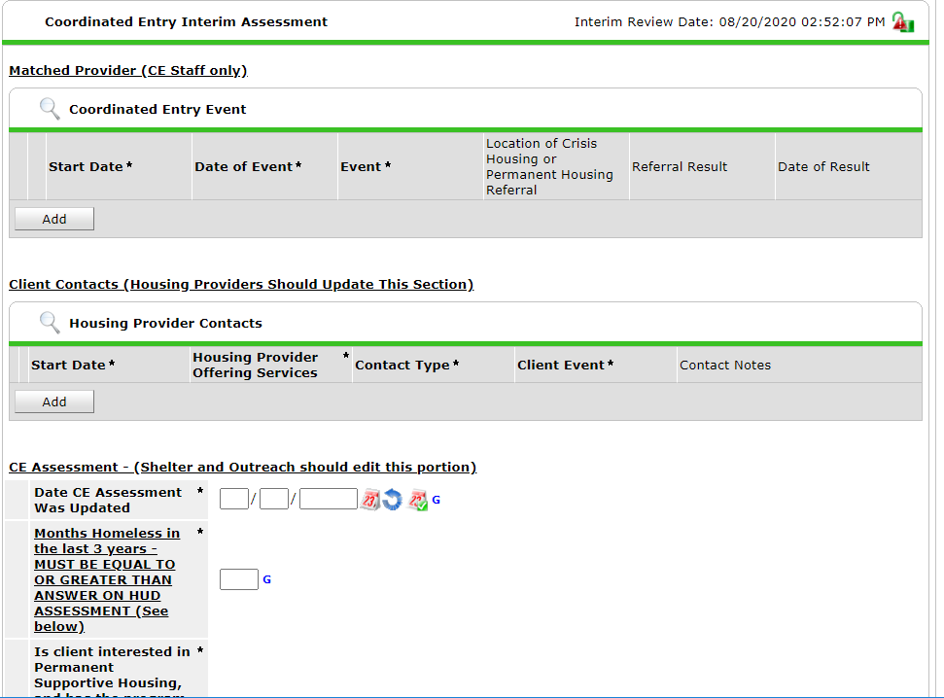
Edit this section and below
not the sections on top.

Slide 101
Updating CE Assessments
When does information need to be updated?
PSH Referrals: once a month, to keep months accurate.
If a new VISPDAT has been performed
If the client’s geographic or program preferences have changed

Slide 102
For PSH/ RRH Providers
Add an interim review
Record contacts with clients

Slide 103
For PSH/ RRH Providers
Your project will be listed here. Do not edit this section

Slide 104
For PSH/ RRH Providers
Record Client Contacts Here

Slide 105
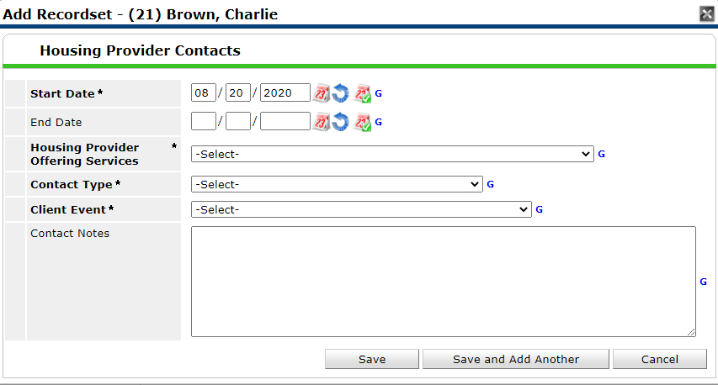

Slide 106
Closing clients
When a client has moved into housing or has not been in contact for >90 days, remove them from the CE project.
Exit the client or household from Coordinated Entry with their appropriate destination

Slide 107
Destinations
PSH : “Permanent Housing for Formerly Homeless Persons, other than RRH”
RRH: “Rental By Client, with RRH or equivalent Subsidy”

Slide 108
Thanks!
Please give us your feedback:
surveymonkey.com/r/HHCCNY_CE_Training
Or link on the HHC website’s Coordinated Entry page

