Slide 1

Housing & Homeless Coalition of CNY:
State of Homelessness 2016
December 21, 2016

Slide 2
2016 Accomplishments

Slide 3
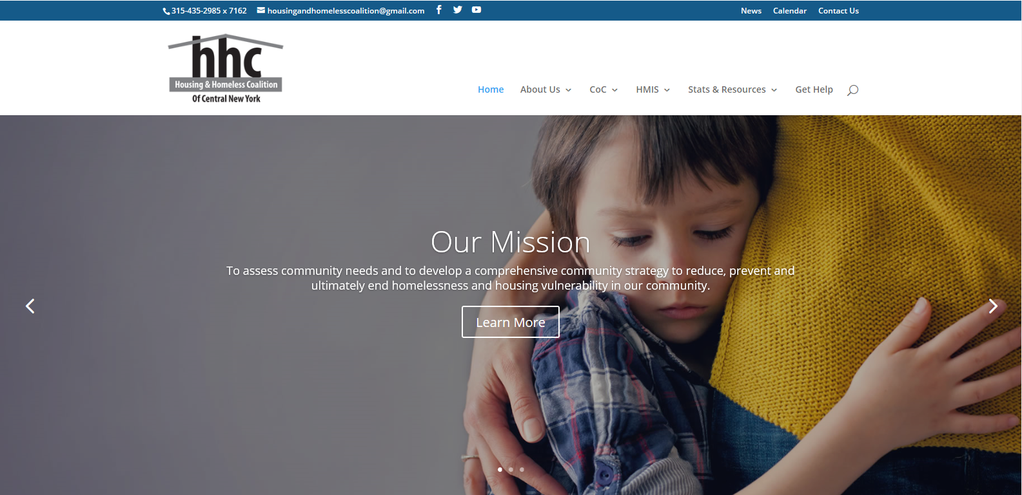
Housing and Homeless Coalition of Central New York
New name
Restructuring Advisory Board
United Way of Central New York
New website

Slide 4
New York State Executive Order 151
When inclement winter weather (at or below 32F; including wind chill) occurs, it presents a risk of hypothermia and death; and the State has an obligation to provide for the aid, care and support of persons in need and to protect and promote the health of its citizens;
The State will assist LDSS if they are lacking facilities, resources or expertise; and imminently mandating that LDSS establish comprehensive housing and supportive service networks designed to meet the diverse needs of each subgroup within the homeless population;
the State can take appropriate steps, including involuntary placement, to protect individuals from harming themselves or others (Sec. 28 & 29 of Article 2B Executive & Mental Hygiene Law).
  directs all LDSS, police including NYS Police, and state agencies to take all necessary steps to identify unwilling/unable individuals to find shelter, and move them to a shelter

Slide 5
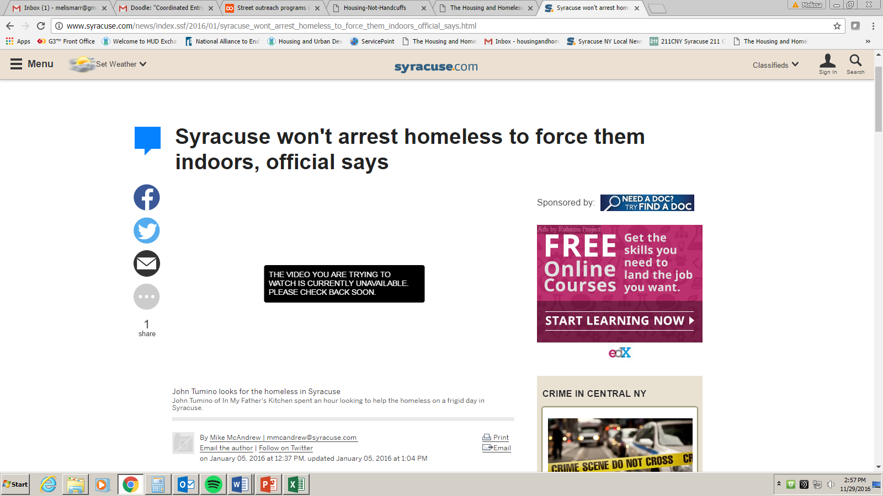
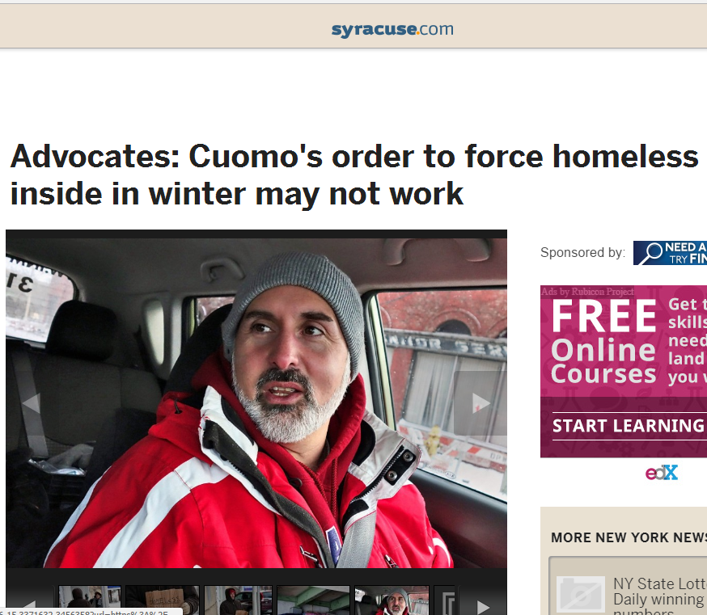
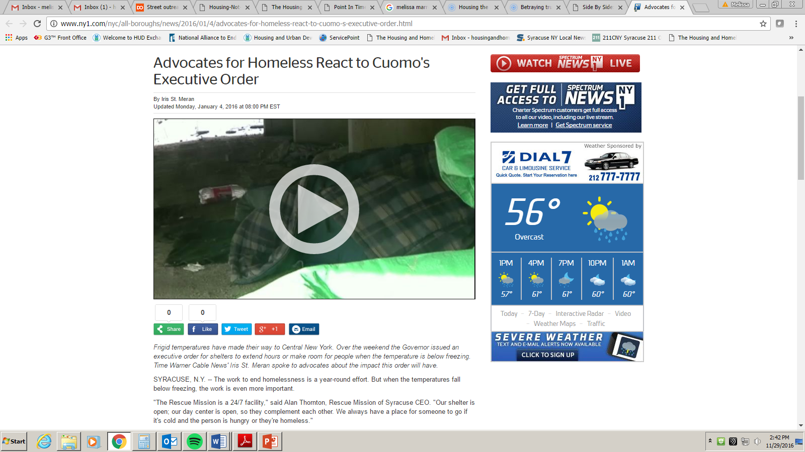
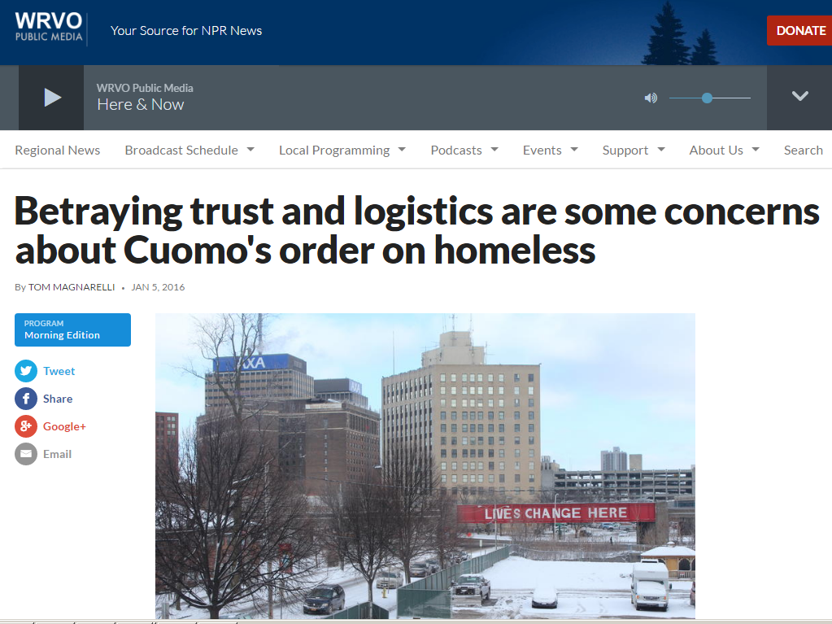
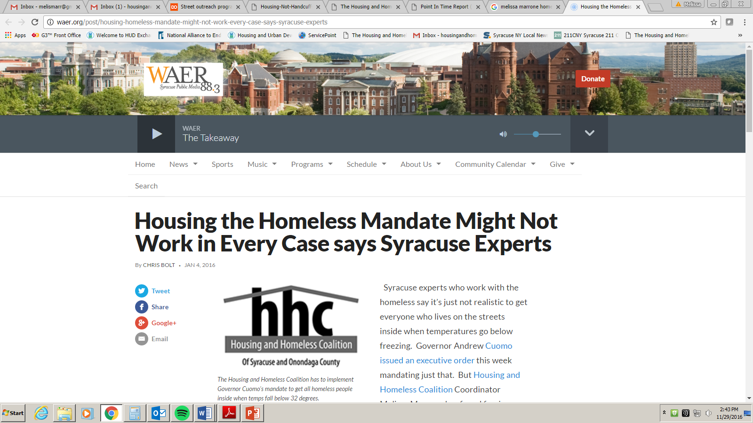
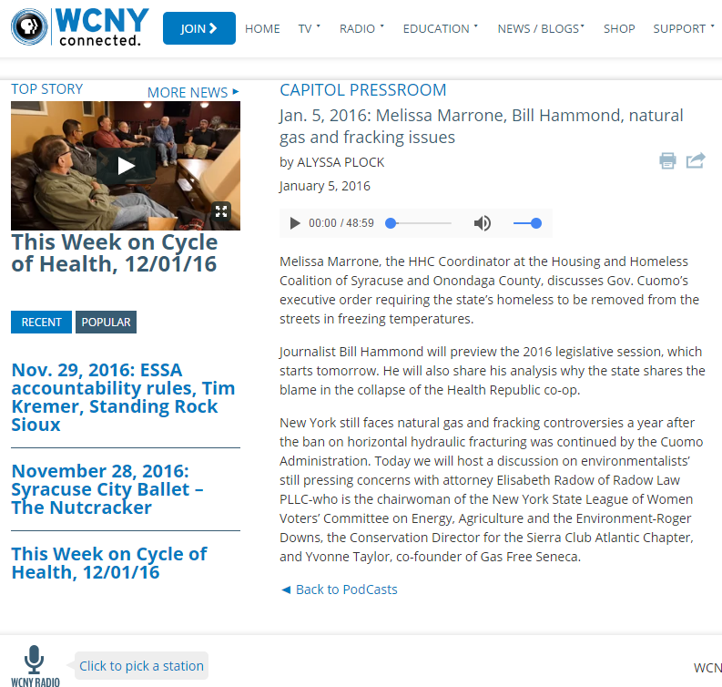

Slide 6
Collaborative Approach
Street Outreach Providers:
  In My father’s Kitchen Street Outreach
  Rescue Mission Homeless Intervention Services (HIS Team)
  The Salvation Army Syracuse Area Services Barnabas Youth Street Outreach
  Trios Model: Hutchings Psych Center, SBH, CHANCE Team, Outreach
Outreach Committee meeting
  Comprised of shelter, outreach, mental health, substance abuse providers as well as SPD, Downtown Committee, Volunteer Lawyers Project and others
Engaged City/County Government, Local Downtown Committee
  The Perfect Partner Award, which recognizes individuals/organizations for advocacy efforts that positively impacts Downtown Syracuse, was presented to the Rescue Mission’s Gary Mann and Jim Hawley, as well as In My Father’s Kitchen’s John and Leigh-Ann Tumino, who embody the mission of their organizations to improve people’s lives through their commitment to changing the way outreach services are delivered to those living with mental illness, substance abuse issues, or homelessness.

Slide 7
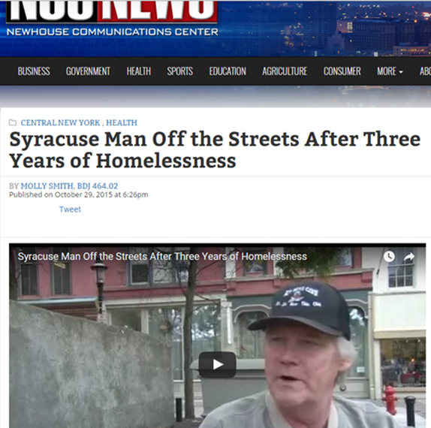
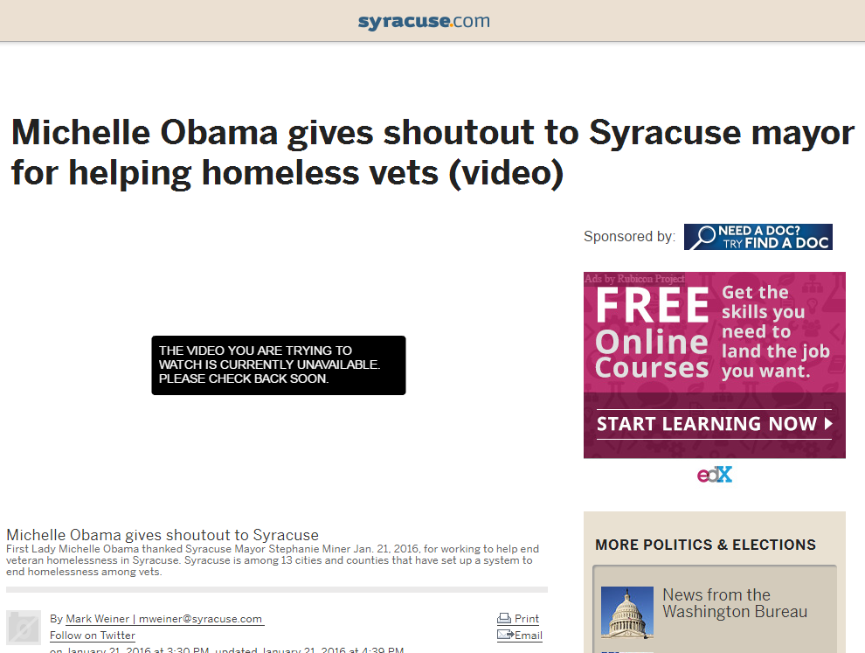
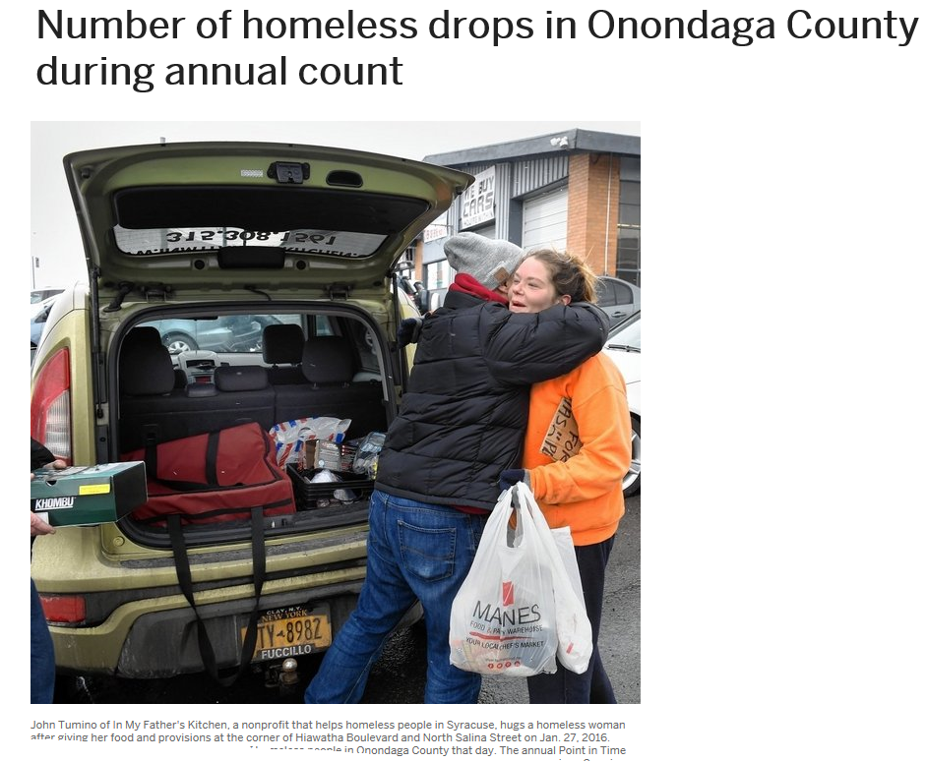
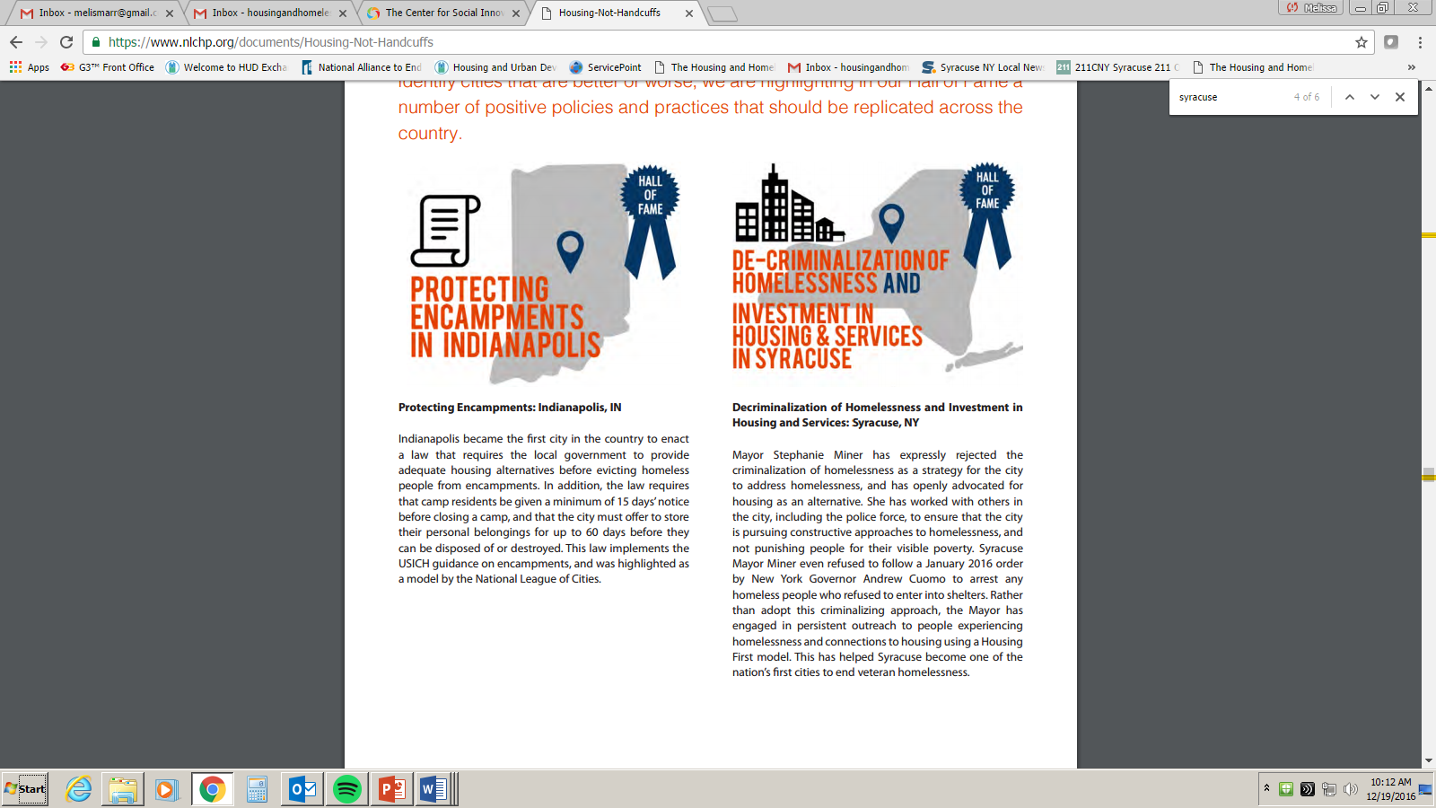
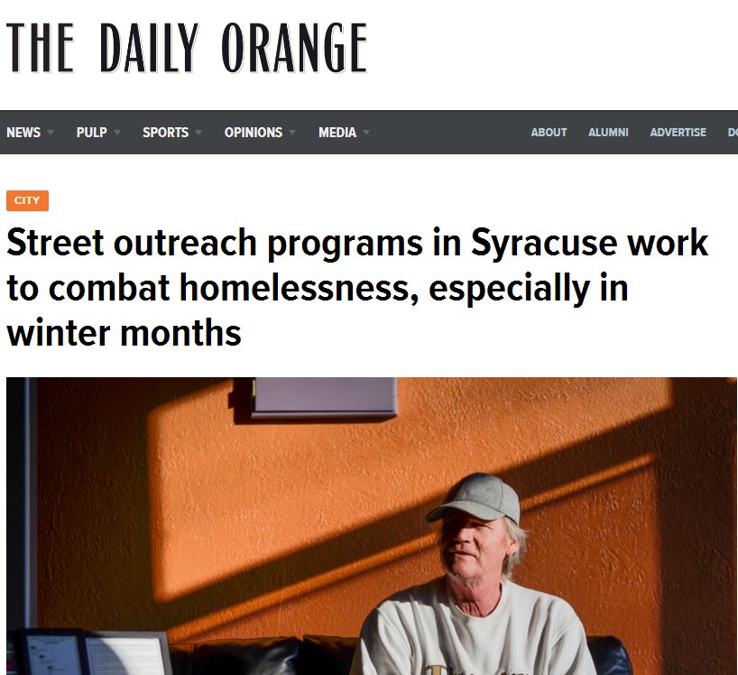
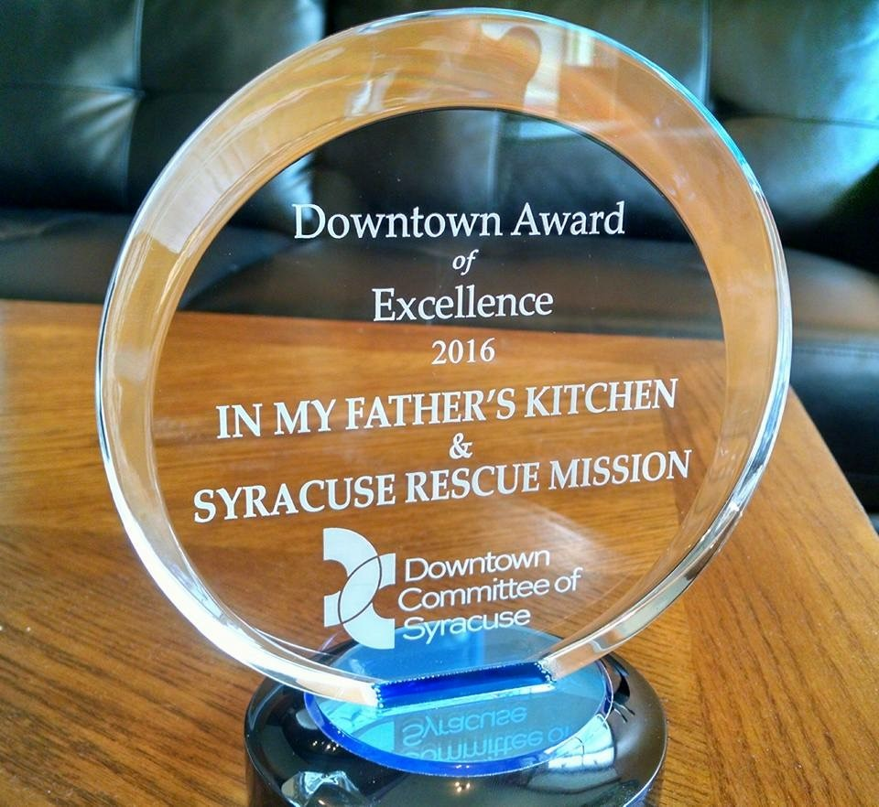
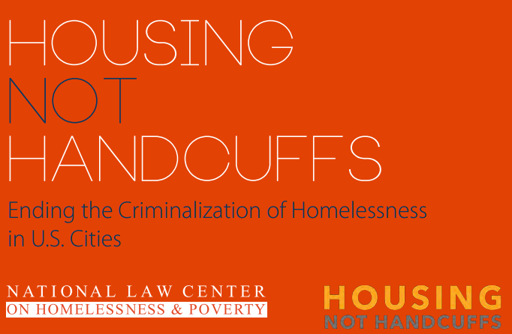

Slide 8

merger with Cayuga County
New Rapid rehousing project
Coordination
HMIS
Technical Assistance

Slide 9
Coordinated Entry
Developed In accordance with HUD’s standards to prioritize the most vulnerable individuals experiencing homelessness for housing
streamlined waitlist for housing
Housing first requirement

Slide 10
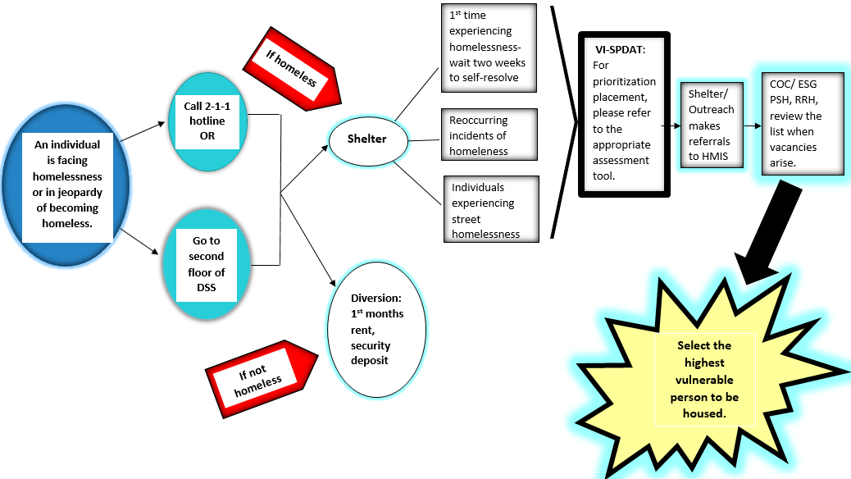

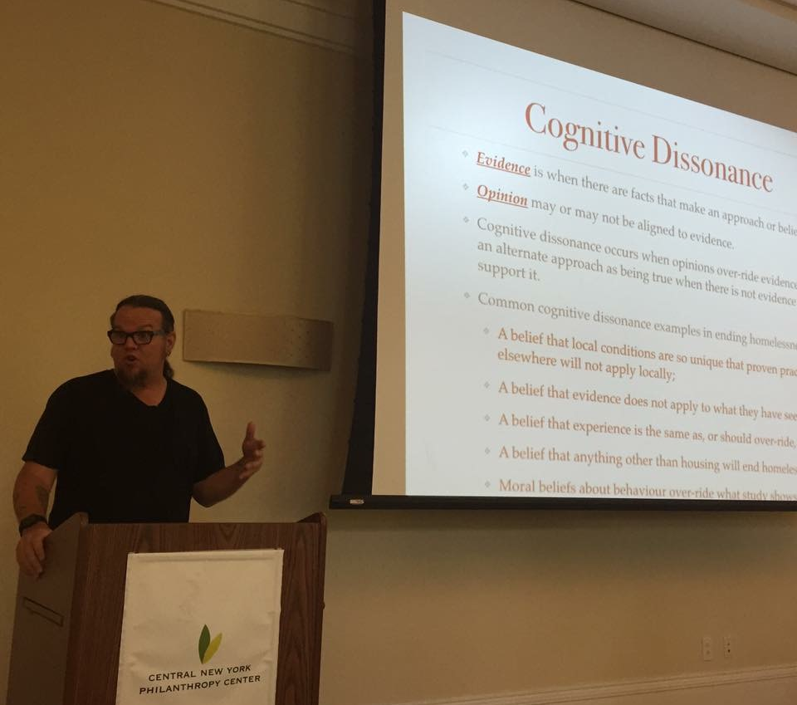

Slide 11
Homeless Management Information System (HMIS)
Oswego County now fully in Hmis
ACR Health, Jamesville Correctional,

Slide 12
Housing
FY 2016 NOFA Completed – Awards to be announced soon
FY2015 CoC Funding Awarded:
  Rapid Rehousing: Catholic Charities, ACR Health (LGBT Youth), OCO, SBH, Salvation Army-youth
  Permanent Supportive Housing: Catholic Charities, SBH, OCO, Liberty Resources
NYS Empire State Supportive Housing Initiative: Christopher Community/St. Camillus, Housing Visions/YWCA, Housing Visions/Salvation Army (Youth and Single Women), RM – Syracuse & Auburn, SHA/Center for Community Alternatives, Catholic Charities, OCO
A Tiny home for Good
Housing Visions Salina Crossing - 49 unit affordable housing complex

Slide 13
Gaps and Needs Survey
Completed by Community Link Student surveying RM Day Center/Meal Services Program and Samaritan Center guests
Themes: Desire for more safe, affordable housing outside of the city with reliable transportation, need for more awareness of resources (211, housing search, legal services), need for more security deposits/furniture, etc. , help finding employment and transportation

Slide 14

Building Partnerships
H2 Initiative - Next meeting scheduled for January 2017
Central Regional Planning Consortium
CNY Works & RRH
Landlord Database
HOPE initiative
Statewide partnerships
McKinney Vento Liaisons
CNY Care Collaborative (DSRIP)

Slide 15
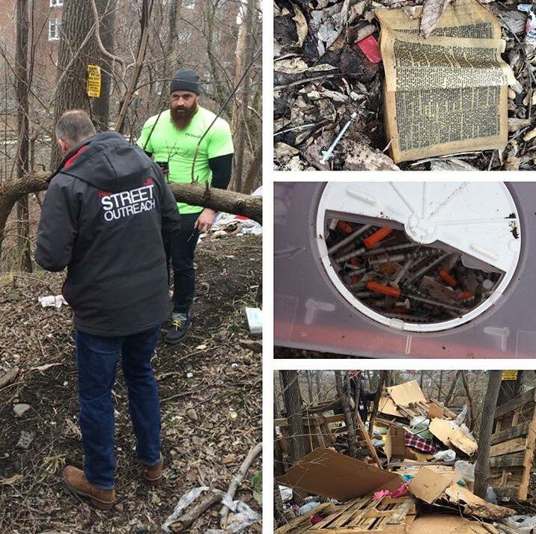
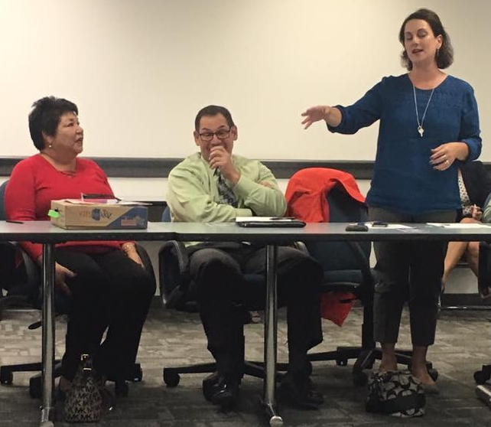
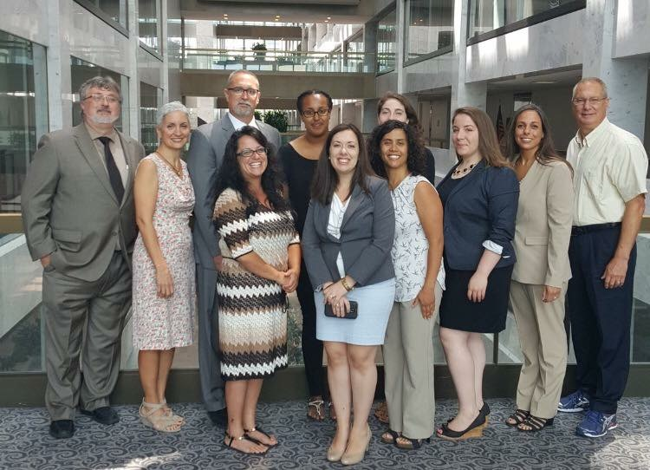
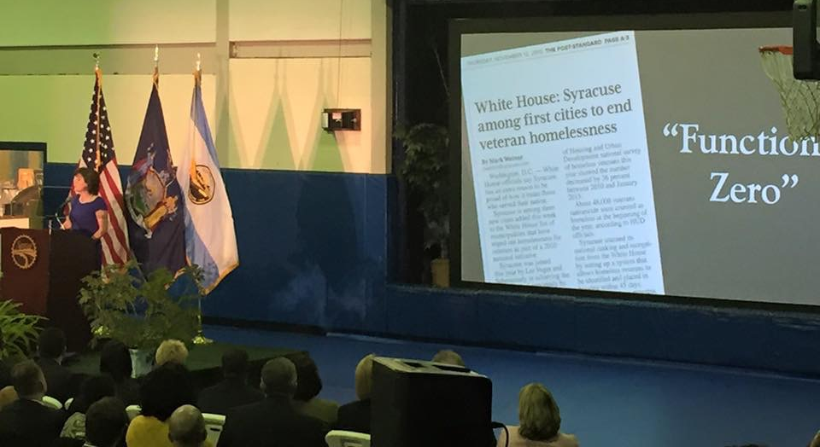
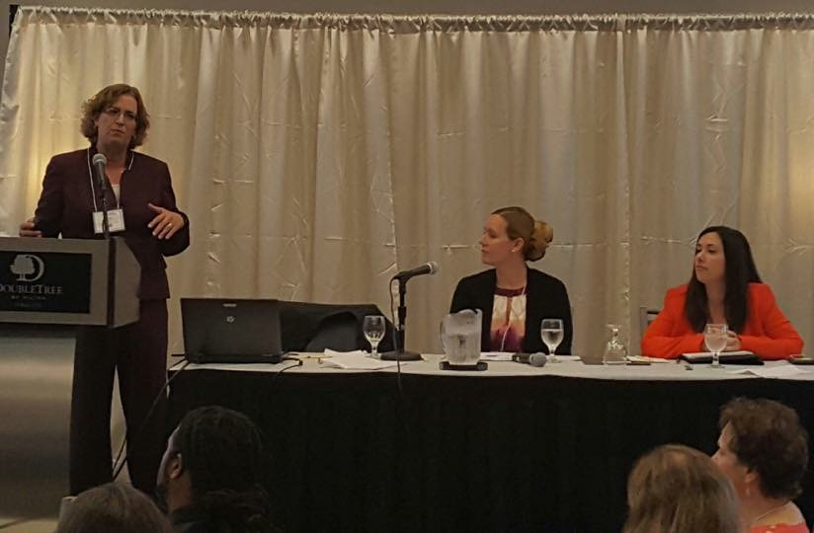

Slide 16
2017 Community Priorities

Slide 17
Data!
Ending Chronic homelessness by the end of 2017
  Need to get an accurate count of everyone who is chronically homeless
Youth homelessness
  Working to get an actual count of every youth who is experiencing homelessness (hud and Mckinney-Vento definition)

Slide 18
Annual Homeless Assessment Report (ahar) data

Slide 19
Point in Time (PIT) count Data

Slide 20

H2 collaborative and SPARC
H2 Collaborative – next meeting in January (full-day) to develop final plan to integrate homeless/housing services into healthcare, criminal justice, mental health systems
SPARC - SUPPORTING PARTNERSHIPS FOR ANTI-RACIST COMMUNITIES
  SPARC

Slide 21
Thank you!

