Slide 1
Housing & Homeless Coalition of CNY: State of Homelessness 2017
December 20, 2017

Slide 2
Housing and Homeless Coalition of Central New York
Restructuring Advisory Board
United Way of Central New York
New Collaborative Applicant
Updated Governance Charter
Executive, Governance/Policy, Program Advocacy Planning and HUD Selection/Performance Evaluation…
Addition of New Staff
Housing Resource Coordinator & Performance Specialist

Slide 3
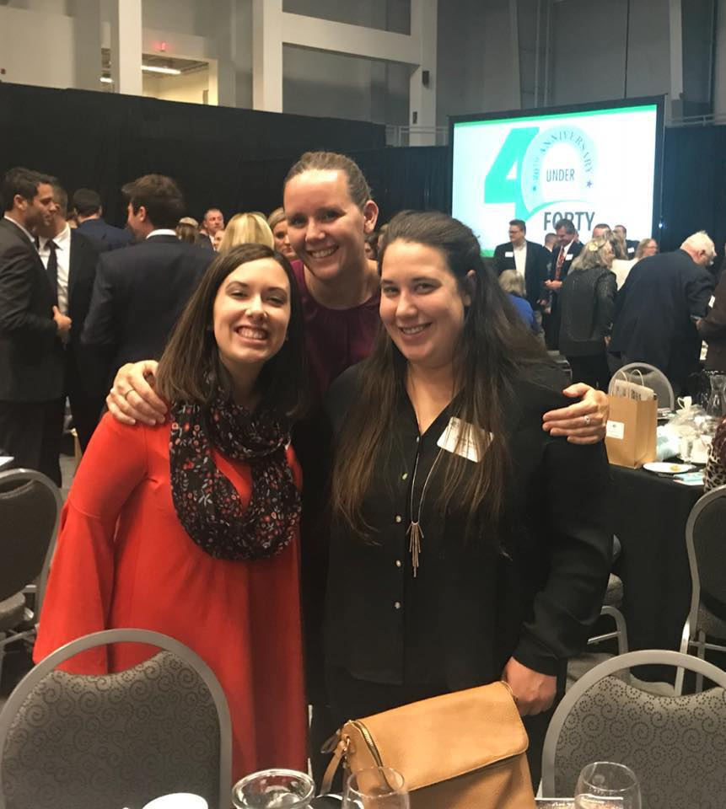
Welcome Megan!

Slide 4
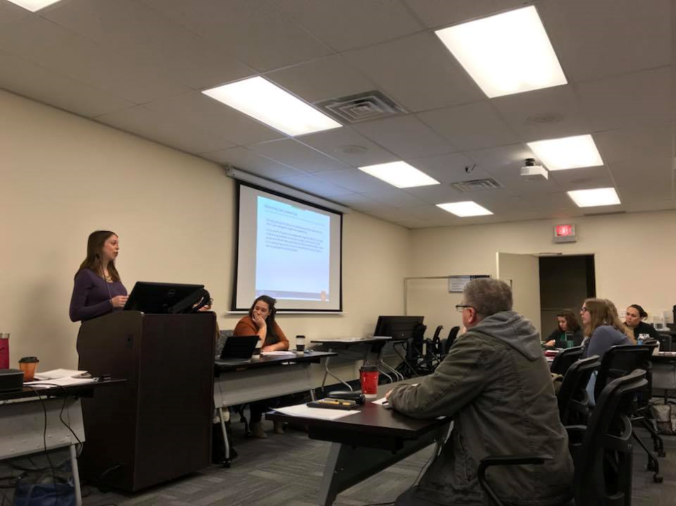
Coordinated Entry
Developed in accordance with HUD’s standards to prioritize the most vulnerable individuals experiencing homelessness for housing
Streamlined waitlist for housing
Housing first requirement
Evidence based assessment
VI-SPDAT, VI-FSPDAT, TAY-VISPDAT
HUD TA assisted in developing and
finalizing our communities’ Written
Standards

Slide 6
Homeless Management Information System (HMIS)
Cayuga County now fully in HMIS
Need agencies and programs were added
Cayuga County Department of Social Services (hotel/motel)
Last House on the Block (Transitional Housing)
All FY-2016 projects were started
Update HUD Data Standards October 1, 2017
Required a lot of Program Specific Data Changes
SSVF, HOPWA, VASH, RHY, and PATH programs
Looking for new Agencies and Programs to come into HMIS in 2018

Slide 7
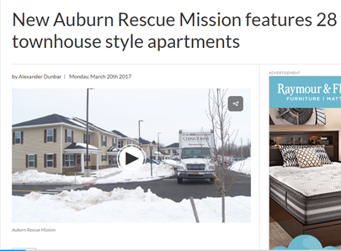
NEW Housing for our community
FY 2017 NOFA Completed – Awards to be announced soon
FY2016 CoC Funding Awarded:
Rapid Rehousing:
Catholic Charities - Rapid Rehousing 2
Syracuse Behavioral Healthcare – FAST Housing
Permanent Supportive Housing:
Catholic Charities – Paths to Success
Syracuse Behavioral Healthcare – KEES IV

Slide 8
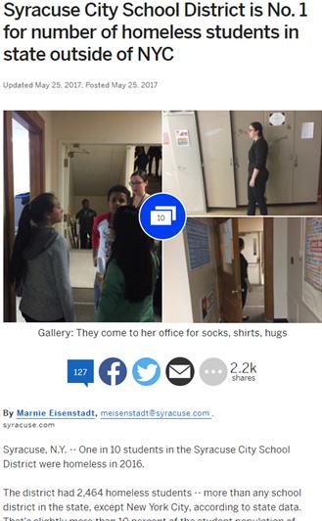
Gaps and Needs Survey
Completed by Community Link Student surveying Youth throughout the CoC
McKinney Vento Liaisons assisted
Low Sample Size/Survey Turnout: 15
Next survey: TBD; Planning/Policy Committee

Slide 9
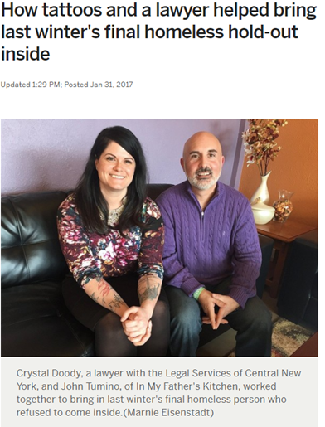
Building Partnerships
Legal Services Street Outreach
Landlord Tenant Judges
Centro
SPARC
Hillside – Children’s Health Homes Programs
Board structure

Slide 10
Data!
Ending Chronic homelessness
Need to get an accurate count of everyone who is chronically homeless
Data Quality and Accuracy is needed
Ending Youth homelessness
Working to get an actual count of every youth who is experiencing homelessness (HUD and McKinney-Vento definition)
Making Data Driven Decisions
SPM, AHAR, HIC, & PIT - Our communities’ tools to find trends in homelessness and find underserved populations

Slide 11
* Total people served is 5196 *Conflict in the Household was #1 reason – 1,209 people *Eviction was #2 – 648 people *There was over 873 people who did not have an answer to this question!

Slide 12
Results Overview…
Eviction as a #2 reason has remained at 12% for the past 3 years.
Data collection needs to be more consistent and eliminate the “missing data” element.
“Conflict in the Household” consistently stays as the #1 reason, but we need more of an in depth look into the meaning behind “conflict.” i.e.: domestic violence, disagreement with rules, etc.
“Chicken Before the Egg” – What happened first?? We need an assessment of homelessness to dig down below the surface and get to the true root of the cause for each client. Does the answer reflect the true cause or is it the person’s perspective?
Recidivism – Look at the client specific cases for Returns to Homelessness and find the reasons.
“Lack of sufficient housing” and “Release From Institution” have remained as the #3 and #4 reason for the past 4 years, but the percentage for each has slowly increased.

Slide 13
Annual Homeless Assessment Report 2017 (AHAR) data
This is the first year we had 98% participation in our Emergency Shelter providers.
As a result the final numbers show and increase in individuals and families served in emergency shelters, but they were all due to an increase in HMIS data entry (Oswego and Cayuga Counties).
We served a total of 5158 people in our shelters in 2017 (individuals and families).
Onondaga County had a decrease in homelessness
4.5% decrease for individuals
14% decrease for families
143 unaccompanied homeless youth in shelters; 20% decrease from 2016

Slide 14
Annual Homeless Assessment Report 2017 (AHAR) data
Onondaga: 3,979
Cayuga: 559
Oswego: 669
Only 49 people were served
In shelters in more than one
County, which is less than 1% of
Emergency Shelter population.

Slide 15
2017 AHAR data conTinued
61% of the people in families who are homeless are children under 18 years of age (1,077 children).
51% of those children are under the age of five (554 children)
31% of adults in family households reported having a disabling condition.
55% of single adults reported having a disabling condition.
60% of all people entering Emergency Shelter leave in less than 90 days.
Household Size:
2 Person 26%
3 Person 28%
4 Person 21%
5 or more Persons 25%

Slide 16
2017 AHAR data continued
Race Statistics of Homeless Families
62% People of Color and 38% white
Race Statistics of Homeless Individuals
53% People of Color and 47% white
Overall Race Population Stats (2014)
White 80%, People of Color 20% (Onondaga)
White 92%, People of Color 8% (Cayuga)
White 96%, People of Color 4% (Oswego)
Combined stats: 81% White; 19% People of Color
This is a 37% race disparity in homelessness in our CoC.

Slide 17
2017 AHAR data continued

Slide 18
2017 AHAR data continued
Transitional Housing (TH)
Families in TH has increased 56%.
Individuals in TH has decreased 10%.
This is partially due to a decrease in TH in our community.
Permanent Supportive Housing (PSH)
Families in PSH has increased by 11%.
Individuals in PSH has also increased by 17%.
Both increases are a result of an increase in PSH beds in our community.
Race in PSH
PSH for Individuals: 52% white, 48% person of color
PSH for Families: 40% White, 59.5% person of color, .5% missing data

Slide 19
2017 AHAR data continued

Slide 20
Point in Time (PIT) count Data
HMIS reported 519 individuals residing in shelters and/or hotels in CoC (Oswego, Cayuga, and Onondaga Counties).
Family homelessness has decreased this year by 28%; 46 families (134 people).
Chronic Homelessness decreased by 30% from 2016
28 people were unsheltered.
Youth homelessness remained the same, but for unaccompanied single youth increased 18% and parenting youth decreased by 34%

Slide 21
PIT Data 2017

Slide 22
SPARC - SUPPORTING PARTNERSHIPS FOR ANTI-RACIST COMMUNITIES
Three initiatives:
Trauma Informed Care
Economic Mobility
Quality Housing Stock
Justice is not something you pray for. It's something you implement.
Submitted all HMIS Data from 2011 to 2017 for analysis
Report released shortly
Upcoming conference in February

Slide 23
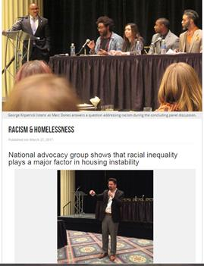
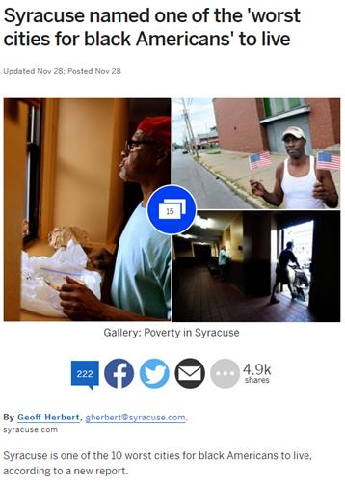
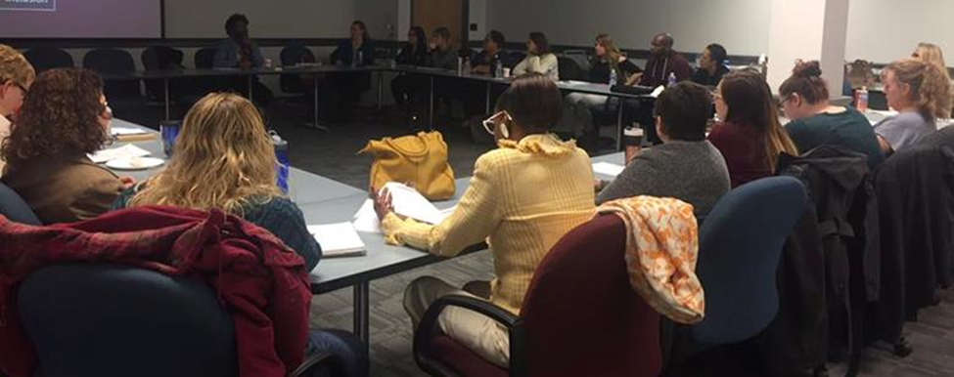
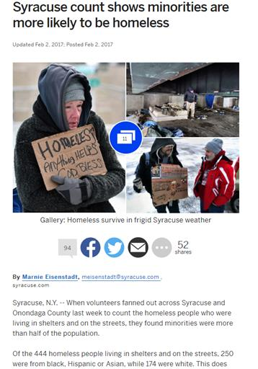
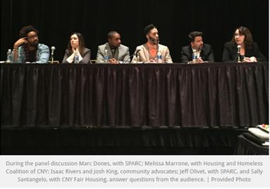
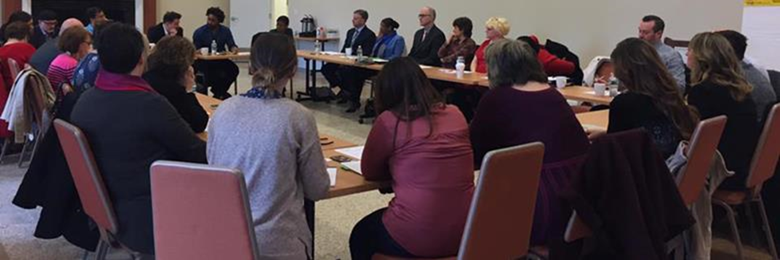

Slide 24
Advocacy
Supportive Housing Network of New York – statewide advocacy
National Alliance to End Homelessness – national advocacy
Meeting with Congressman John Katko
Meetings with Lynne Patton; HUD Region 2 Administrator

Slide 25
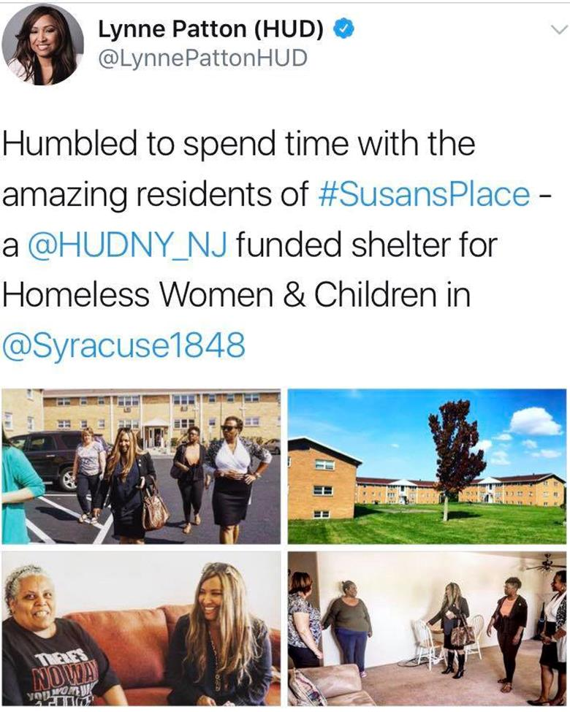
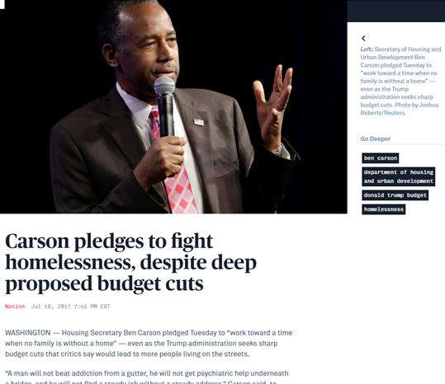
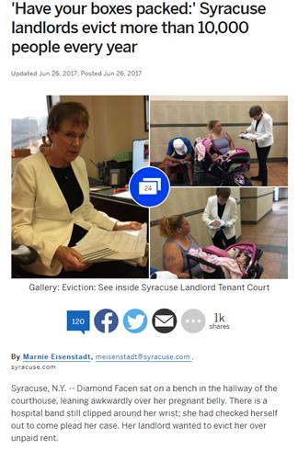
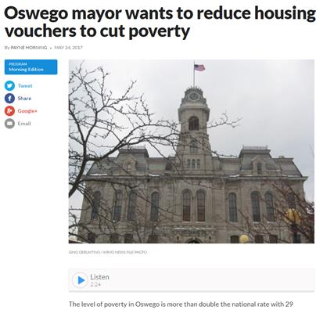
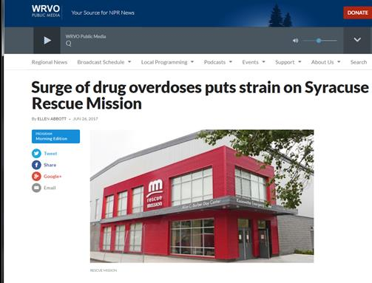

Slide 26
Thank you!
Melissa Marrone – mmarrone@unitedway-cny.org or 315-428-2216
Sarah Schutt – sschutt@unitedway-cny.org or 315-428-2218
Megan Stuart – mstuart@unitedway-cny.org or 315-428-2224

