Slide 1
Housing and Homeless Coalition of Central New York
Annual State of Homelessness
Notes:
Welcome everyone-
Electeds:
Helen Hudson

Slide 2
Agenda
Welcome & Introduction to the HHC
Presentation
Racial Equity and Homelessness – Sherrain Clark
Presentation
Trends in Homelessness Before and After COVID-19- Fred Hintz and Sarah Schutt
Presentation
Main Takeaways- Megan Stuart
Question & Answer

Slide 3
Housekeeping
All participants are muted
Use the Q&A to ask questions
The presentation is being recorded and will be posted to our website

Slide 4
Who We Are
Coalition of organizations across Onondaga, Oswego, and Cayuga counties
Mission to end homelessness and housing vulnerability in our three-county region
Act as HUD’s Continuum of Care (CoC) which brings over 9 million dollars in housing programs to our community
Foster community collaboration
Operate and oversee the homeless management information system and operate the community’s Coordinated Entry System
Notes:
Before we dive into our presentations, I’ll begin by telling you a little bit about the coalition. The Housing and Homeless Coalition of Central New York is a coalition of organizations across three counties- Cayuga, Onondaga, and Oswego. Our mission is to end homelessness and housing instability in Central New York. The Coalition acts as HUD’s Continuum of Care for homelessness in the region, bringing 9.75 million dollars in housing programs into our community. We also operate and oversee the Homeless Management Information system and the Coordinated Entry systems.

Slide 5
Our Core Values
Housing is a human right
Housing First
Homelessness can be ended
Notes:
These guiding principles inform all of the work we do at the HHC. We believe that housing is a fundamental human right- that everyone deserves a safe and stable place to call home.
Now more than ever, we remain committed to housing first which is an evidence based method of providing housing so people are able make goals and address barriers once housing has been secured.
And finally, we believe that homelessness can be ended. Through collaboration and investment into safe, affordable housing, we truly believe that homelessness will no longer exist in our community.

Slide 6
How We Do Our Work
Incorporating the Voices of People with Lived Experience
Being Data Driven
Working Together to Create Solutions
Notes:
There are three important ways we do our work.
Today you’ll hear audio from our client advisory board throughout the staff presentations talking about their experiences with homelessness. You’ll hear the voices of Angela Hightower, Martha Ehlert, Rex Beverage, and Edgar Hughes. We believe that centering people with lived experience is the most effective way to make policies and solutions that will work for the people who use them.
Also imperative in creating effective housing policies is being data driven and using data to ensure that our system is performing well. Later on, you’ll hear about the ways we’re doing just that.
And last but not least, partnerships and collaboration are everything in this work. We are extremely grateful to our partners and the opportunities for cross sector collaboration. Collaboration is the one thing that truly sets us apart from most other communities seeking to end homelessness.

Slide 7
A Look at 2020
A commitment to racial justice
Trends in homelessness data before and after COVID-19
Notes:
Our presentation this year is going to be a little different than in years past. 2020 has been a challenging year in more than ways than one. COVID-19 and our nation facing its systemic racism has impacted everyone, especially people experiencing homelessness. We at the HHC have worked over this past year to respond to both the pandemic and housing injustice in our community. Our presentations this year will focus on these two topics.
First I’ll hand it over to Sherrain, who will do a deep dive into racial equity and homelessness. After that Fred and Sarah are teaming up to look at our trends in homelessness and the HHC’s response to COVID-19.
Please remember to ask questions in the Q&A throughout the presentations as we have dedicated time to responding after our presentations.

Slide 8
Racial Equity and Homelessness

Slide 9
Equality vs equity: equality is the practice of giving people the same exact thing, equity gives people what they need to be successful
Notes:
It is important to recognize that every person has a different story, a different background
People from different races typically have different experiences and the accessibility to resources are often different which results in different groups having different needs. Some need more support to overcome barriers, to be successful and make it to the top as the illustration shows.
Edgar will now share with us some of the barriers that he has faced.

Slide 10
Targeted Universalism
Goal: End homelessness for all
Performance measure: The number of BIPOC experiencing homelessness is larger than the number of white people
Different groups have different barriers to overcome
Notes:
We as a community, as a nation need to take a targeted universalism approach to help everyone overcome barriers. Targeted universalism is a process in which targeted strategies are put into place to reach universal goals, and our goal is to end homelessness for all! Im going to repeat that, our goal is to end homelessness for all!
This is where we will need to consider the different barriers that different groups are up against especially those of specialized populations

Slide 11
Definitions
Nationally, Pacific Islanders are 9x more likely to experience homelessness than white people, Native Americans are 4x, and African Americans are 3x more likely
Systemic Racism: A form of racism that is embedded as normal practice within society or an organization
Notes:
We will now hear from Angela
What Angela has expressed is in fact true
There is a racial disparity in the homeless population nationwide.
Due to systemic racism which is….””
There are disparities of generational wealth, there is a disparity with education and employment opportunities, criminal justice, housing redlining, healthcare, and others

Slide 12
Definitions
Racial Trauma Informed Care: Practices that promote a culture of safety, empowerment, and healing and fully incorporates an understanding of racial trauma and culturally appropriate healing practices
Cultural Competence: Ongoing process of self exploration and self critique combined with a willingness to learn from others. Honor others’ beliefs, customs, and values
Notes:
It is really important that our staff are trained on racial trauma informed care and cultural competence
We need to be able to acknowledge and accept differences

Slide 13
Definitions
Othering: A set of common processes that engender marginality and persistent inequality across any other full range of human differences. The failure to recognize someone's full humanity at the conscious, unconscious, or structural level
Neutrality- The state of not supporting or helping either side in a conﬂict or disagreement
Notes:
We should be aware of othering
neutrality-Absence of decided views, expression, or strong feeling.
We cannot just remain neutral we have to examine our own system and identify disparities within our community

Slide 14
SPARC Goals
Building anti racist organizations
Elevating the voices of people with lived experiences
Equity based assessment and prioritization data
Focusing on specific at risks groups
Using data with a racial equity lens
Cross sector collaboration
Long term solutions
Notes:
We are a SPARC community, what does this mean? We have partnered with The Center for Social Innovation to examine the racial dimensions in our area. SPARC stands for Supporting Partnerships For Anti-Racists Communities. As a community we have collectively come up with the following goals

Slide 15
Building anti racist organizations
Require all CoC and ESG funded agencies to have anti racism policies and practices in place
Provide equity, fair housing, and trauma informed care training to frontline workers
Hire more BIPOC in senior-level positions including executive level and increased board diversity
Notes:
HHC has added an equity question in our monitoring process
Check quality of service by getting client’s perspective

Slide 16
Elevating the voices of people with lived experience
Create and facilitate lived experience boards
Board electives from the lived experience board, act as representatives on the full CoC board
Create panels for board members
Provide advocacy training for board members and advocate to government officials
Notes:
We have a client and youth advisory board
What does this mean?
Members from the board participate in the CoC decision making process
Their voices are used to shape policies and funding decisions

Slide 17
Equity based assessment and prioritization, data
Length of time homeless trump VI-SPDAT score when prioritizing
Eventually eliminate the VI-SPDAT
Create an equitable Coordinated Entry system by developing a new tool that lessens the racial disparity by accurately assessing vulnerability
Notes:
We currently use the VISPDAT to help with prioritizing those who are the most vulnerable in our homeless population
vispdat stands for- vulnerability index service prioritization decision assistance tool
Length of time..
We have analyzed the VI-SPDAT for racial equity disparities
The vispdat is not perfect which is why we plan to eventually eliminate
Review and change Coordinated Entry policies annually

Slide 18
Focusing on specific at-risk groups
Youth homeless including McKinney Vento
Partner with school districts, juvenile justice system, foster care, to address barriers causing youth homelessness
Ensure youth experiencing homelessness are connected to specific housing focusing on racial disparity and LGBTQ
Assess youth data for disparities
Notes:
Apply for Youth Homeless Demonstration Project funds
We have a Runaway homeless youth committee
We are planning to focus on our most marginalized populations using the targeted universalism approach
Edgar will now speak on challenges he faced as a youth

Slide 19
Using data with a racial equity lens
Assess entire homeless service system annually for racial disparity by developing policies and procedures for assessing data annually as part of the formal operations of the CoC
Conduct census tract diversion, collect census tract data and compare against homelessness data-diversion efforts can be better targeted to vulnerable neighborhoods
Conduct an annual presentation of data assessment and report on correlation between census tract and homelessness
Using data to identify and address any existing racial disparities, identify projects or aspects that perpetuate racial inequity
Notes:
In the near future we plan to conduct census

Slide 20
Cross sector collaboration
Partner with healthcare providers, insurance companies’, and health home care managers
Private sector collaboration and coalition partners
End the healthcare disparity by ensuring that BIPOC have access to healthcare
Notes:
We will now hear from Martha on her experiences with healthcare and homelessness
We are hoping that these collaborations will build a bridge so that people are not being discharged without having stable housing to return to

Slide 21
Long term solutions
Increase affordable housing
End the disparity of BIPOC entering homelessness system
Increase the number of color in leadership positions
Have a community dedicated to anti-racism
Notes:
How do we accomplish our goals?
We as a community must understand implicit bias and remove stereotypes
We must be culturally competent
We must create a space were those who have experienced racial trauma is at the table and are able to tell their story, are able to be heard and know their voice counts
We must create a space of belonging for all people
The goals we have created as a community should help us overcome systemic racism and eliminate racial disparities
I will now hand it over to Sarah and Fred to share with you trends in homelessness

Slide 22
Trends in Homelessness in 2020 Before and After COVID-19
Housing and Homeless Coalition
Annual State of Homelessness

Slide 23
Where we were with System Performance in October 2019
First Time Homeless numbers were decreasing consistently
Yearly Numbers of people experiencing homelessness each year continues to decrease
Returns to Homelessness over 2 years was staying at 32%
Average Length of Time people were remaining homeless had a slight increase from 52 days to 54 days
Notes:
Positive Outcomes - Inflow is decreasing,
Areas we still need improve on – Returns/ Average LOT - still having difficulties placing high need people

Slide 24
How we were doing before COVID-19
16% decrease in homelessness in January 2020 PIT count

Slide 25
2020 PIT Subpopulations
Increase in many of the high-risk subpopulations
Victims of Domestic Violence increased by 29% (21 ppl)
Substance Use Disorders increased by 22% (19 ppl)
Mental Illness increased by 16% (19 ppl)
Chronically Homeless increased by 39% (21 ppl)
What does this mean?
Need for more supportive housing to assist people with more complex needs.
Shortage of at least 39 new chronic PSH beds to keep up with inflow
1,922 homeless adults this year had a disability and would be eligible for Supportive Housing
Notes:
Note that despite decreases in overall population, increases in proportion with mental illness and substance abuse
Chronic PSH number comes from : 207 exits from PSH in FY2020, 246 chronically homeless persons)

Slide 26
COVID-19 and homelessness
What happened?

Slide 27
Initial Community Response
Working closely with LDSS & Health Department to develop a comprehensive community plan to address the pandemic
Assisting agencies and programs to continue to provide services to the homeless
Development of COVID screening tools/ Assessments in HMIS to track positive cases and quarantine need
Development and sharing of information and resources with all community agencies, engaging 2-1-1 crisis line to assist with this
Notes:
Include Edgar’s Clip

Slide 28
State and Federal Response to the COVID Pandemic
Changes in HUD regulations for housing providers
Addition and approval of Eviction Moratoria which are still in effect
New Funding provided for communities for Emergency Solution Grant (ESG) programs, Street Outreach, Emergency Shelter, Homeless Prevention & Rapid Rehousing, as well as CDBG funds for housing assistance

Slide 29
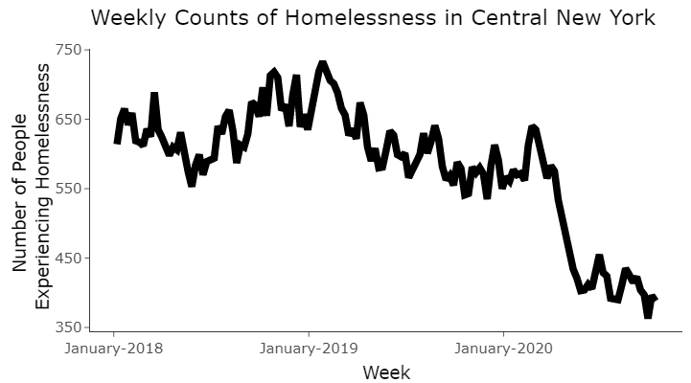
How did COVID-19 affect Emergency Shelter numbers?
2018 low: 553
2019 low: 541
2020 low: 363
Notes:
Big reductions
There is usually a summertime-fall dip, but this year was especially pronounced
However, also reduced outflows into housing programs because of fewer housing units available

Slide 30
What we were seeing…
Start of COVID-19 Pandemic

Slide 31
How will COVID-19 affect homelessness in the next year?
Inflow into system
End of eviction moratoria –Increased risk of homelessness
Expect to be pronounced in vulnerable census tracts
Placement of clients
Housing units are less available due to the eviction moratoria and restrictions on viewing and inspection

Slide 32
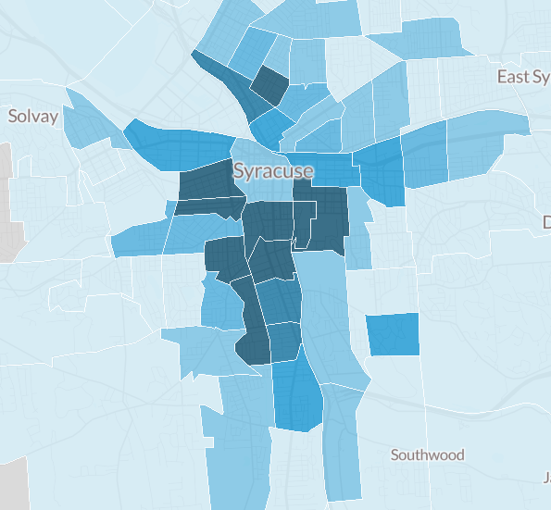
Notes:
Housing Vulnerability Index –Urban Institute
9 census tracts in Syracuse are in the top 5% in NY state of tracts most likely to need emergency rental assistance.
urban institute released rankings of the census tracts in new York state using data on poverty, severely cost-burdened low-income renters, renter-occupied housing units, and unemployment

Slide 33
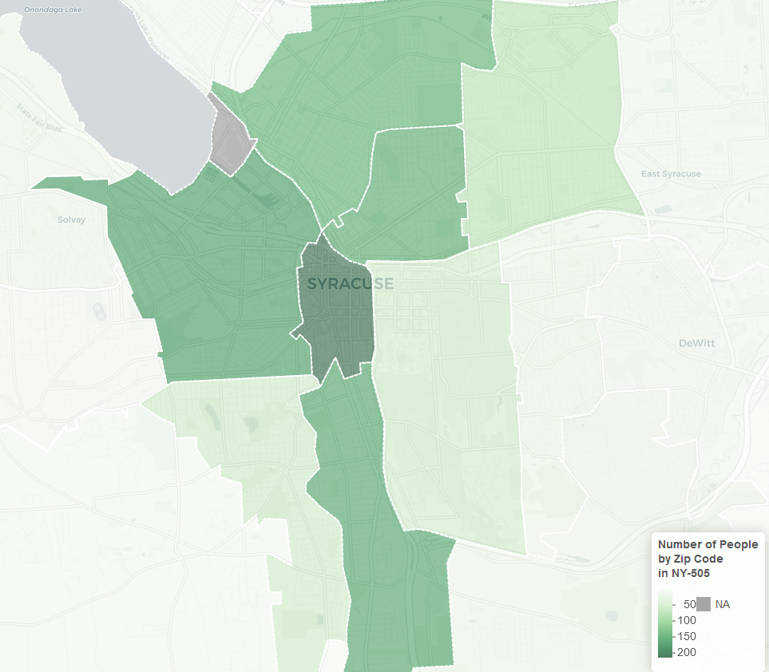
Zip code of last permanent address of homeless shelter residents
Notes:
Our Locally collected data bears this out – Shelter clients’ last permanent address is mainly the north, near-west, and south sides of the city

Slide 34
Housing Vulnerable Areas in Onondaga County
Approximately 4,000-5,000 people have extremely low incomes* and rent housing in these high-risk census tracts
Most pay more than 50% of their income in rent
20,000 people across all of Onondaga County are estimated to be extremely low income renters
*Extremely low income in CNY:
<$15,950/year for 1 person
<$26,200 for a family of 4
Notes:
Housing was already tough for them
Severely cost-burdened low-income renters (add example of extremely low incomes)
In each of these census tracts the majority of low-income renters pay more than 50% of their income in rent
High unemployment
High poverty rates
Lack of health insurance
Higher percentages of these census tracts are also Black, Hispanic, and new americans
Add Martha Clip here

Slide 35
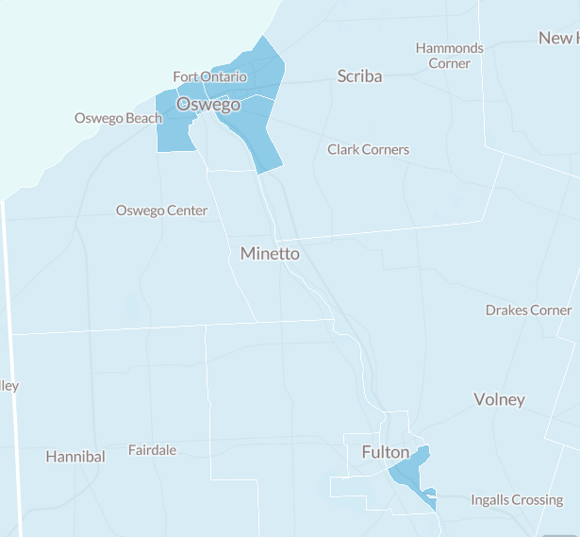
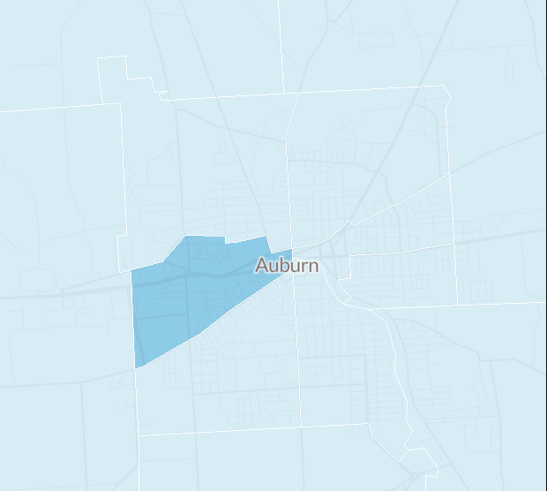
Housing Vulnerable Areas in Cayuga and Oswego Counties
2000 people in Cayuga county are extremely low income renters
4300 people in Oswego county are extremely low income renters

Slide 36
How do we prevent homelessness for vulnerable households?
Research shows that eviction increases risk of homelessness, but is not typically the direct cause
Target people where they stay before entering shelter
Notes:
Rex

Slide 37
Notes:
Rex + Angela clips here

Slide 38
How are we preparing to assist people at high risk of homelessness due to COVID?
Targeted homelessness prevention programs
Centralized intake line at Onondaga and Oswego DSS
Prioritizing people in high-need census tracts
Prioritizing people who are doubled up to focus on people imminently going to shelter
Special program to assist households who lost income due to covid-19
Legal Aid programs to advocate for low-income tenants and utilize CDC moratoria
Move vulnerable people out of shelter as fast as possible
Increased Rapid Rehousing capacity
Prioritizing people susceptible to COVID-19

Slide 39
Main Takeaways
Need strategic investment in housing, especially supportive housing for the most vulnerable members of our community
01
Need to ensure that racial equity is centered in decision making and policy creation
03
Need to prepare for unprecedented number of people facing housing insecurity
02
Notes:
Here are the main takeaways that we are taking into 2021.

Slide 40
Supportive housing pipeline at risk
In 2016 Governor committed to creating 20,000 units of supportive housing over next 15 years STATEWIDE – the Empire State Supportive Housing Initiative (ESSHI)
ESSHI was the first multi-year commitment to creating supportive housing outside NYC
2016-2020: State funded first 5 years/6,000 units
The first five year commitment is expiring this year
Advocates are pressing the Governor to re-commit to ESSHI in this year’s budget
Notes:
In 2016 Governor Cuomo committed to creating 20,000 units of supportive housing over the next 15 years statewide. This was the first multi-year commitment to creating supportive housing outside of New York City. The first five year commitment is expiring this years and we are advocating for the Governor to re-commit to ESSHI. The development of supportive housing is necessary in both the response to COVID-19 and in ending homelessness. This funding gives us the ability to create more supportive housing for our most vulnerable people experiencing homelessness, including those with disabilities, the frail/elderly, and people with substance use disorders.

Slide 41
Expand Targeted Homeless Prevention Efforts
Use the data and evidence from current homeless prevention projects to better target people most likely to end up in emergency shelter
Continue to advocate for expansion of homeless prevention funding and emergency rental assistance and eviction prevention
Notes:
We need to use the information we are gathering from the existing projects to continue reaching our most vulnerable populations.
We are also advocating for additional Emergency Solutions Grant funding to expand homeless prevention, rapid rehousing, shelter and street outreach programs in our community.
Also necessary in the response for COVID-19 is emergency rental assistance and eviction prevention. When the eviction moratoria are lifted, renters will be faced with substantial amounts of back rent owed creating housing instability.

Slide 42
Centering Racial Equity
Centering racial equity needs to be part of assessing existing projects and the creation of new ones
Notes:
When our system works for the most marginalized groups, it works for everyone.

Slide 43
Thank You to Our Partner Agencies
Notes:
The HHC staff are simply the mouthpiece of all the incredible work that is done by our partner agencies in this community. This community is incredibly strong and collaborative which is why we have been so effective in decreasing homelessness. We will rely on these partnerships as we tackle the challenges that lay before our community in the months ahead.
We would also like to thank the United Way of CNY for making the HHC one of its initiatives and giving the HHC a home.

Slide 44
Special Thanks to our Client Advisory Board
Storytelling is the most powerful way to put ideas into the world today.
Notes:
And last but certainly not least, I want to thank our Client Advisory Board who were willing to share their stories with us. I want to leave you with some final thoughts from Martha, Angela, Rex, and Edgar.

Slide 45
Q&A

