Slide 1
Governance Charter: Updates 2018

Slide 2
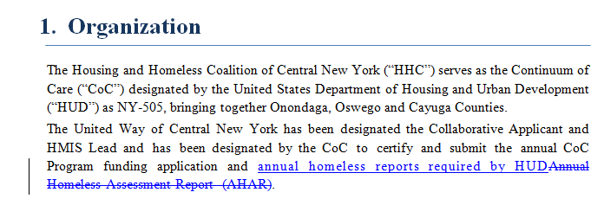
Page 1

Slide 3
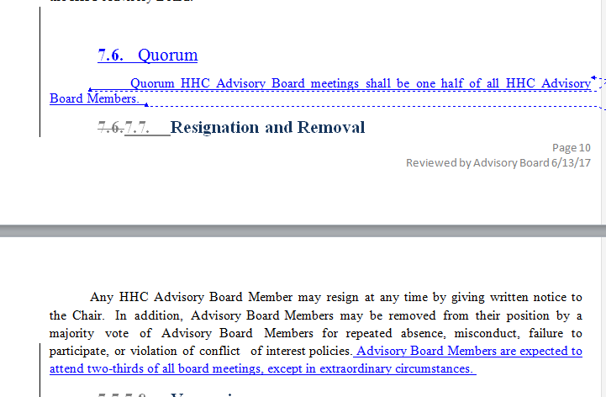
Pages 10-11

Slide 4
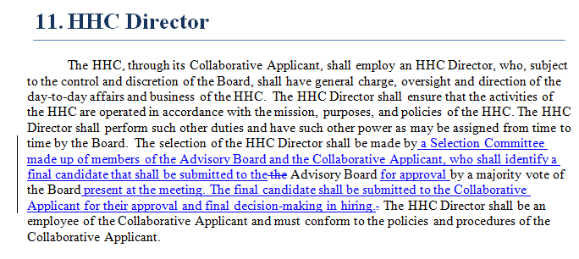
Page 14

