Slide 1

Point in Time Count & Housing Inventory Count Final Report 2018

Slide 2
What is a Point in Time Count?
The Point-in-Time (PIT) Count is a count of sheltered & unsheltered homeless persons on a single night in January.
HUD requires that CoCs conduct an annual count of homeless persons who are in emergency shelter, transitional housing, and Safe Havens on a single night as well as unsheltered (places not meant for human habitation).

Slide 3
How the Count was Administered
On Wednesday, January 24, 2018.
The day of the Count, In My Father’s Kitchen asked people who were outdoors where they will be sleeping that night. Canvassing confirms this the evening of the count.
Over 100 volunteers went out from 7:00pm to 12am and canvassed in Onondaga, Oswego, and Cayuga Counties (mainly known locations: bridges, encampments, transportation centers, hospitals, etc.)

Slide 4
The Next Day
Drop in Centers/Day Programs/Soup Kitchens, etc. surveyed people to determine if slept in places not meant for human habitation the night before.
The information gathered above was checked against HMIS to confirm whether or not these individuals were in shelter the night of the Count.

Slide 5
Youth PIT Data
This year we attempted a second time to get a true picture of what youth homelessness looks like in our CoC
Challenges:
Low participation
Missing data elements
Data elements differ
Next year the data collection for schools is changing.
HHC Staff is working to connect to School district administration to create more buy-in in data collection

Slide 6
Last Year’s Count, 2017
HMIS reported 532 individuals residing in shelters and/or hotels in CoC (Oswego, Cayuga, and Onondaga Counties)
Family homelessness has decreased this year by 23%; 49 families (144 people)
Chronic Homelessness decreased by 28%
Unsheltered number for CoC is 28
Youth homelessness remained the same, but for unaccompanied single youth increased 9% and parenting youth decreased by 54%

Slide 7
2017 Point in Time
 | Sheltered | Unsheltered | Total
Individuals | 532 | 28 | 560
Households | 49 | 1 | 50
Adults | 382 | 22 | 404
Youth (24 & under) | 150 | 6 | 156

Slide 8
This Year’s Count, 2018
HMIS reported that there were 547 individuals residing in shelters and/or hotels that evening. This was up from 532 in 2017, partially because of more data by 2 different shelters being added.
51 unaccompanied youth were in shelter (10 under 18 years of age, 41 youth 18-24 years old)
This was down by 6% from 2017
Family homelessness has decreased this year by 8%; 42 families (132 people)
Unsheltered number for CoC is 12. This was a 57% decrease, but the temperature was ~ 20 degrees colder this year.

Slide 9
2018 Point in Time
 | Sheltered | Unsheltered | Total
Individuals | 547 | 12 | 559
Households | 42 | 0 | 42
Adults | 408 | 12 | 420
Youth (24 & under) | 139 | 0 | 139

Slide 10
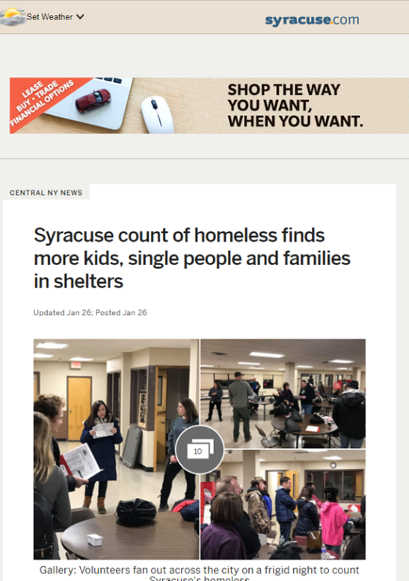
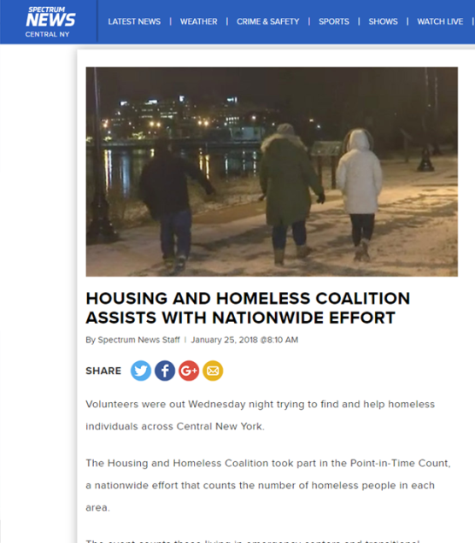
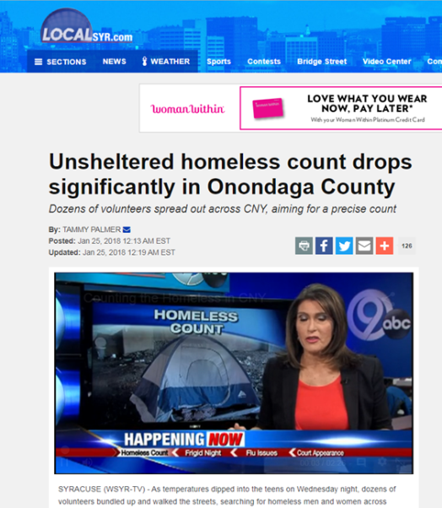
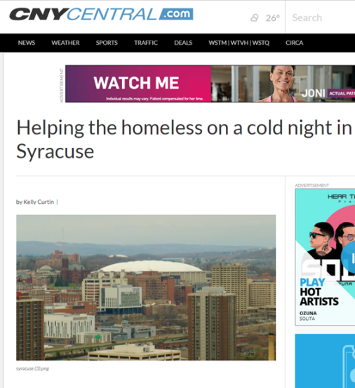
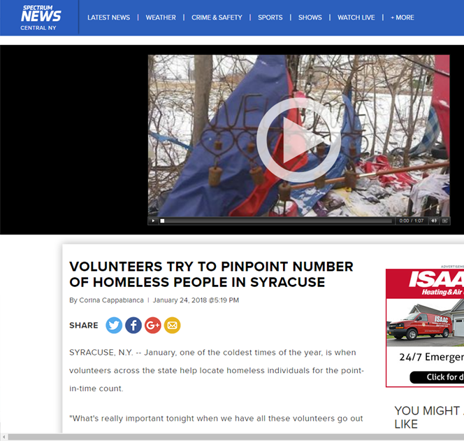
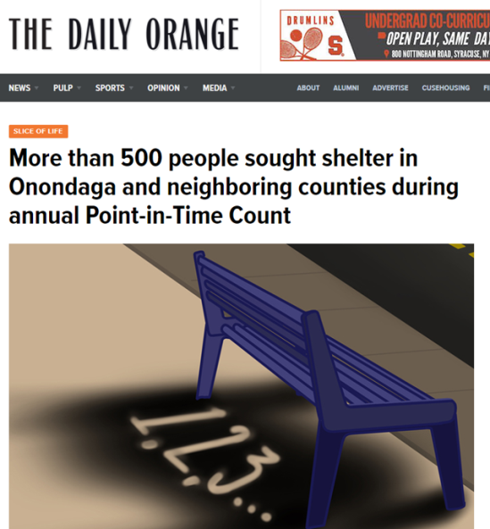
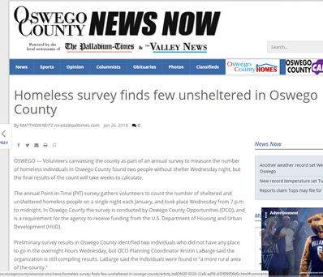

Slide 11
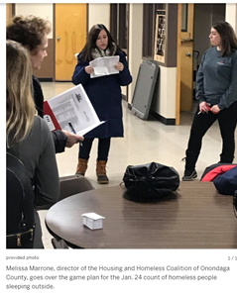
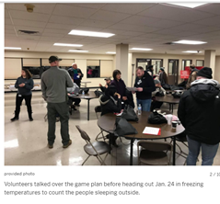
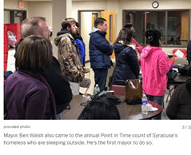
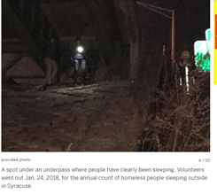
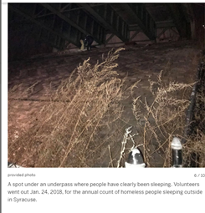
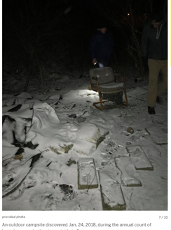
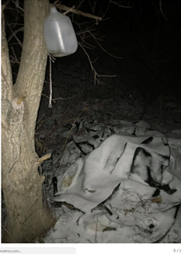
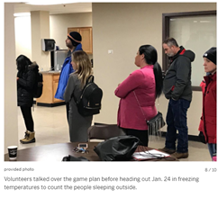
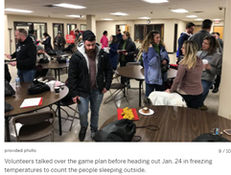
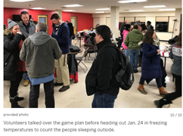

Slide 12
Housing Inventory Count
What is it?
Count of all housing that we have in our community that serves primarily homeless individuals and families
Separated into housing type categories
Emergency Shelter –30 days
Transitional Housing – 30-90 days
Rapid Rehousing – up to 2 years of rental assistance with Case Management
Other Permanent Housing – long term housing with NO disabling condition required
Permanent Supportive Housing – long term with disabling condition is required

Slide 13
Changes in this year…
Transitional Housing numbers were down significantly due to loss of Transitional Housing funding.
Increased our Rapid Rehousing beds from 313 in 2017 to 623 in 2018.
Our Permanent Supportive Housing Beds went down by 428 beds.
The decrease was due to 3 projects no longer serving primarily homeless and Shelter Plus Care losing beds.
We also moved 2 programs to the “Other Permanent Housing” category, YMCA and Auburn Rescue Mission.

Slide 14
QUESTIONS???

