Slide 1
System Performance Measure Reports
2018 Results

Slide 2
Changes in This Years Report
HUD allowed every CoC to submit a revision to the 2016 System Performance Measure Reports (10/1/15 to 10/1/16)
  Reasons for our CoC re-submission
    Cayuga County DSS did back data entry from 10/1/16
    Cayuga County’s data import from CARES was completed
  The re-submission showed a difference in many of the measures we submitted last year.
Measure 1b – Length of Time Homeless using the data element “Approximate Date Homelessness Started” was submitted for the second year and now we had comparable data.

Slide 3
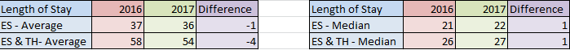
Measure 1 - Length of Time Persons Remain Homeless
Our Average LOT homeless decreased by 1 day for ES and by 4 days for ES and TH
The median increased by 1 day
The Average LOT homeless by the "Approximate Date Homelessness Started" data element decreased significantly; 22 days. This had a lot to do with correction of the data element.

Slide 4
Measure 2 - Extent to which Persons who Exit Homelessness to Permanent Housing Destinations Return to Homelessness
Total returns to homeless remained the same as it did last year, 27% for all project types.
50% of all returns occur within the first 6 months of exiting a program to a permanent housing destination.
For SO 70% of people return in less than 6 months
For project types SO and TH went down, ES went up, and PH stayed the same.

Slide 5
Project level Returns to Homelessness

Slide 6
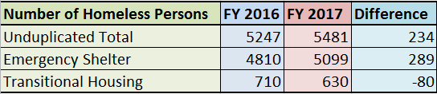
Measure 3 - Number of Homeless Persons
The number of homeless increased by 234 homeless people in HMIS this year, but most of them are from Cayuga County DSS Hotel placements which were all new to the system this year. (347 people)

Slide 7
Measure 4 – Employment and Income Growth for Homeless Persons in CoC Program-funded Projects

Slide 8
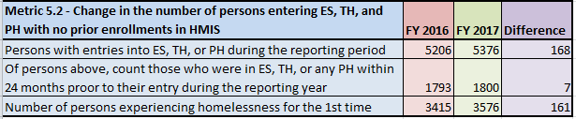
Measure 5 – Number of Persons who Become Homeless for the First Time
The total number of people experiencing homelessness for the first time in our CoC is 3576.
This is an increase from 2016 of 161 people, or 4.5%.

Slide 9
Measure 6 – Homeless Prevention and Housing Placement of Persons defined by Category 3 (at risk of homelessness) of HUD’s Homeless Definition in CoC Program-funded Projects
We do not currently report on this measure

Slide 10
Measure 7 – Successful Placement from Street Outreach and Successful Placement in or Retention of Permanent Housing

Slide 11
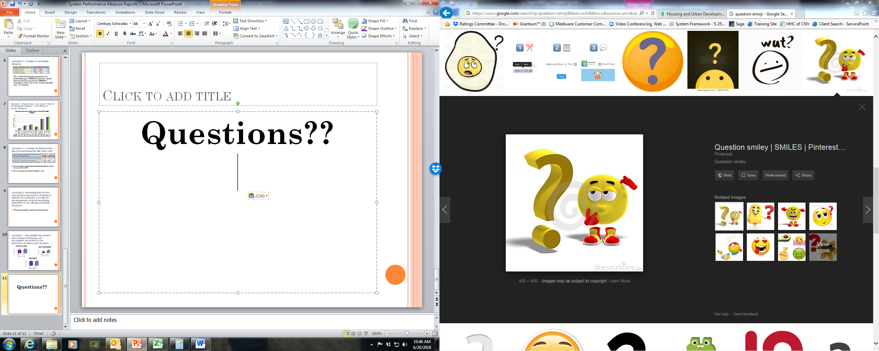
Questions??

