Slide 1

Housing and Homeless Coalition of Central New York
Annual State of Homelessness

Slide 2
Agenda
Presentation
2019: A Year in Homelessness in Central New York
Panel
The HHC Lived Experience Board Members
Presentation
Homelessness: Myths vs. Reality
Presentation
Using Data & Technology to End Homelessness
Presentation
A Look Ahead at 2020
Question & Answer

Slide 3
Who We Are
Coalition of organizations across Onondaga, Oswego, and Cayuga counties
Mission to end homelessness and housing vulnerability in our three county region
Act as HUD’s Continuum of Care (CoC) which brings over 9 million dollars in housing programs to our community
Foster community collaboration
Operate and oversee the homeless management information system and operate the community’s Coordinated Entry System

Slide 4
Housing Programs
Two types of housing programs funded through CoC
rapid rehousing
permanent supportive housing
Over 1100 housing units in the three county region

Slide 5

Our Core Values
Notes:
Every person should have access to safe, affordable housing.
Homelessness can be ended- we do this by being data driven and incorporating the voices of the people who have experienced homelessness.

Slide 6
Housing is a human right

Slide 7
Housing First

Slide 8

Homelessness can be ended

Slide 9
How We Do Our Work

Slide 10

Incorporating the Voices of Lived Experience

Slide 11
Being Data Driven

Slide 12
Working Together to Create Solutions

Slide 13
2019
What have we accomplished?

Slide 14
Preliminary 2019 Numbers
Area | 2018 | 2019 | Percentage
Cayuga County | 603 | 623 | 3% increase
Onondaga County | 3657 | 3362 | 8% decrease
Oswego County | 865 | 789 | 8.7% decrease
Full Continuum of Care | 5094 | 4767 | 6% decrease

Slide 15





Monthly Trainings

Slide 16
Increased HUD funding
Including a new permanent supportive housing project
Increased total award by 7.8% ($744,035)

Slide 17

Street Outreach Study
“We cannot arrest your way out of homelessness. Partnerships are a better approach”.
Deputy Police Chief Richard F. Schoff, Jr., Syracuse Police Department
Decriminalization of Homelessness and Investment in Housing and Services
Mayor Stephanie Miner has expressly rejected the criminalization of homelessness as a strategy for the city to address homelessness and has openly advocated for housing as an alternative. She has worked with others in the city, including the police force, to ensure that the city is pursuing constructive approaches to homelessness, and not punishing people for their visible poverty. Syracuse Mayor Miner even refused to follow a January 2016 order by New York Governor Andrew Cuomo to arrest any homeless people who refused to enter into shelters. Rather than adopt this criminalizing approach, the Mayor has engaged in persistent outreach to people experiencing homelessness and connections to housing using a Housing First model. This has helped Syracuse become one of the nation’s first cities to end veteran homelessness.
Housing Not Handcuffs, National Law Center on Homelessness and Poverty, 2016
“We are a community – able to call anyone with questions, everyone is there to assist, working toward one common goal – ending homelessness.”
Megan Stuart, HHC lead

Slide 18

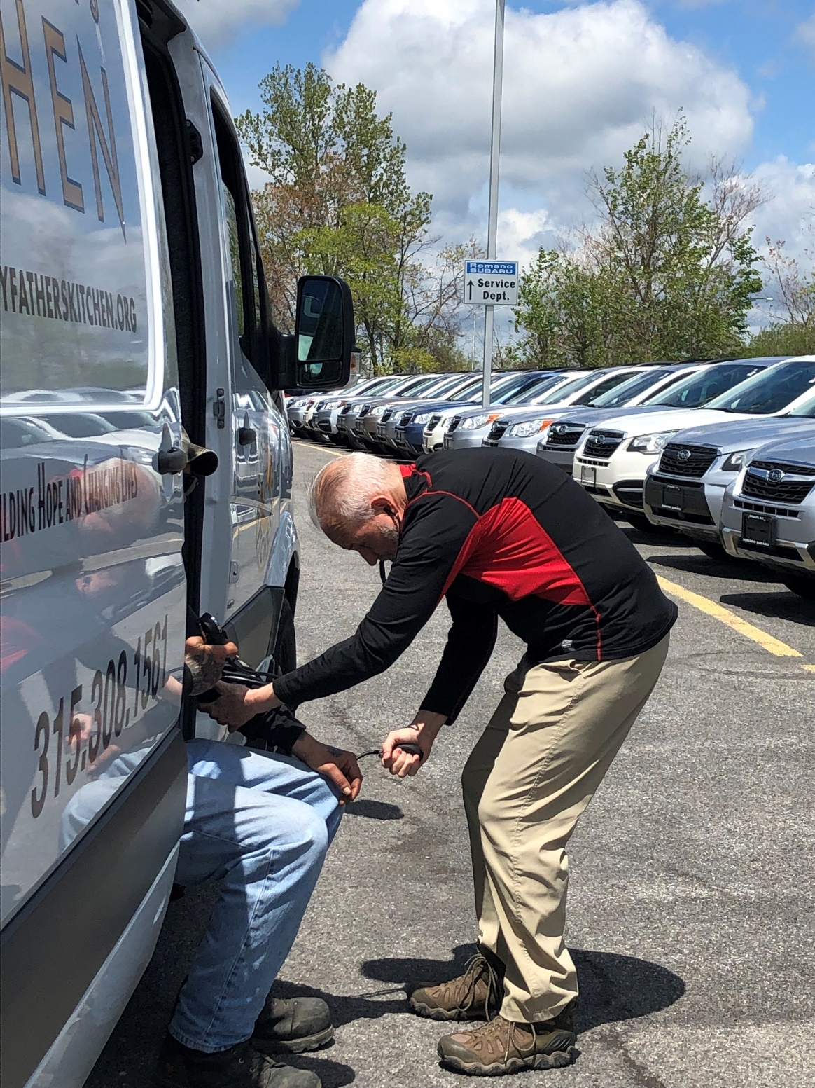

Less Criminalization… More Outreach
Hire Ground- An Alternative to Panhandling
Housecalls for the Homeless Street Medicine
Notes:
Evidence based practice that criminalization does not work… our representatives listened to experts and our community rallied around our population outside

Slide 19
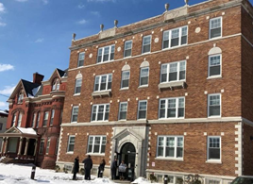
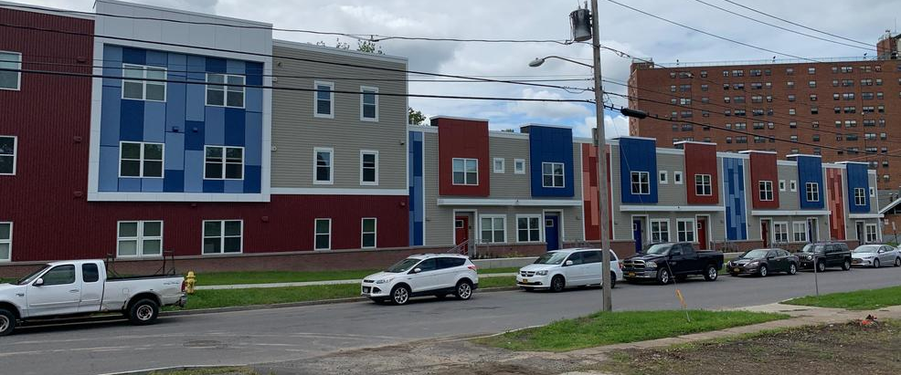
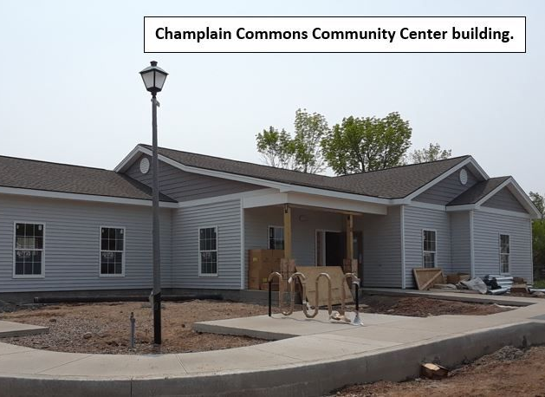
New Affordable Housing

Slide 20
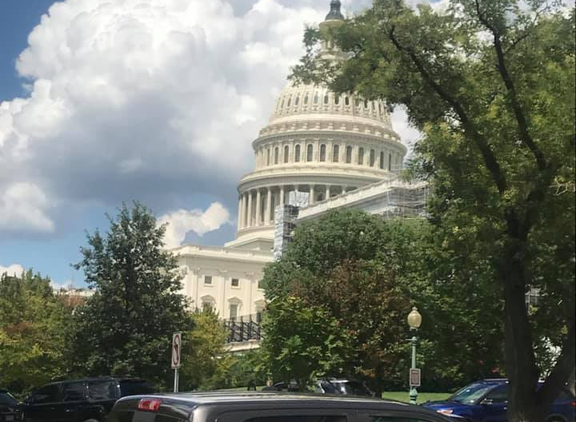
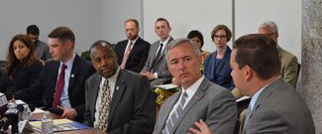

Advocacy

Slide 21
Focus on Chronic Homelessness

Slide 22
Lived Experience Boards

