Slide 1

THE ANNUAL STATE OF HOMELESSNESS
Presented by
Continuum of Care NY-505

Slide 2

Who is the
Housing and Homeless Coalition?

Slide 3
New 10-Year Plan to End Homelessness

Slide 4
HHC Mission and Values
Mission: To assess community needs and to develop a comprehensive community strategy to reduce, prevent, and ultimately end homelessness and housing vulnerability in our community.
Values:
Housing is a Human Right | Housing Justice Promotes Equity
Homelessness Can Be Ended | Lived Experience Matters
Housing First Works

Slide 5
Coordinated
Entry
A Coordinated Entry System (CES) that functions well to provide clients an appropriate housing service within 30 days of entering shelter/street outreach.
OBJECTIVE

Slide 6
Who participates in the coordinated Entry system?
25 participating agencies
4 Street Outreach Teams
21 Emergency Shelter Programs
10 Transitional Housing Programs
25 Rapid Re-Housing Programs
20 Permanent Supportive Housing Programs

Slide 7
How many people are served?
  In 2020, the Coordinated Entry System sent 587 referrals to housing providers for people experiencing homelessness

Slide 8
Strategies to Achieve COORDINATED ENTRY Goal
Support
Each person in shelter or street outreach over 2 weeks is assess and referred to CES
Partner
Have all permanent & transitional housing projects use CES to fill vacancies
Lead
Provide training for all shelter & street outreach providers
Convene
Evaluate prioritization at least annually
Change
Change assessment tool to address racial inequities in the
Create
Create written standards for projects
Vi-SPDAT

Slide 9
End Homelessness for Specific
Populations
End homelessness for specific populations: Chronic, Youth, Families, and Veterans in the entire CoC, as defined by USICH benchmarks
OBJECTIVE

Slide 13
Strategies to house specific populations
Lead
Lead by creating community plans for each subpopulation for each county
Apply
Apply for the Youth Homelessness Demonstration Project grant to increase supportive housing for people experiencing chronic homelessness
Build
Build RRH capacity in rural communities
Create
Create new housing options for our most vulnerable people with a variety of needs

Slide 14
Increase
Housing stock
Increase the amount of safe, affordable housing stock
OBJECTIVE

Slide 15
Increase amount of safe, affordable housing stock
20,220 households or 50% of all low-income renters in the CoC are paying more than half of their income in rent
30,885 households or 75% of low-income renters have severe housing problems

Slide 16
Creating More Affordable Housing
In 2016 , NYS committed to creating 20,000 units of supportive housing over next 15 years STATEWIDE – the Empire State Supportive Housing Initiative (ESSHI)
ESSHI was the first multi-year commitment to creating supportive housing outside NYC
2016-2020: State funded first 5 years/6,000 units
ESSHI has been extended- allowing the opportunity for more units to be developed in NYS

Slide 17

Emergency housing vouchers
(EHV)
23 vouchers secured
4 leases in place

Slide 18
Strategies to increase housing stock
Partner
Create community plan for affordable housing development
Lead
Develop relationships with and education for landlords about CoC & Homeless Permanent Housing programs
Support
Increase housing capacity in rural and suburban areas of the CoC

Slide 19
Racial Equity
Eliminate racial disparity in homelessness and housing systems
OBJECTIVE

Slide 20
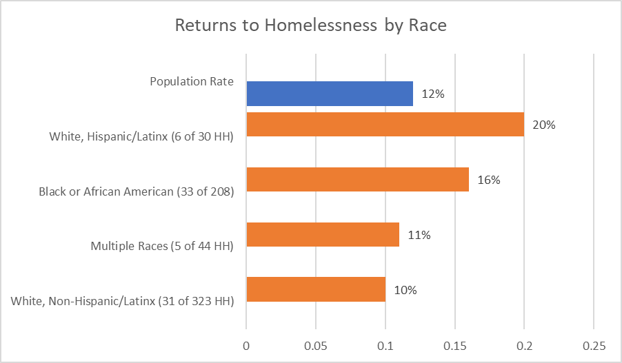
Eliminate Racial Disparity
Source: HUD Longitudinal Systems Analysis FY2020, NY-505 CoC. Accessed through HUD HDX 2.0 Stella P Dashboard

Slide 22
Strategies to Eliminate housing system racial inequities
Elevate and Support
Elevate and support the voices of people with lived experience
Design
Design a community-wide anti-racism policy
Create
Create annual racial equity dashboards and metrics
Build
Build anti-racist organizations
Establish
Establish consistent expectations across all funding streams
Institute
Institute consistent and equitable services across entire homeless response system

Slide 23
Effectively end homelessness
Effectively end homelessness for all populations:
Making homelessness
One time, rare and brief
OBJECTIVE

Slide 24
Strategies to effectively end homelessness
Conduct
Conduct gaps & needs assessments every three years
Reduce
Reduce inflow into homelessness using prevention & diversion
Facilitate
Facilitate better discharge planning to limit discharges to homelessness from institutions
Create
Create a comprehensive media strategy for HHC to educate public
Drive
Drive advocacy on behalf of people experiencing homelessness

Slide 25
Housing and Homeless Coalition Metrics
HOMELESSNESS IS DECREASED BY AT LEAST 5% EVERY YEAR
THE AVERAGE LENGTH OF TIME HOMELESS IS NO LONGER THAN 30 DAYS
THE COC HAS MET THE BENCHMARKS FOR ENDING HOMELESSNESS IN SPECIFIC POPULATIONS, AS WRITTEN BY USICH
THERE IS NO RACIAL DISPARITY IN ENTRY OR EXIT POINTS IN THE HOMELESSNESS SYSTEM
ADD NEW AFFORDABLE HOUISNG UNITS IN CENTAL NEW YORK
PEOPLE EXIT HOMELESSNESS INTO PERMANENT HOUSING MORE THAN 75% OF THE TIME
NO MORE THAN 5% OF PEOPLE RETURN TO HOMELESSNESS WITHIN TWO YEARS

Slide 26
A Look to 2022

Slide 27







THANK You to all our partners

Slide 28

Q&A

Slide 29
Thank you for attending the HHC’s
Annual state of Homelessness

