Slide 1


Annual State of Homelessness 2022:
Housing & Homeless Coalition of CNY’s
What Can Central New York Do to End Homelessness?

Slide 2
Agenda
Homelessness in 2022
Panel: What Can CNY Do to End Homelessness
Q&A

Slide 3
HHC Values
Housing is a human right
Homelessness can be ended
Housing First works
Housing Justice promotes equity
Lived experience matters

Slide 4

Coordinated Entry
25 participating agencies
4 street outreach teams
21 emergency shelter programs
10 transitional housing programs
25 rapid rehousing programs
20 permanent supportive housing programs
1,220 total referrals

Slide 5
Homeless Management Information System
39 Agencies
176 active projects
340 Users
85,000 Client Records

Slide 6
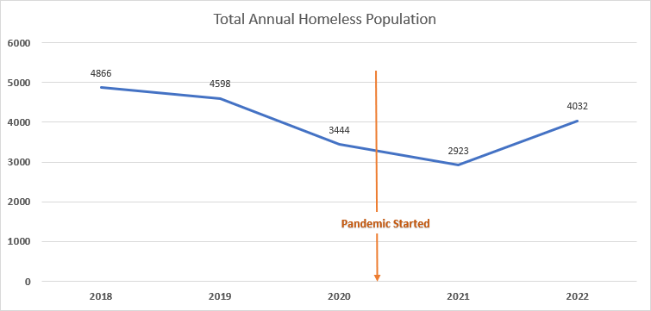

Slide 7
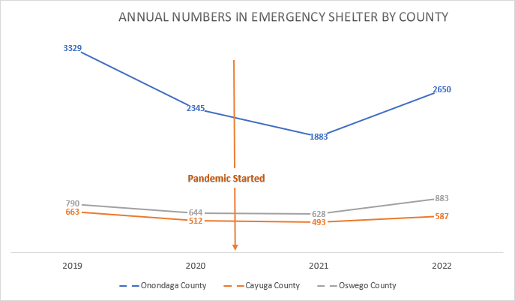

Slide 8
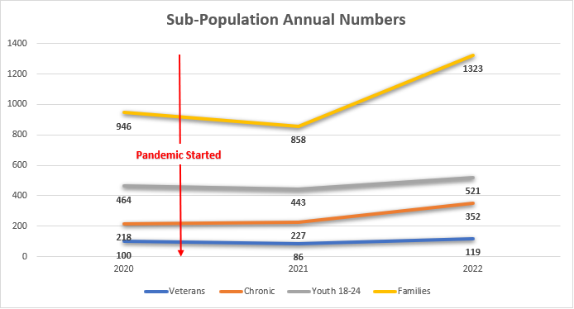

Slide 9
HHC Metrics
Goal | 2022 | % Change from 2021
Homelessness is decreased by at least 5% every year | Increase of approximately 1125 people | 28% increase
The average length of time homeless is no longer than 30 days | 50 Days | 12% increase
People exit homelessness into or retain permanent housing more than 75% of the time | Street Outreach- 41% | 6% increase
 | Emergency Shelter, Transitional Housing, and RRH- 35% | 11% decrease
 | Permanent Supportive Housing- 98% | 1% increase
No more than 5% of people return to homelessness within two years | Street Outreach- 38% | No change
 | Emergency Shelter- 31% | 2% increase
 | Transitional Housing- 17% | 10% decrease
 | Permanent Housing- 23% | No change
 | Total Population- 28% | No change

Slide 10

Please welcome our panel to the stage.

