Slide 1
Coordinated Entry Training
Housing and homeless coalition of central new York
Cassie Montressor - Coordinated Entry Specialist
Sherrain Clark - Deputy Director

Slide 2
Agenda
Introductions
Key Terms
Progressive Engagement and Housing First
Overview of Coordinated Entry System
Assessment
  CNY-VI
  Assessing Chronic Homelessness
  Client Preference
Project Types
------- BREAK -------
Prioritization
The CE List
Entering Assessments in HMIS
Recording Contacts in HMIS

Slide 3
Key Terms

Slide 4




What is Coordinated Entry?
Coordinated Entry describes how our community:
    Assesses
    Prioritizes
    and Refers
    People experiencing homelessness to HUD CoC Housing assistance resources.

Slide 5

Literally homeless
Definition provided by HUD
  Individual or family who lacks a fixed, regular, and adequate nighttime residence
  CoC projects (PSH, TH, RRH, and ESG RRH) are for these households
  Does not include “couch-surfing”
  Source:
  https://www.hudexchange.info/resources/documents/HomelessDefinition_RecordkeepingRequirementsandCriteria.pdf
Notes:
Source:
https://www.hudexchange.info/resources/documents/HomelessDefinition_RecordkeepingRequirementsandCriteria.pdf

Slide 6
Types of literal homelessness
Has a primary nighttime residence that is a public or private place not meant for human habitation;
Is living in a publicly or privately operated shelter designated to provide temporary living arrangements (including congregate shelters, transitional housing, and hotels and motels paid for by charitable organizations or by federal, state, and local government programs); or
Is exiting an institution where (s)he has resided for 90 days or less and who resided in an emergency shelter or place not meant for human habitation immediately before entering that institution
Is fleeing or attempting to flee domestic violence, has no other residence, and lacks the resources to obtain other permanent housing

Slide 7
Progressive engagement and housing first

Slide 8


Philosophies of Coordinated Entry
Progressive Engagement
  Provide only as much assistance as necessary to re-house a person
  Once housed, provide additional services that support household’s goal of remaining housed

Slide 9
Progressive Engagement and the
Black hole of homelessness
People with less time homeless may need less assistance to become stably housed

Slide 10

Black hole of homelessness
People remain homeless longer -> lose social ties/connections
Lost social ties -> more difficult to get out of homelessness
Assistance can
“catapult” people
out of homelessness

Slide 11
Housing First
The solution to homelessness is safe and affordable permanent housing for everyone
Watch YouTube video on the next slide which will explain the 5 Principles of the Housing First Model

Slide 12

Notes:
https://www.youtube.com/watch?v=pwdq2VWavtc&t=37s

Slide 13

Why Housing First?
Evidence shows that there are no reliable predictors of success in Housing First programs.
Housing First respects client choices and autonomy.

Slide 14
Overview of coordinated entry system

Slide 15
Coordinated Entry System for CoC housing programs
REFERRAL SOURCE
Domestic Violence Shelter
Emergency Shelter
Street Outreach
HOUSING PROJECTS
Rapid Re-housing
Permanent Supportive Housing
HUD RAP
ESG Supplemental
HHC STAFF
Prioritized
Coordinated Entry List
assessments
matching

Slide 16
Roles of each part of the system
SHELTER AND STREET OUTREACH
  Assess clients
  Refer to coordinated entry
    Explain different program types to clients
    Refer to programs that the client is eligible for and that they are interested in.
  Manage referrals
    Update information as it changes
    Remove clients who have self-resolved or otherwise are no longer interested in services

Slide 17

When to make a referral
(Shelters and Street Outreach)
Client’s first time being homeless, and they have not been able to find housing within the first 2-4 weeks
If they are chronically homeless
If they have a disability that is limiting them in obtaining or maintaining housing (many times homeless)

Slide 18
Roles of each part of the system
Housing and Homeless Coalition Staff
  Check the quality of referrals
  Match households to housing provider openings
  Organize referrals in order of priority and distribute the list to the coordinated entry group
  Check that all entries to CoC-funded housing providers are coming from coordinated entry
  Organize Coordinated Entry Workgroup
  Coordinated Entry Training

Slide 19
Roles of each part of the system
Housing Service Providers
  Communicate openings to CE in a timely manner
  Contact clients that have been matched to the program in order of priority
  Give clients 2 weeks to attempt to make contact
  Record contact attempts in HMIS
  Close out CE program entries when clients have moved into housing units

Slide 20
How matching works:
Step 1
Step 1: Housing providers contact CE staff when they have program openings via E-mail

Slide 21
How matching works
Step 2:
Step 2: HHC Staff match the next person on the appropriate list that
  Has had recent contact with emergency shelter or street outreach staff
  Has not recently been matched or exited from that program
  Fits the program’s targeting criteria

Slide 22
How matching works
STEP 3:
Step 3: Matches are communicated through the weekly CE email list.
  “Matched housing provider” column on lists
  “RRH Matches” or “PSH Matches” tab on list
  Matches may not always appear in order

Slide 23
How matching works
STEP 4:
Step 4: Providers contact clients directly or shelter case managers to set up appointments
  Matches are taken off the list when clients are opened in an RRH, TH, or PSH program

Slide 24
How matching works
STEP 5:
Step 5: Matches are removed when:
  Providers no longer have openings
  Clients have completed intake
  Clients have been contacted and choose not to participate in services
  Providers deny clients

Slide 25
Have questions or concerns with your matches?
Issues/Grievances/Inappropriate Matches
  Contact CE staff
    Cassandra Montressor, or Sherrain Clark
  Document reasons match is inappropriate in HMIS

Slide 26
Assessment

Slide 27
What is the purpose of CE assessment?
Triage to determine household vulnerability and identify areas where supports are needed
1
Target clients to achieve community goals (e.g. ending youth, family, and chronic homelessness)
2
Aid in prioritizing program referral
3

Slide 28
What the vulnerability index doesn’t do:
The tool DOESN’T make decisions about housing project referrals
It DOESN’T provide a diagnosis
It DOESN’T take the place of professional clinical assessment

Slide 29
The assessment score is Not a prediction of Success
“Everyone’s very focused on - ‘let’s predict who can’t make it’, but in fact, we can’t predict who can make it. We really don’t know.
So, we have to give every single person a chance to demonstrate what they can do in that new environment.”
- Dr. Sam Tsemberis, creator of the first Housing First program in the US

Slide 30
3 components of assessment
The CNY-VI
Verifying History of Homelessness
Client Preferences

Slide 31
CNY-VI
Central New York-Vulnerability Index
Standardized Interview
  Based on client self-report
Numerical rating of vulnerability
  Score is out of 25

Slide 32
CNY-VI Musts
Conduct the interview in a private room or confidential setting
Store data securely.
  Paper copies should be locked in a cabinet. Files should only be saved in password-protected accounts or folders.
Maintain confidentiality
  Information about CNY-VI scores or what was learned through to course of the interview should only be shared while coordinating or providing services to the client.

Slide 33
Rules of thumb for administering the CNY-VI
Allow clients to stop or not answer when they choose
The CNY-VI does not provide a suggestion for a housing project. Do not make housing referral decisions based on this score.
Be attentive to power dynamics – Workers who administer beds, food, etc. should not also conduct the CNY-VI if possible.

Slide 34
CNY-VI Review

Slide 35
Safety
If a client’s safety is in danger, talk to them about how or if they would like to proceed.
Ask about what supports they would need in order to feel safer, and what strategies they could use to keep themselves safe.
Attempt to do a “warm handoff” to services like DV shelter, EMS, or other services.

Slide 36
What DOES the tool do:
Helps prioritize who gets served in housing services next
Prompt conversations around barriers to housing

Slide 37
When to enter a new CNY-VI
Enter a new CNY-VI if significant changes have occurred that would affect the client’s vulnerability.
  Examples: substantially increased history of homelessness, new medical issues, loss of income, etc.
If it appears that the client did not fully disclose all of the accurate information on the original survey.

Slide 38
Assessing chronic homelessness

Slide 39
Chronic Homelessness
An individual who has a disabling condition
AND
Has been continuously homeless for a year or more
OR
Has had 4 or more episodes of homelessness in the last 3 years, adding up to 12 months.
Source: https://www.hudexchange.info/resources/documents/DefiningChronicHomeless.pdf

Slide 40
Documenting time homeless
Episodes of homelessness must be separated by 7 days or more in a “non-homeless” housing situation (transitional housing, RRH, PSH, or living/ staying with friends or family).
Documentation required for Chronic-dedicated Permanent Supportive Housing projects
A small percentage of time can be self-reported.

Slide 41
Assessing Chronic Homelessness
Step 1: Do your homework.
  Find all the client’s shelter stays and count the number of months and episodes of homelessness in the last three years before meeting with the client, if possible.
Step 2: Meet with your client and ask where they were during their gaps in shelter stays.
Step 3: Document this information using the standardized PSH packet forms.
Step 4: Collect disability documentation, self-certification, and third-party verification forms if necessary.

Slide 42
PSH Assessment Packet
Disability Documentation
HHC Disability Verification form
SSA Award Letter
Other documentation signed by a health professional qualified to diagnose that disability in NYS
Length of Time Documentation
HMIS Entry/Exit Page
Third-Party Verification
Self-Certification

Slide 43
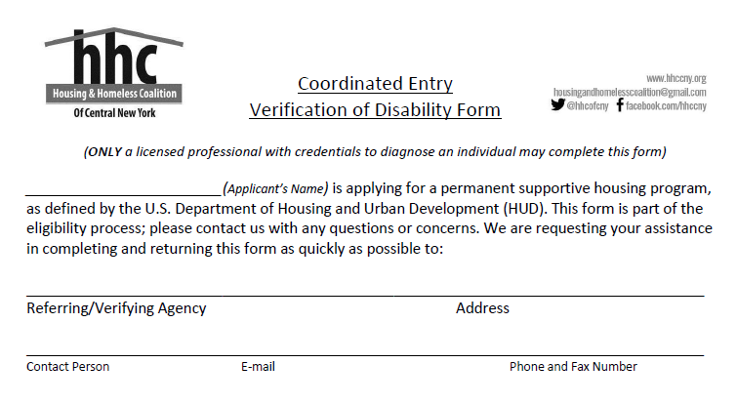
Your information goes here

Slide 44
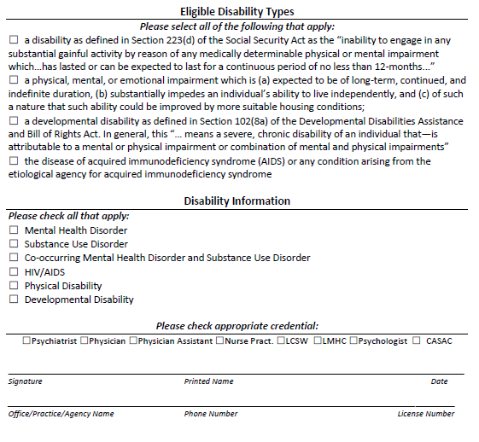
Ensure at least one is checked
Ensure at least one is checked
Health Care Provider Information Here

Slide 45
Third-Party Verification Of Homelessness
“Third party” means not the client or the PSH project.
  Should describe instances where the person was seen in a literally homeless situation at least once in each month verified.

Slide 46
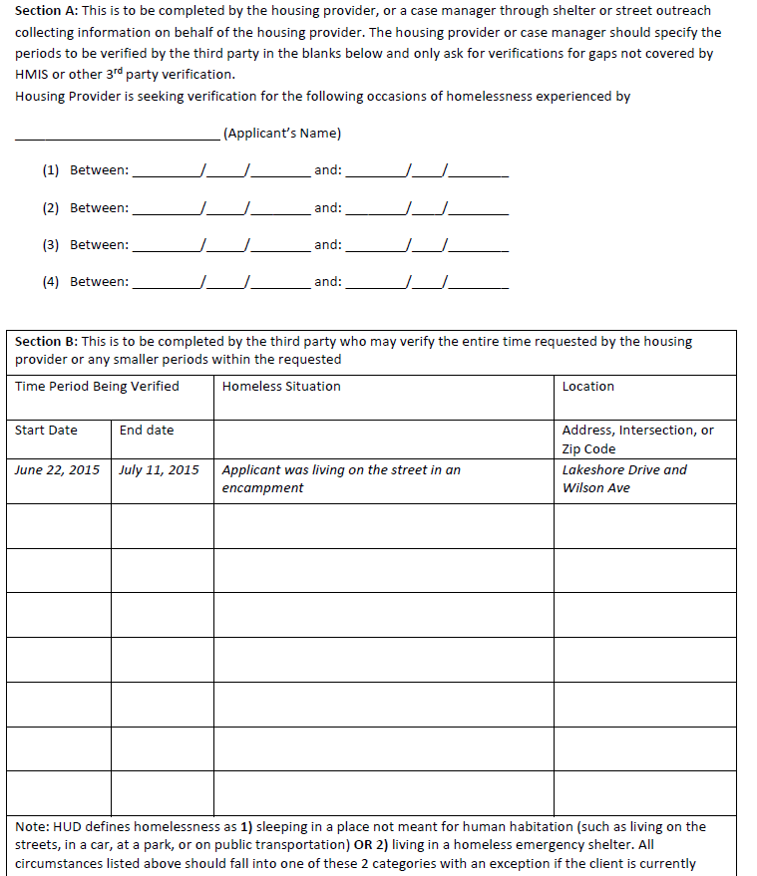
Time Periods Requested by case manager
Living situations verified by Third Party

Slide 47
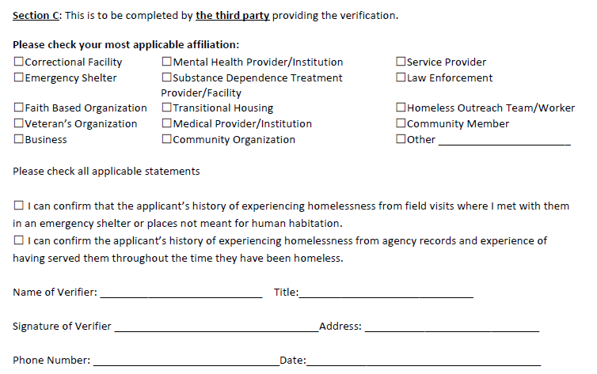
Should be filled out completely

Slide 48
Self-Certification / Breaks
Self-certification: When no third party can be reached to verify the client’s living situation, the client can self-certify up to 3 months of their 12 months of homelessness.
Breaks in homelessness: If a person is chronically homeless because they experienced homelessness 4+ times in the last three years, they must attest that they were housed at least 3 times in the last three years.

Slide 49
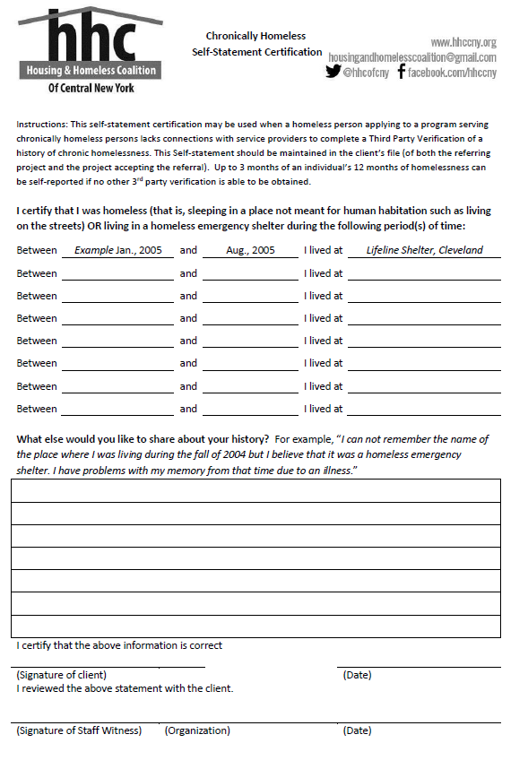
Self-statement certification

Slide 50
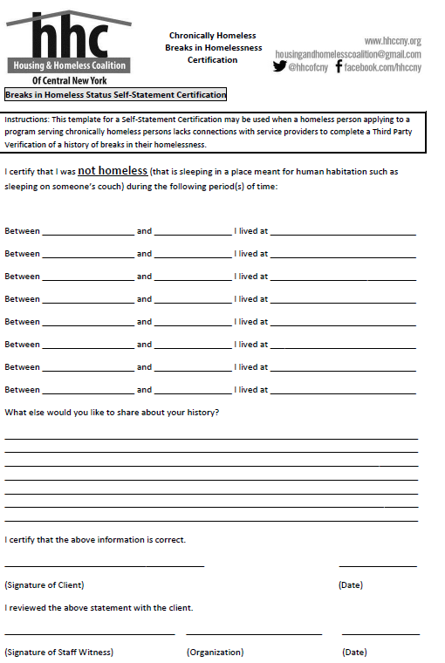
Breaks in homelessness certification

Slide 51
Client preference

Slide 52
When referring to a housing project
Think of the following:
  Which project type is the client interested in?
    ESG RRH, CoC RRH, TH, or Permanent Supportive Housing
  Is the client eligible for the project?
    Do they meet criteria, for example having a disability for PSH
  Project selection is how households are categorized on the CE List, so please double-check your selections
  Clients can choose multiple project types.

Slide 53
Which housing assistance programs accept referrals through coordinated entry?
Rapid Re-Housing
ESG/STEHP
CoC
Transitional Housing
Permanent Supportive Housing

Slide 54
Types of Projects
ESG/STEHP RRH
  Temporary rental assistance
  Minimal Case Management; 6 months maximum
  Targeted to clients that need the least amount of assistance to be independent

Slide 55
Projects in each county
ESG/STEHP/CDBG Rapid Re-housing
Cayuga
CAP ESG-CV RRH
Chapel House CDBG-CV RRH
Onondaga
Catholic Charities Men’s Shelter ESG-CV RRH
Catholic Charities STEHP RRH
Rescue Mission ESG-CV RRH
Salvation Army Youth ESG RRH
Salvation Army City ESG-CV RRH
Salvation Army ESG RRH
Oswego
Oswego DSS ESG-CV RRH
Oswego County Opportunities STEHP RRH

Slide 56
Types of Projects
Rapid Rehousing
  6-24 months in duration
  Rental assistance
  Case management to stabilize client and increase income
  Client starts in project in shelter, then moves to own apartment
  Lease is in client’s name

Slide 57
Projects in each county
CoC Rapid Rehousing
Cayuga
CAP Rapid Rehousing
Catholic Charities SSVF (Veterans)
Soldier On SSVF (Veterans)
Onondaga
ACR LGBT RRH (LGBT Youth)
Catholic Charities Rapid Rehousing
Helio Health Rapid Rehousing
Salvation Army Barnabas Rapid Rehousing (Youth)
Salvation Army Housing Assistance and Life Skills Education
Vera House Rapid Rehousing (DV Survivors)
Catholic Charities SSVF (Veterans)
Oswego
Oswego County Opportunities Rapid Rehousing
Oswego County Opportunities DV Rapid Rehousing (DV Survivors)
Soldier On SSVF (Veterans)

Slide 58
Transitional Housing
Transitional Housing
  Stay is expected to be approximately 90 days
  Congregate living environment, with case management
  6 month follow up case management

Slide 59
CoC Transitional Housing (through CE)
Onondaga
Chadwick Transitional Housing (Single Women and Families)
YWCA Transitional Housing (Single Women and Families)
YMCA Transitional/RRH (Single Men)
Last House on the Block Ministries
Projects in each county

Slide 60
Types of Projects
Permanent Supportive Housing
  Indefinite duration
  Rental Assistance
  Case management to stabilize client and increase income.
  Most intensive intervention
  Provider holds lease, acts as intermediary with landlord

Slide 61
Types of Projects – PSH HUD RAP
Rental Assistance Program (HUD-RAP)
  Indefinite duration
  Rental Assistance – client responsible for 30% of their income
  Case management to stabilize clients and increase income
  Tenant holds lease after completing housing search

Slide 62
Projects in each county
Permanent Supportive Housing
Cayuga
Chapel House Permanent Supportive Housing
Onondaga
Catholic Charities HUD RAP
Catholic Charities Permanent Supportive Housing
Chadwick Residence Permanent Supportive Housing (Families)
Helio Health (3 projects for Individuals and Families)
Helio Health Susan’s Place (Single Women and Families)
Liberty Resources PSH
Salvation Army State Street Apartments (Youth with SPMI diagnosis)

Slide 63
“Set up for failure”
What percentage of people who enroll in Rapid Rehousing exit to permanent housing destinations in our CoC?
86%
What percentage return to homelessness within 6 months after a successful exit?
17% in 6 months
28% in 2 years
Notes:
FY2020 system performance measures

Slide 64
break

Slide 65
COVID-19 Changes to Prioritization
In April 2020, the CE committee decided to prioritize the following in response to the Covid-19 pandemic:
  Adults over the age of 65
  People with conditions the CDC declared were at high risk for Covid-19
    These conditions are: Chronic Kidney Disease, COPD, Immunocompromised, Obesity, Serious Heart Conditions, Sickle Cell Disease, and Type 2 Diabetes

Slide 66
COVID-19 Changes to Prioritization
In April 2022, the CE committee decided to make the following changes to prioritization:
  The priority for households that had identified housing has been removed to ensure that the CoC continues to prioritize the most vulnerable.
  Prioritization is by months homeless calculated by HMIS.

Slide 67
Prioritization
Priority groups vs Tiebreakers
  Priority Groups – people in higher priority groups must be served before people in lower priority groups
  Tie Breakers – determines who gets served first within each priority group.

Slide 68

Tie breakers
Older than 65
Susceptible to COVID-19
Longest history of homelessness in past 3 years
In an unsheltered location during Code Blue
CNY-VI Score
Veteran Status

Slide 69
PSH & HUD RAP Prioritization
Chronically homeless individuals and families
Non-chronic Homeless individuals and families with a disability
CNY-VI Score

Slide 70
RRH, TH, ESG Prioritization
  Older than 65
  Susceptible to COVID-19
  Longest length of current episode of homelessness
  An individual or family who is living in an unsheltered location during Code Blue
  CNY-VI Score

Slide 71

Eligibility for certain projects
Some projects target specific populations (youth, veterans, women, etc.)
Matches are made with consideration of project’s targeted groups.

Slide 72

Acceptance/Rejection policies
If a referral matches eligibility requirements, housing providers can only reject it if:
  Legal issues exist between the client and project
  Safety concerns exist with program staff

Slide 73


If a client refuses entry into a project
Other projects offer similar services as openings become available
Case Conferencing as needed
Bi-weekly engagement from shelter workers, documented in HMIS

Slide 74

Special note about DV clients
Privacy concerns
Still have full access to Coordinated Entry System
Their referrals do not go through HMIS

Slide 75





De-Identified Referral
With minimum necessary Info
DV Shelters
Coordinated Entry List
Communication based on DV Shelter’s ID number
Housing Service Providers

Slide 76

DV Clients
Once clients of VSPs are entered in CoC-funded projects, they must be entered into HMIS
Clients still have the choice not to release their information to other HMIS providers.

Slide 77

Cross-County Referrals
Clients are allowed to move across geographic areas
Providers are only required to accept clients outside of geographic area if there are no eligible assessed clients in their area.
May create significant logistical difficulties
Mark this on their assessment form

Slide 78
The List
15 tabs:
  PSH: Chronic, Individuals, Families, and HUD RAP
  RRH: Combined, Individuals, and Families
  ESG: Individuals and Families
  TH: Combined
  SSVF and VASH
  All open PSH Matches, All open RRH Matches

Slide 79
The list – Continued
Lists for each program type are made according to prioritization criteria from most recent information in HMIS
Includes information from assessments, most recent shelter/street outreach record, most recent case manager

Slide 80
Error Lists
Clients with assessments/records that should be fixed
  Missing CE Information
  Duplicate Entries
  Clients open in PSH
  Clients who have not been in shelter for 90 days

Slide 81

Final thoughts about CE
Coordinated Entry alone will not solve homelessness
BUT
It helps us to coordinate and communicate in a more intentional and formalized way to work towards our common goal

Slide 82

Practice in Servicepoint
Add a new client to the training site using a fake name, D.O.B., and SSN
Additional program info is not necessary

Slide 83
Entering clients into CE
** Providers in Oswego or Cayuga county should use their county-specific provider. I will refer to all 3 providers as “Coordinated Entry NY-505” **
Shelter and street outreach workers are required to:
Create new “Coordinated Entry” Entry/Exit records for clients who are assessed and being considered for housing services.
Update information once a month for clients who are continuously engaged with seeking services.
Close old “Coordinated Entry” Entry/Exit records for clients who have not been engaged with services for over 90 days.

Slide 84
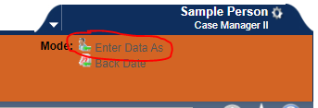
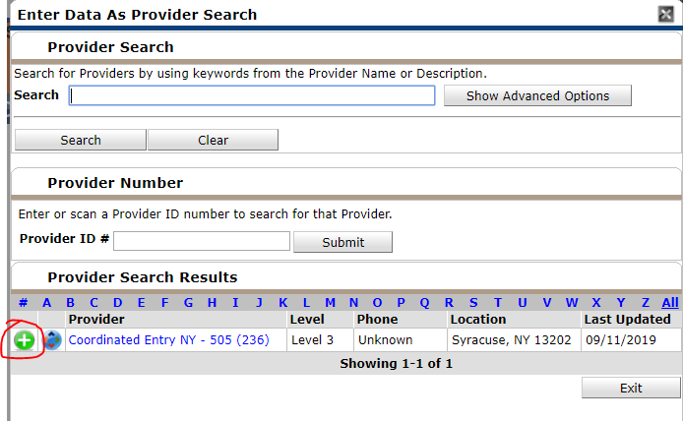
Switch Enter Data As to “Coordinated Entry NY-505”

Slide 85
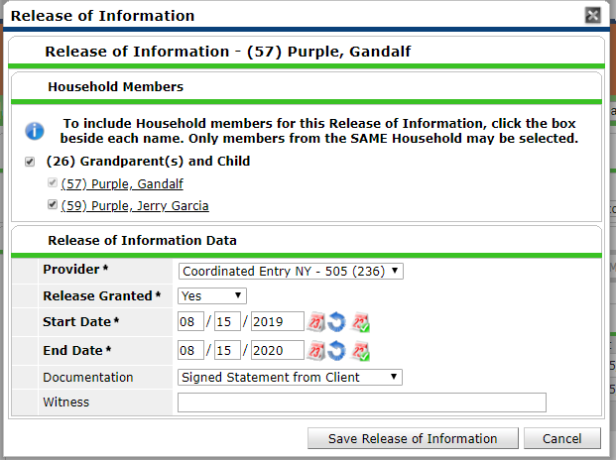
Entering clients into CE
Navigate to client’s profile in Clientpoint
Add a release of Information for the “Coordinated Entry NY-505” Provider
  make sure the date of ROI is the same day or prior to the CE Entry date

Slide 86
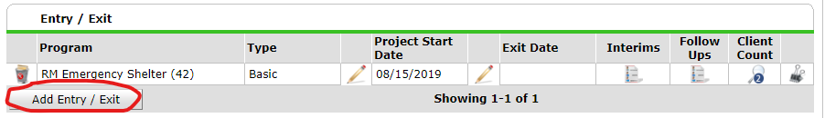
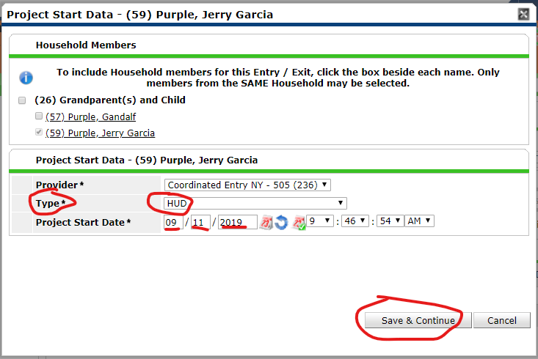
Entering clients into CE
Navigate to the Entry/Exit Tab, and add a new entry/exit for the “Coordinated Entry NY-505” provider on the date the client was assessed. Select “HUD” as the Entry Type. Remember to add the entry for all household members if a household is being assessed.

Slide 87
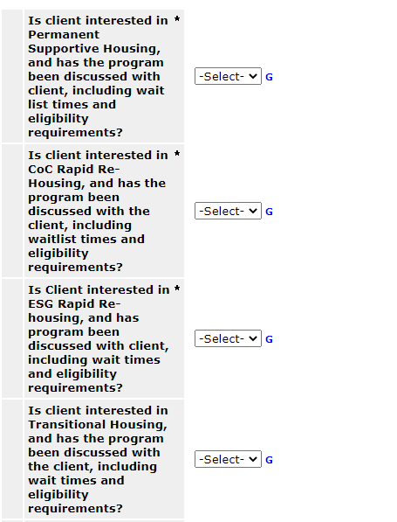
CE Assessment
Complete the Coordinated Entry Information Assessment
  Complete the questions referring to clients interest in PSH, CoC RRH, ESG RRH, and TH after discussing the program types with the client and cooperatively determining which would best suit the client’s needs.

Slide 88
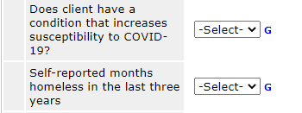
CE Assessment
HMIS now calculates months homeless based on Entry/Exits, Service Transitions for Street Outreach programs, and client self-reported months homeless.

Slide 89
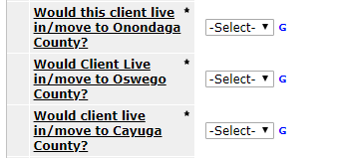
CE Assessment cont.
Complete the county preference questions. Only select a different county than their current location if you have discussed the implications of moving with the client

Slide 90
CE Assessment Cont.
Complete the Family composition question.
Enter the number of bedrooms needed in the unit, or the age and gender of each member of the household
  e.g., 33 F, 2 M, 0 F

Slide 91
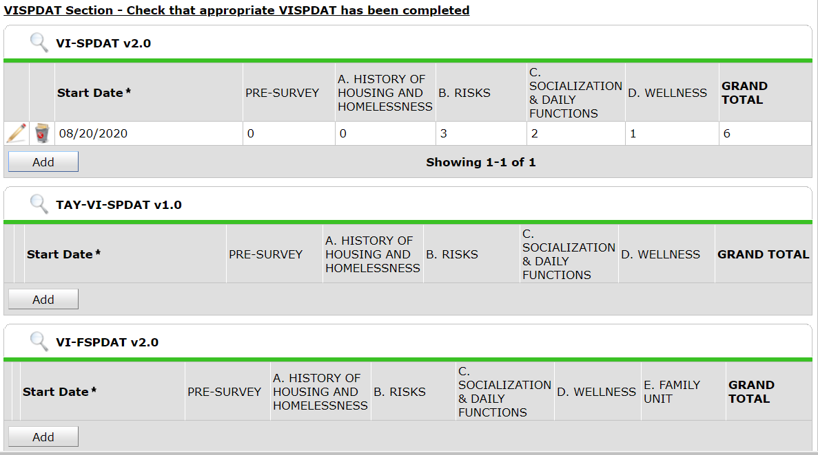
CE Assessment Cont.
Check that the client has the appropriate VI-SPDAT completed and that the score is up to date.

Slide 92
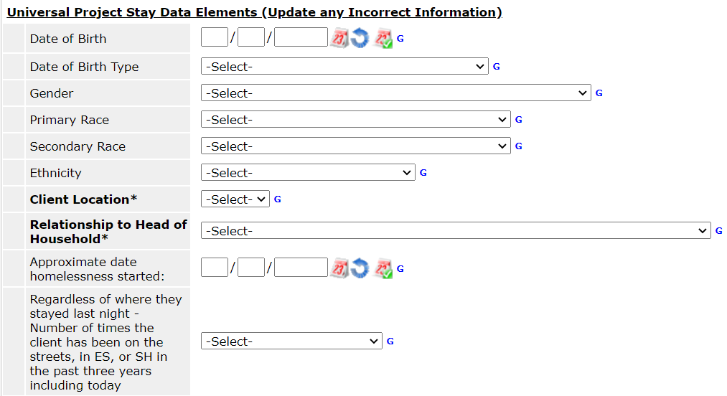
CE Assessment Cont.
Confirm that the information being pulled from the most recent intake assessments is as accurate as possible.
If information is not accurate, change it here.

Slide 93
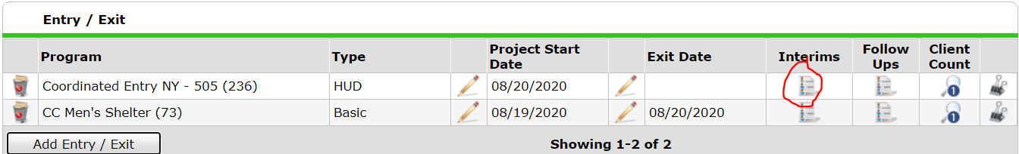
Updating CE Assessments
Add an interim assessment whenever client information needs to be updated

Slide 94
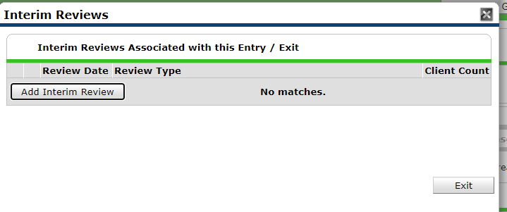
Updating CE Assessment Cont.

Slide 95
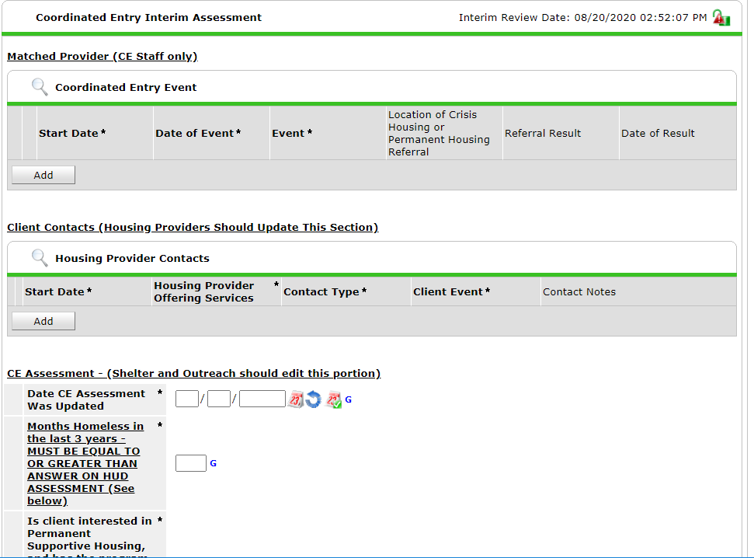
Edit this section and below
not the sections on top.

Slide 96
Updating CE Assessments
When does information need to be updated?
  PSH Referrals: once a month, to keep months accurate.
  If a new CNY-VI has been performed
  If the client’s geographic or program preferences have changed

Slide 97
For PSH/ RRH Providers
Add an interim review
Record contacts with clients

Slide 98
For PSH/ RRH Providers
Your project will be listed here. Do not edit this section

Slide 99
For PSH/ RRH Providers
Record Client Contacts Here

Slide 100
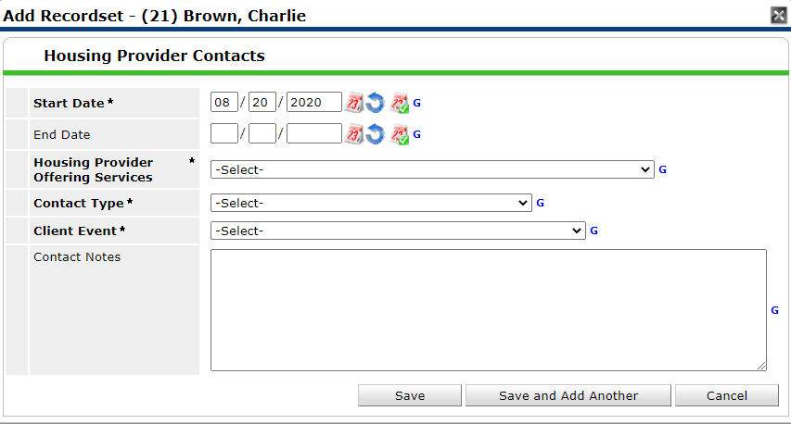
Adding a CE Note

Slide 101
Closing clients
When a client has moved into housing or has not been in contact for >90 days, remove them from the CE project.
Exit the client or household from Coordinated Entry with their appropriate destination

Slide 102
Destinations
PSH : “Permanent Housing for Formerly Homeless Persons, other than RRH”
RRH: “Rental By Client, with RRH or equivalent Subsidy”

Slide 103
Thanks!
Please give us your feedback:
surveymonkey.com/r/HHCCNY_CE_Training
Or link on the HHC website’s Coordinated Entry page

